Slide 1
Archiving, Analysis and Modeling
of Wendelstein 7-X Experiment Data
Andreas Werner for the W7-X CoDaC Team
Max-Planck-Institut für Plasmaphysik, Germany

Slide 2
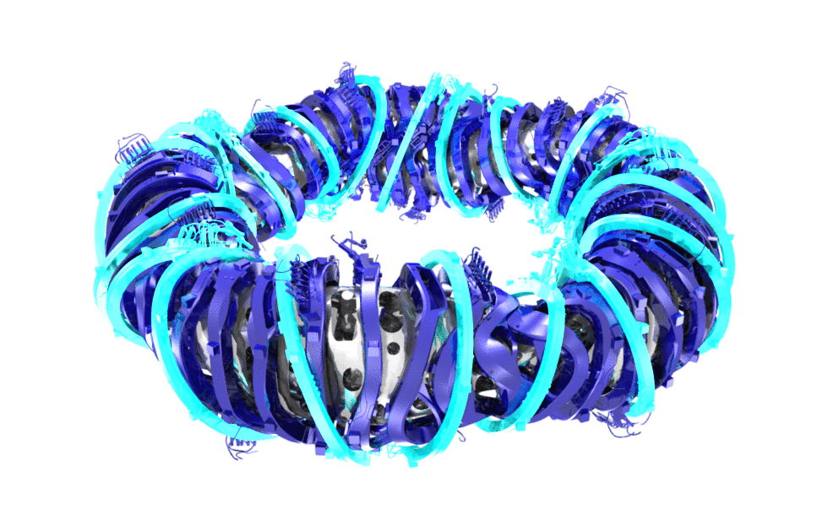
Introduction Wendelstein 7-X
Stellarator principle: Magnetic confinement of Deuterium – Tritium plasma at temperatures of 100 Mio K => thermo-nuclear fusion as a primary energy source
Key engineering and physics parameters
major radius 5.5 m
minor radius 0.53 m
plasma volume 30 m³
number of ports 253
machine height 4.5 m
machine diameter 16 m
machine mass 725 t
cold mass 425 t
non-planar coils 50
planar coils 20
rotational transform 5/6 - 5/4
induction on axis 2.5 - 3 T
stored energy 600 MJ
heating power 15 - 30 MW
pulse length 30 min
energy turn around 18 GJ
Superconducting magnets
Producing helically twisted magnetic fields

Slide 3

The Fusion “Business”
ctrl4
daq1
analys1
ctrl1
ctrl5
daq2
analys2
analysA
control
ctrl2
daq3
analys3
analysis
ctrl3
ctrl4
daq4
analys4
analysB
ctrl5
daq5
analys5
param
feedback
assessment
pattern
central plasma control
model3
model1
model4
prediction
model2
model5
Data are the documentation of the experiment!
Wendelstein 7-X aims for a complete set of documentation!

Slide 4
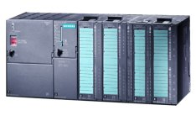
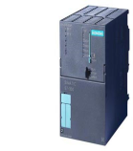



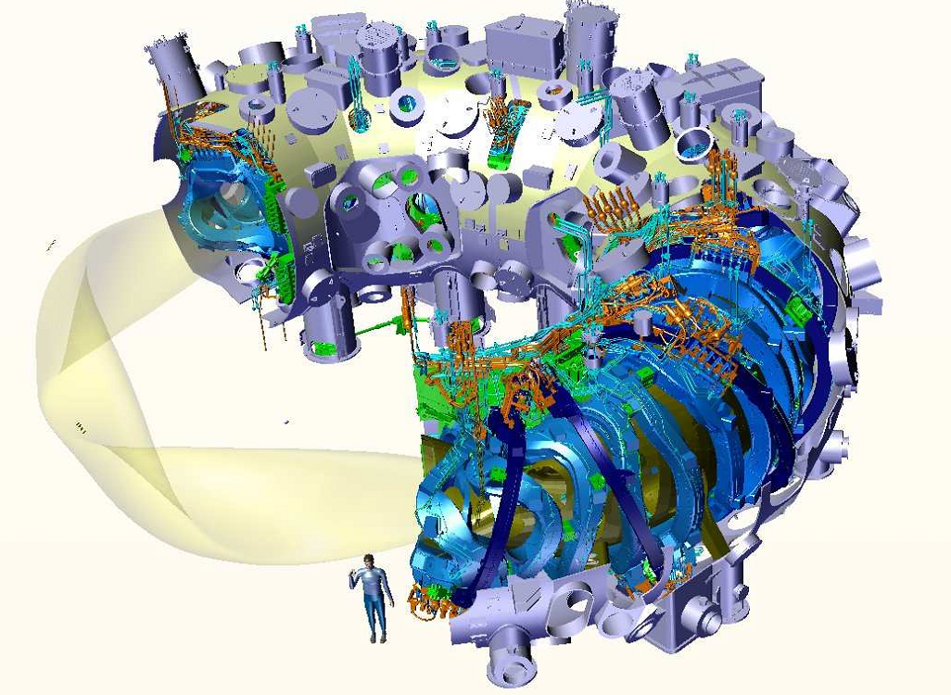
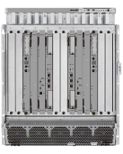
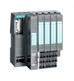
Wendelstein 7-X Data Sources
Central Control System PLC
Central Safety System PLC
Configuration
DB
PLCs engineering data 24/7
High performance data acquisition:
Single devices up streams up to 10 Gb/s
Camera signals, typically visible light & infrared
Multi-Channel systems at high sampling rates and many channel, e.g. X-ray thomography with 400 channels
Real-time computers that store RT signals
Experiment segment control logs
Configuration logs
Analyzed data
Modeling data
Data streaming for all data types!
Sequence
Controller
Central
Time
Event
Distribution
Plasma Control
GPS
DAQ
Frontend
System
DAQ
DAQ
Frontend
System
DAQ
DAQ
DAQ
DAQ
DAQ
Local PLC
Local PLC
Local PLC
Local PLC
Local PLC
Local PLC
Local PLC
Local PLC
Segment RTControl
Segment RTControl
Segment RTControl
Segment RTControl
Segment RTControl
Segment RTControl
Segment RTControl
Segment RTControl

Slide 5
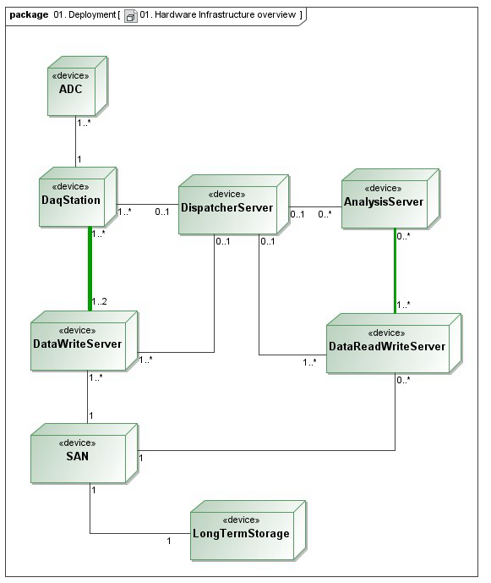
Archiving
30 Gbyte/s data rate
4 Pbyte/a theoretically
1 Pbyte/a design value
Exponential growth!
(data doubling every
0.7 – 2 years)

Slide 6
Data Acquisition Challenges
Short pulse experiment (W7-AS)
Pulse
+DAQ
Pulse
+DAQ
Database Transfer
Data Analysis
3 s
10 min.
time
Steady state experiment (W7-X)
Segment based
control
Continous DAQ and online
analyses (30 + 6 Gbyte/s)
Automated
detailled analyses
Data Analysis
Offline
Data Analysis
Database Transfer
Database Transfer
Plasma Operation + DAQ
20 min.
time

Slide 7
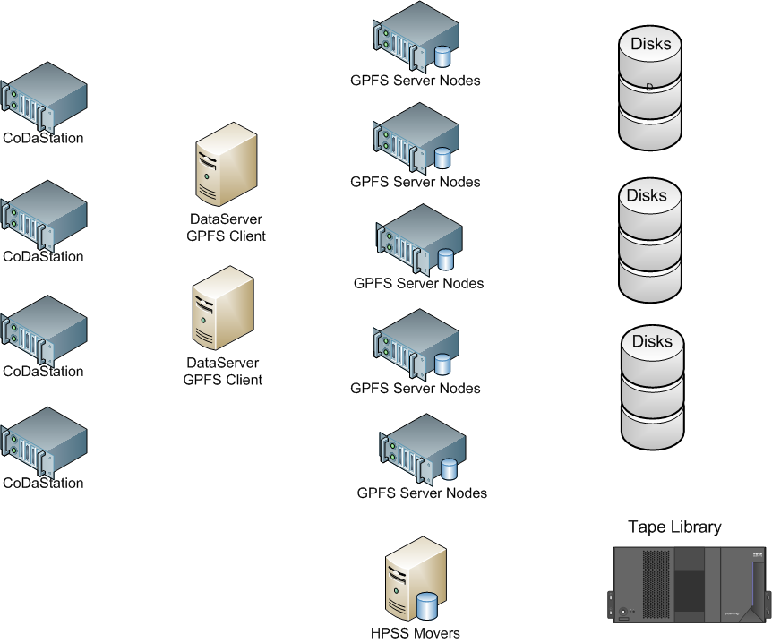
Scalable mass storage
Horizontal scaling required
Data server with parallel
filesystem (GPFS)
Data migration with
HPSS
Due to data streaming,
network has to scale in bandwidth!
WDC
RZG
WAN 10G link to RZG

Slide 8
Data- and Parameterstreams
Segment
Parmboxes
Databoxes
time

Slide 9
Data- and Parameterstreams
SegPar 1
Datastream 1
SegPar 2
Datastream 2
time

Slide 10
File Tree of Archived Data
/GPFS
/W7X
/LAB2
/WEGA
/LAB1
/asg1
/asg2
…
/asgN
/asg1
…
/as1
/as2
…
/asZ
Files:
asg1_as1_year_day.boxes
asg1_as1.yap (Db4o database)
asg1_as1_2011_001.boxes
asg1_as1_2011_002.boxes
….
asg1_as1_2011_365.boxes
….
asg1_as1_2028_365.boxes
+ global catalog for fast access
to be defined in later stage (+2 years):
SQL DB
NoSQL & MapReduce

Slide 11
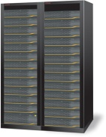
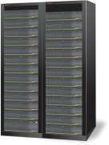
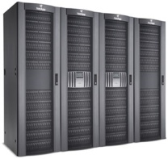
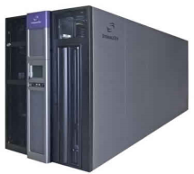
Wendelstein 7-X Data Archive
Central Control System PLC
Central Safety System PLC
Configuration
DB
Sequence
Controller
Central
Time
Event
Distribution
Plasma Control
GPS
Storage Systems
High Availability Storage
Archive Data
Server
High Scalability Storage
DAQ
Frontend
System
DAQ
DAQ
Frontend
System
DAQ
DAQ
DAQ
Long Term Archive
& Policy Driven Data Management
DAQ
DAQ
Local PLC
Local PLC
Local PLC
Local PLC
HPSS
Local PLC
Local PLC
Local PLC
Local PLC
Segment RTControl
Segment RTControl
Segment RTControl
Segment RTControl
Segment RTControl
Segment RTControl
Segment RTControl
Segment RTControl
Images by Siemens, Dell, EMC, HP, Oracle

Slide 12
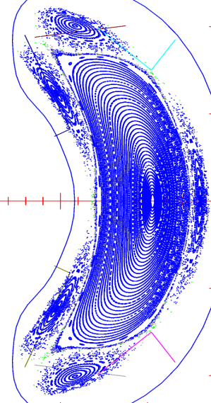

The Data Analysis Challenge
W7-X cross section
Sensors
Plasma diagnostics, indirect measurement of
plasma parameters
Observations depend on multiple plasma
parameters!
Information linked by magnetic surfaces
Radio Frequency
(RF, IC, ICRF, ICE)
Vacuum Ultra Violet
(VUV, EUV, XUV)
Infra-Red
(IR, Far IR)
Micro Wave
(μw, ECE, mm-waves)
Visible
Light
X-Rays
(Soft, Hard)
γ
ρ
Thermal
Particles
(H, H₂, H⁺,H₂⁺,e⁻,Z⁺)
Heated
Particles
(H⁺,e⁻)
Fusion
Products
(α, n)

Slide 13
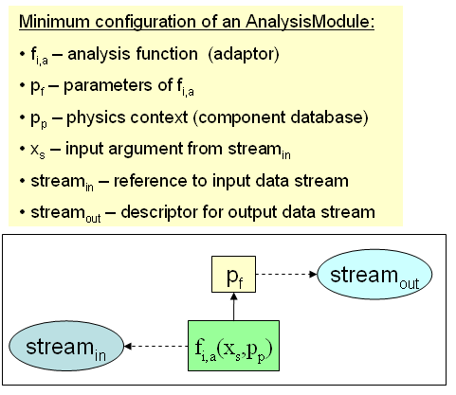
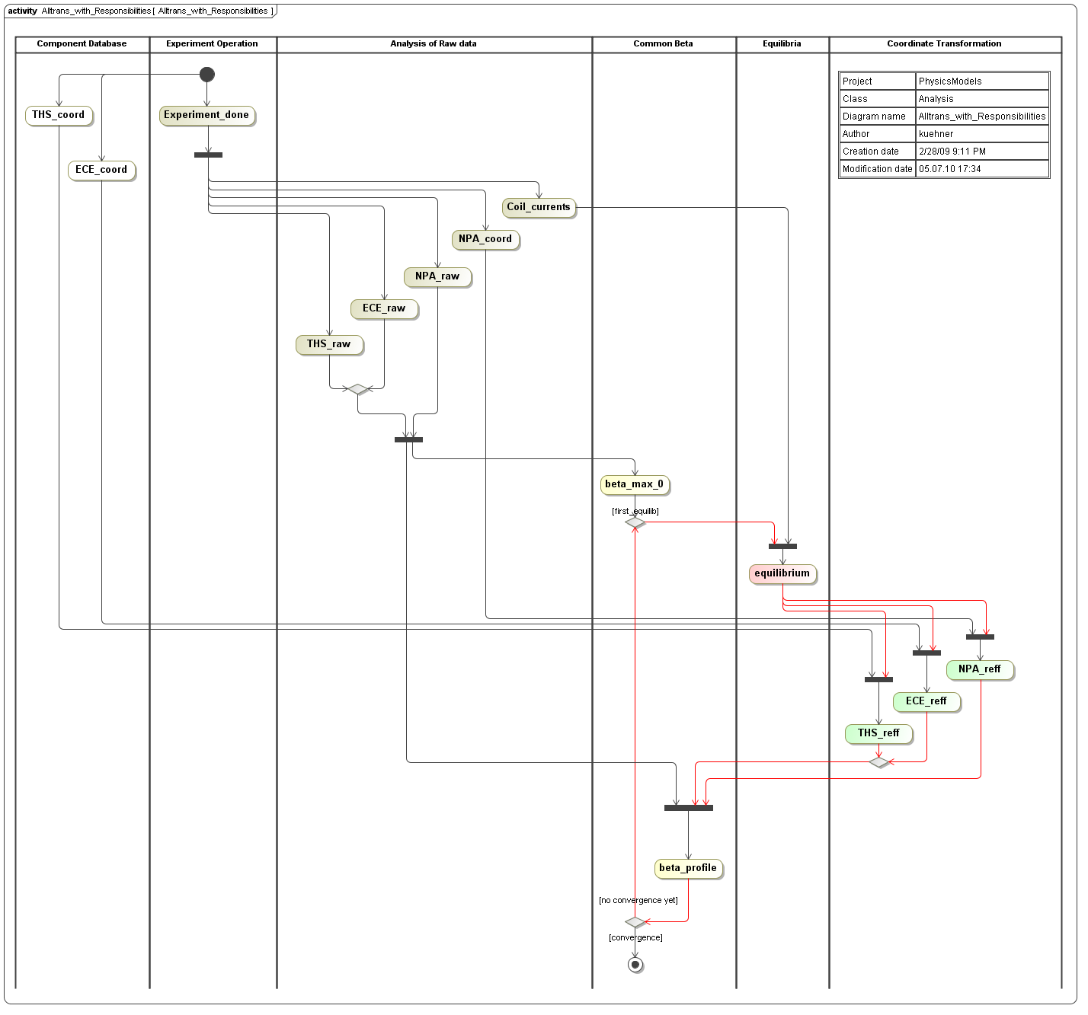
Petri Net like Analysis Chains
All data analysis output are stored as a data stream
Exactly like acquired data!

Slide 14
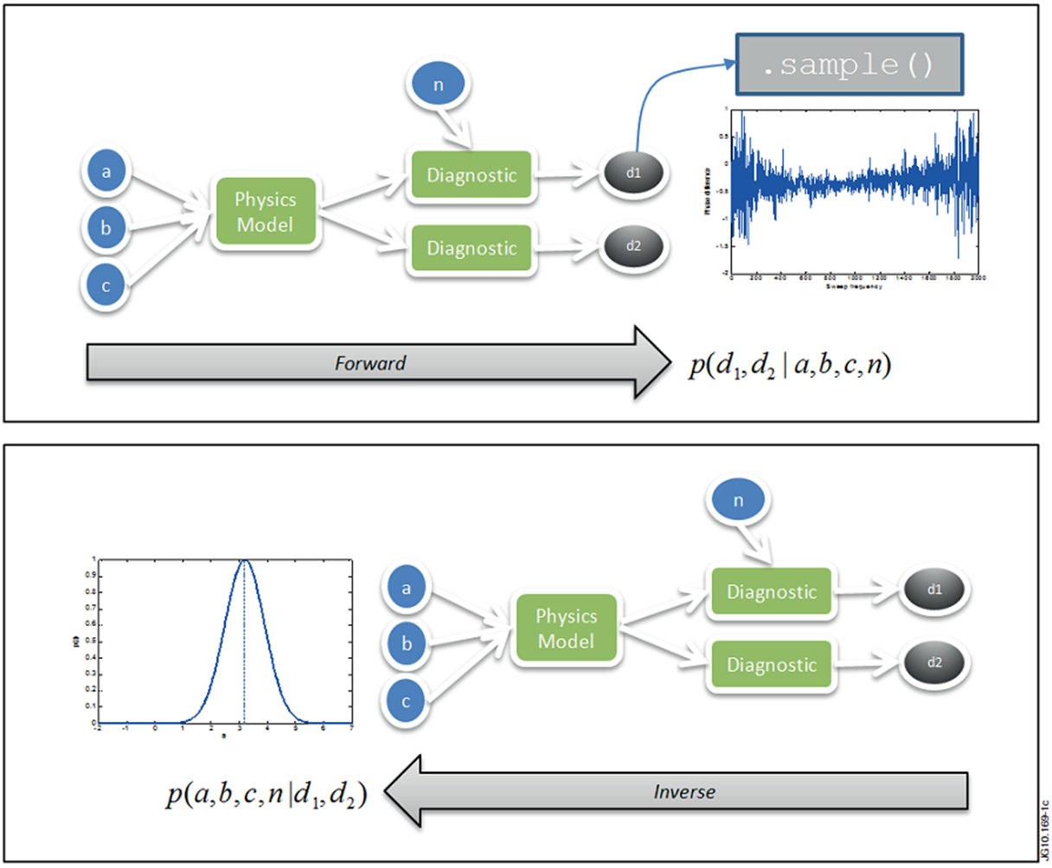
Bayesian Modeling
Graph theory + Bayesian statistical models
Setup of a (complete, nonlinear) model including uncertainties
Prediction of sensor data
Application of inversion methods with measured data
www.seed-escience.org
Improved inference by considering all measurements!
=> Better automated data analysis and, consequently, better plasma control

Slide 15
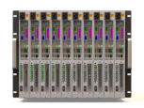
W7-X Online / Offline Data Analyses
Central Control System PLC
Central Safety System PLC
Configuration
DB
Sequence
Controller
Central
Time
Event
Distribution
Plasma Control
GPS
SOA / Data
Analysis
Storage Systems
High Availability Storage
Archive Data
Server
High Scalability Storage
DAQ
Frontend
System
DAQ
DAQ
Frontend
System
DAQ
DAQ
DAQ
Long Term Archive
& Policy Driven Data Management
DAQ
DAQ
Local PLC
Local PLC
Local PLC
Local PLC
HPSS
Local PLC
Local PLC
Local PLC
Local PLC
Segment RTControl
Segment RTControl
Segment RTControl
Segment RTControl
Segment RTControl
Segment RTControl
Segment RTControl
Segment RTControl
Images by Siemens, Dell, EMC, HP, Oracle

Slide 16
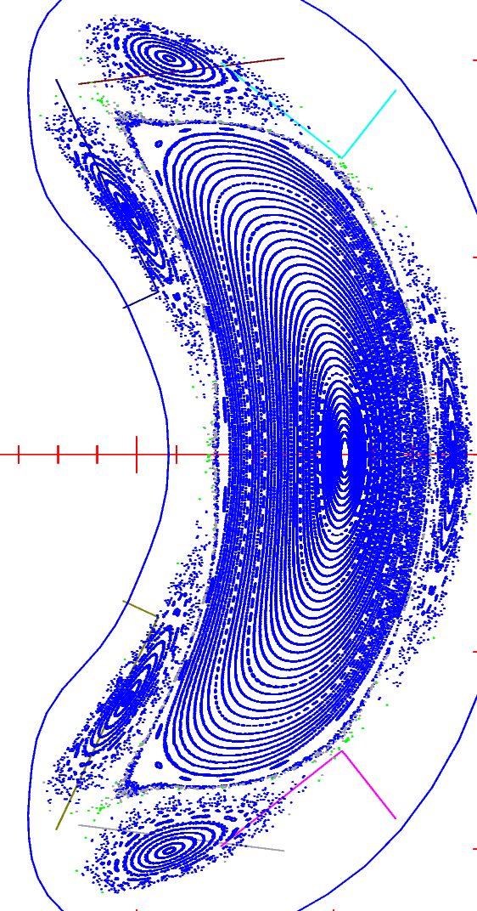
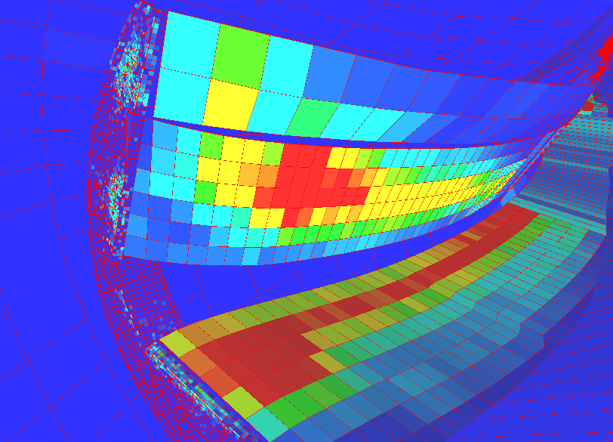
Modeling Offline & Online
Magnetic configuration control with long system response times (100 s)
Divertor graphite tiles heat load 10 MW/m²
In advanced scenarios online modeling (combined feed forward and feedback) required

Slide 17
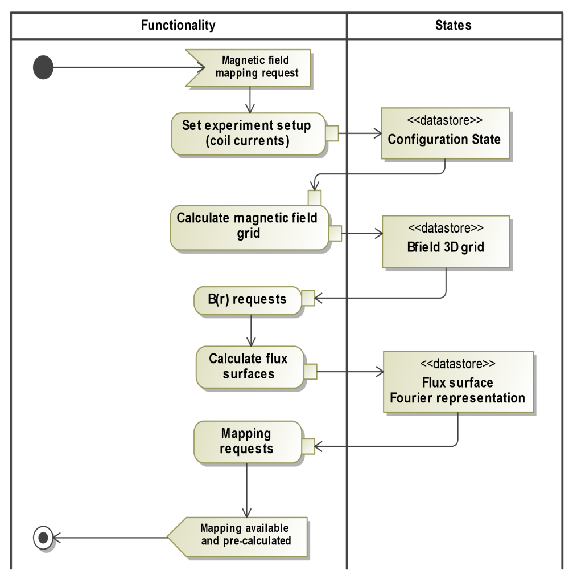

Chain Analyses + Modelling with SOA
SOA-ESB
Enterprise Service Bus
proxy service
proxy service
scientific services
Also parallelization for distributed memory applications
(for shared memory applications ESB just as application interface)

Slide 18
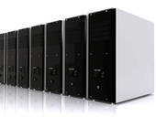

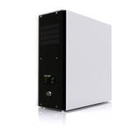
Coupling SOA to Real Time Plasma Control?
or, how to get distributed CPU power into central plasma control …
dynamically configurable
compute cluster
scalable ESB
quality of service
RT plasma control
fault tolerant
intended for slow control, 10 - 100 ms cycle time
ESB can measure response times, QoS
Service endpoint adjustments => easy to manage in a virtualized environment
Mainly for distributed memory problems (major use case for W7-X)

Slide 19



Combination SOA + Virtualization
Private cloud computing, adjustable clusters, service chains
Temporary procurement of compute resources by VM deployment
Sometimes re-analyses of whole datasets required
(deployed on RZG tapes via WAN):
Instead of bringing the data to analyses machine,
bring the analyses VM to the data
Publication of algorithms: Keep the service providing VM runnable
I(infrastructure)aaS
Amazon Elastic Cloud
Profitbricks
VMware vSphere
…
Create server
Setup switch
Suspend server
…

Slide 20

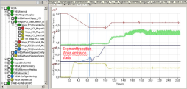





W7-X IT Virtualization
Central Control System PLC
Central Safety System PLC
Configuration
DB
Control Room
& Montoring
Scientific& Administration Offices
Sequence
Controller
Central
Time
Event
Distribution
Plasma Control
GPS
SOA / Data
Analysis
Control Room and Office Cloud
Virtual Desktops
Storage Systems
High Availability Storage
Archive Data
Server
High Scalability Storage
Central Server Cloud
Central IT-Services
DAQ
Frontend
System
DAQ
DAQ
Frontend
System
DAQ
DAQ
DAQ
Long Term Archive
& Policy Driven Data Management
DAQ
DAQ
Local PLC
Local PLC
Local PLC
Local PLC
HPSS
Local PLC
Local PLC
Local PLC
Local PLC
Segment RTControl
Segment RTControl
Segment RTControl
Segment RTControl
Segment RTControl
Segment RTControl
Segment RTControl
Segment RTControl
Images by Siemens, Dell, EMC, HP, Oracle

Slide 21
Summary
Wendelstein 7-X aims for data streaming and data analysis / modeling accordingly (well developed with the help of RZG)
Archive uses GPFS and HPSS by RZG (disk storage in HGW)
How to get computing power into plasma control systems of steady state experiments (W7-X, ITER?)
Analysis/Modeling chains using SOA and Virtualization
IaaS by RZG for big data analysis jobs?
Publishing: Archive is immutable, Service VMs could be archived.
Referencing?

Slide 22
Backup Slides

Slide 23
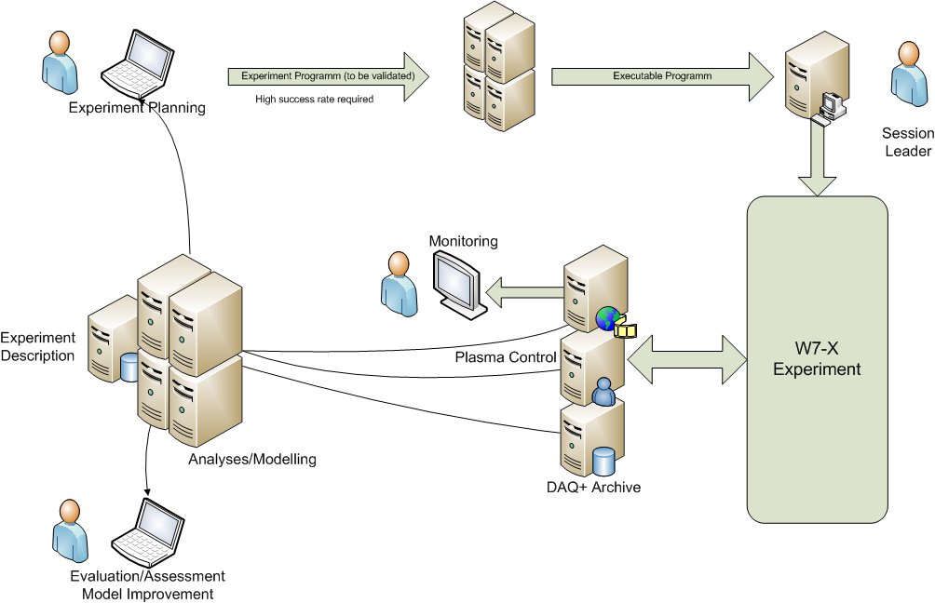
Scientific Workflow W7-X

Slide 24





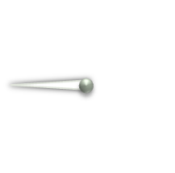


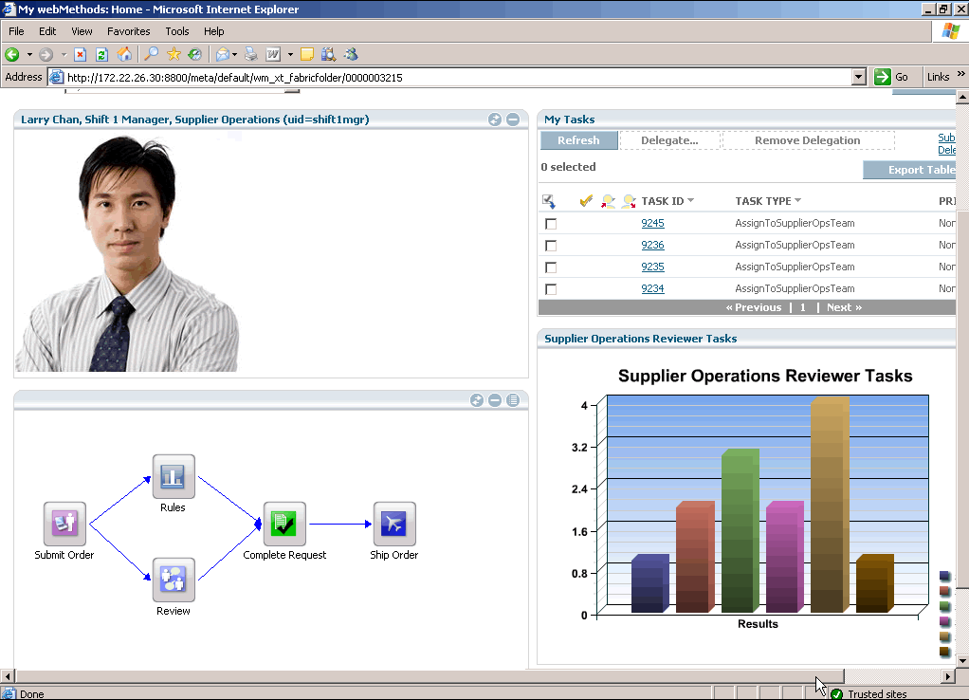













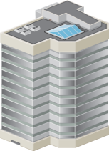

How SOA works
Monitoring
and Analytics
Business
Process
Management
Enterprise
Service Bus
Governance

Slide 25
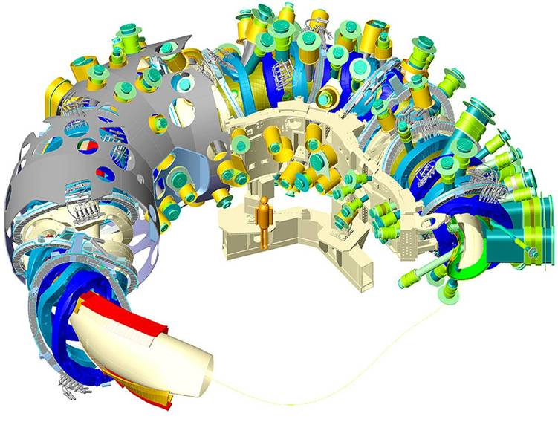
The Need for Online Modeling
Control problems with long system response times, e.g. plasma current control
Thomson
ECE
Magnetics
DB/Cache/RT-network
ECRH
Data Analyses + FP
Central Plasma Control
Power
Deposition
Segment Control /
Controller
Transport
Model
ECCD
Model

Slide 26
Solving Model Equations for RT Systems
Balance equations
Electric field
Diffusion equation
for current
Boundary conditions
Y. Turkin

Slide 27
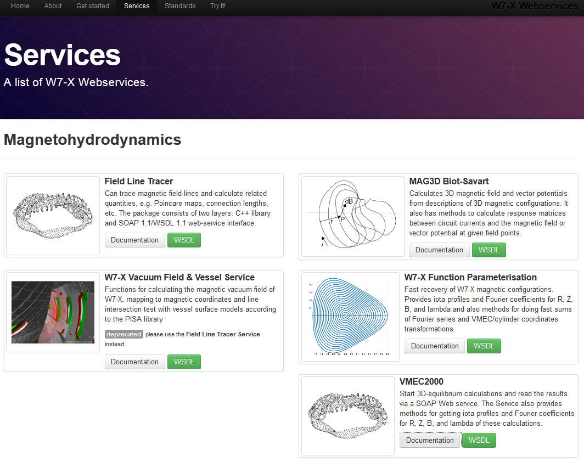
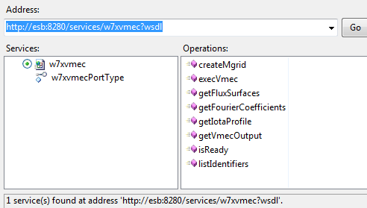
VMEC service example
try-it web page
draw WSDL into e.g.
MS visual studio C#
functions can be immediately used!
almost all languages supported

