Slide 1
High-resolution quantitative magnetization transfer imaging of post-mortem marmoset brain
Henrik Marschner¹, André Pampel¹, Roland Müller¹, Nicholas A. Bock², Marcel Weiss^{1,3}, Stefan Geyer¹, Harald E. Möller¹
Notes:
Welcome to my talk on the topic
High-resolution quantitative magnetization transfer imaging of post-mortem marmoset brain.

Slide 2

Declaration of
Financial Interests or Relationships
Speaker Name: Henrik Marschner
I have no financial interests or relationships to disclose with regard to the subject matter of this presentation.
Notes:
I have no financial Interests or Relationships to declare.

Slide 3
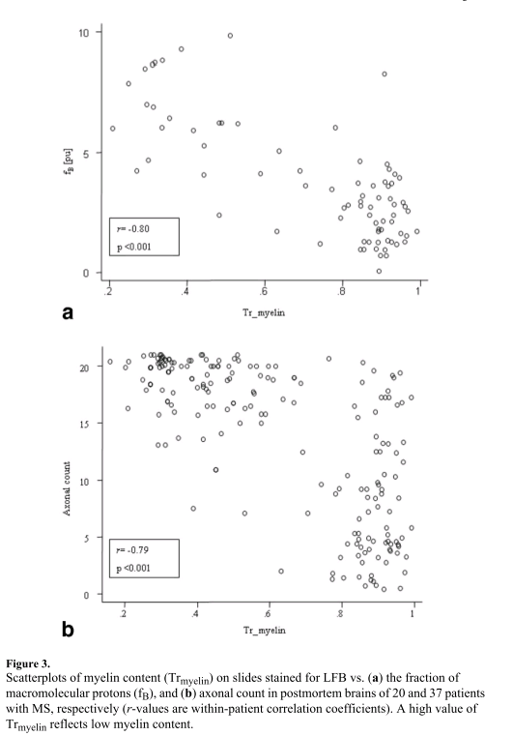
Motivation for qMTI
Information on otherwise MR-invisible macromolecules.
Parameters assumed to be related to myelin.^{[1]}
Post-mortem brain for comparison with histology.
Pixel-wise instead of ROI-based comparisons.
Emphasis on GM.
Comparison with T₁ mapping.
[1] K. Schmierer, J. Magn. Reson. Imaging 26:41-51, 2007
Notes:
qMT imaging is an MRI method that utilizes magnetization transfer to gather informations on otherwise MT-invisible macromolecules.
The parameters of the applied physical model are assumed to be related to myelin,
Which has been investigated for example by Schmierer et. al for white matter in MS pathology.
We used a post-mortem brain to enable easy comparison with myelin based histology but
Went for a pixel-vise analysis instead of a ROI based one.
We also put more emphasis on gray matter.
The qMT parameter maps and histology were also compared with T1 mapping.

Slide 4
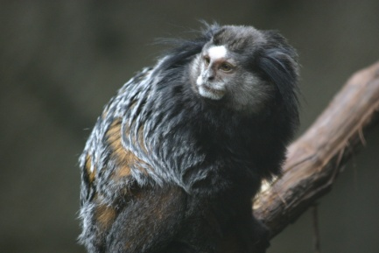
Specimen*
Post-mortem marmoset brain (7.6 y, male).
Fixation in 4% formalin via perfusion.
[*] Kindly provided by Dr Afonso C. Silva NIH, Bethesda, MD.
Notes:
The investigated specimen was a post-mortem brain of a 7.6 years old, male marmoset.
The marmoset was chosen since it’s a well studied animal with an anatomy well suited for WM and GM investigations.
Brain extraction and fixation was performed on the day of the specimens demise.
After fixation in 4% formaline PBS solution the brain was stored in PBS and Sodium trinitride for 2 more years.

Slide 5
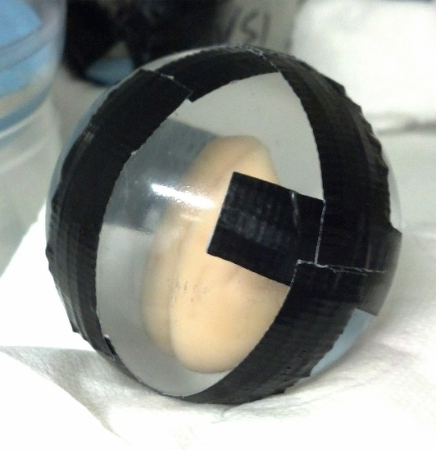
Specimen*
Post-mortem marmoset brain (7.6 y, male).
Fixation in 4% formalin via perfusion.
Prepared for MRI in 6cm acrylic ball.
Cut for histology shortly after MRI into 55µm slices.
[*] Kindly provided by Dr Afonso C. Silva, NIH, Bethesda, MD.
Notes:
The brain got prepared for MRI by placing it in an 6 cm acrylic ball and filled with a chemically innert and MRI invisible oil.
After the MRI sessions it was cut into 55 µm thick coronal slices for histology.

Slide 6
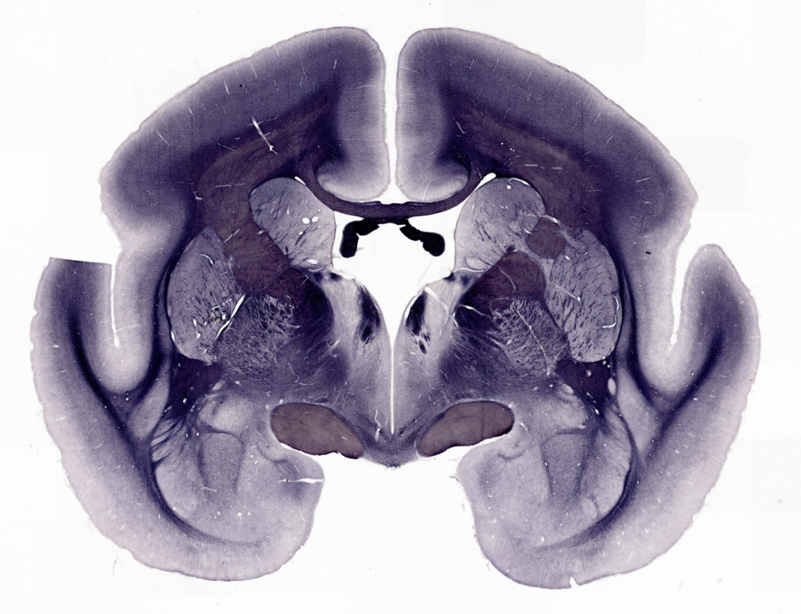
Histology (55µm slice thickness)
Myelin Basic Protein (MBP).
Notes:
From the histology we got different stainings.
Of interest for this study were two myelin based ones.
A stain for myelin basic protein.

Slide 7
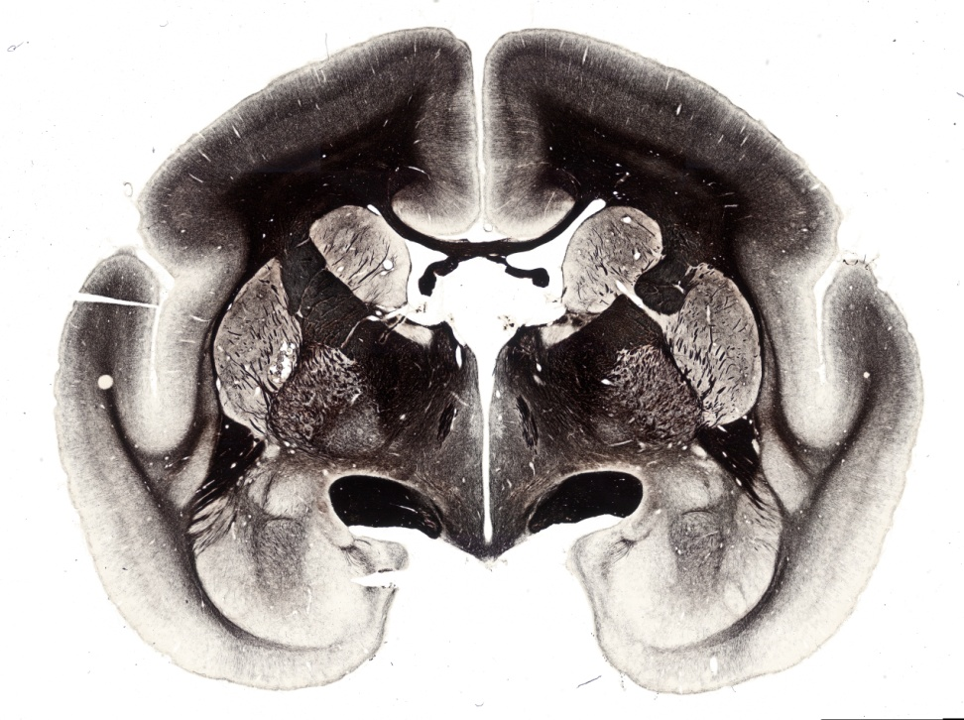
Histology (55µm slice thickness)
Myelin Basic Protein (MBP).
Gallyas silver stain.
Notes:
And the second, a silver staining with a protocol developed by Kerenyi and Gallyas which is used to visualize myelin.
We used this particular stain due to it’s monochromic staining and therefore easy conversion in correlateable intensity values.

Slide 8
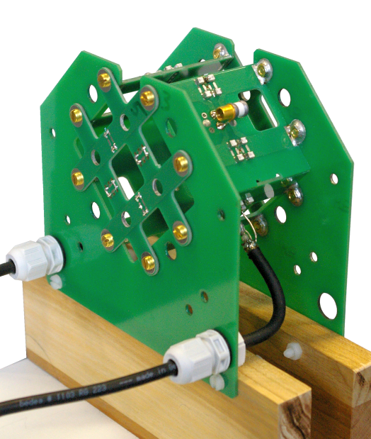
3D qMTI (200 µm isotropic)
Human-scale 3T scanner:
Bruker MedSpec 30/100.
Custom-built CP transceiver coil:
2 perpendicular Helmholtz pairs.^{[2]}
45 image volumes (70 hours):
  MT-FLASH
  TR 32ms; TE 8.2ms; α 10º.
  11 off-resonance frequencies:
  0.25-50 kHz.
  7 sat. pulse amplitudes:
  0.6-7068 rad/s.
  3D maps of T₁^{obs}, B₀, B₁⁺.
[2] R. Müller, Proc. ISMRM 21:4366, 2013
Notes:
The 3T MRI sessions were performed on a Bruker MedSpec 30/100, using a custom build CP tranceiver coil with a suffcient volume to carry samples up to 6 cm diameter.

Slide 9
3D qMTI (200 µm isotropic)
Human-scale 3T scanner:
Bruker MedSpec 30/100.
Custom-built CP transceiver coil:
2 perpendicular Helmholtz pairs.^{[2]}
45 image volumes (70 hours):
  MT-FLASH
  TR 32ms; TE 8.2ms; α 10º.
  11 off-resonance frequencies:
  0.25-50 kHz.
  7 sat. pulse amplitudes:
  0.6-7068 rad/s.
  3D maps of T₁^{obs}, B₀.
FLASH
T₁^{obs} [ms]
[2] R. Müller, Proc. ISMRM 21:4366, 2013
Notes:
All volumes were recorded in 200 µm isotropic resolution.
Several MT prepared measurements were performed over a period of 70 hours,
Covering up to 45 different combinations of offset frequencies and pulse amplitudes including up to 16 repetitions for averaging.

Slide 10
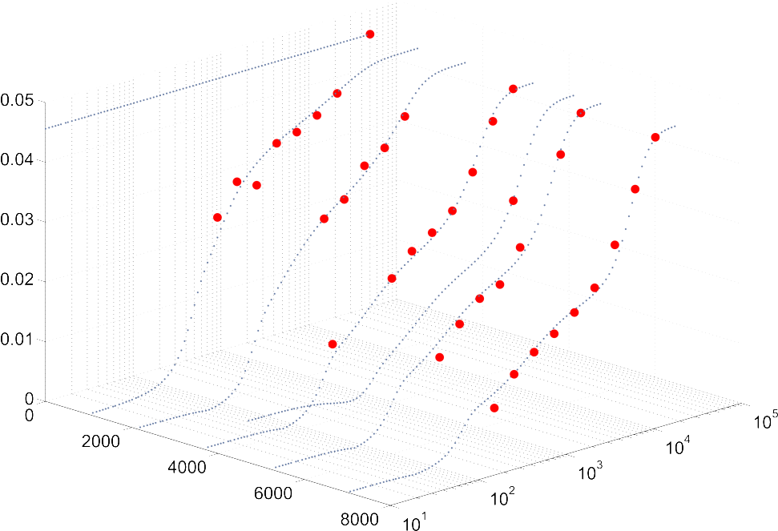
3D qMTI (200 µm isotropic)
Human-scale 3T scanner:
Bruker MedSpec 30/100.
Custom-built CP transceiver coil:
2 perpendicular Helmholtz pairs.^{[2]}
45 image volumes (70 hours):
  MT-FLASH
  TR 32ms; TE 8.2ms; α 10º.
  11 off-resonance frequencies:
  0.25-50 kHz.
  7 sat. pulse amplitudes:
  0.6-7068 rad/s.
  3D maps of T₁^{obs}, B₀.
Signal intensity / a.u.
Saturation pulse
amplitude / rad/s
Off-resonance
frequency / Hz
[2] R. Müller, Proc. ISMRM 21:4366, 2013
Notes:
With these data we gathered z-spectra like this one for each voxel.

Slide 11
Binary Spin Bath Model
Binary spin bath model^{[3]}
(R₁^{b} ≡ 1 s^{–1});
6 free parameters:
  Scaling factor
  σM₀ª;
  Rel. semi-solid pool size
  M₀^{b}/M₀ª;
  Relaxation rates/times
  R₁ª; T₂ª; T₂^{b};
  Transfer-rate constant
  RM₀ª.
[3] R.M. Henkelman, Magn. Reson. Med. 29:759-765, 1993
Notes:
Those data were fitted using a binary spin bath model with 6 free parameters.

Slide 12
Binary Spin Bath Model
Binary spin bath model^{[3]}
(R₁^{b} ≡ 1 s^{–1});
6 free parameters:
  Scaling factor
  σM₀ª;
  Rel. semi-solid pool size
  M₀^{b}/M₀ª;
  Relaxation rates/times
  R₁ª; T₂ª; T₂^{b};
  Transfer-rate constant
  RM₀ª.
[3] R.M. Henkelman, Magn. Reson. Med. 29:759-765, 1993
Notes:
In this talk we will use the relative semi-solid pool size as an example of the calculated qMT parameters.

Slide 13
MT Parameter Fitting
Matrix-algebra-based-simulation of entire pulse sequence.^{[4]}
  Full fit (least squares); Levenberg-Marquardt algorithm.
[4] D.K. Müller, J. Magn. Reson. 230:88-97, 2013.
Notes:
The parameters were calculated in high precision partially by least squares fitting, which took several days per slice.
The rest of the data, over a hundred more slices…

Slide 14
MT Parameter Fitting
Matrix-algebra-based-simulation of entire pulse sequence.^{[4]}
  Full fit (least squares); Levenberg-Marquardt algorithm.
Artificial Neural Network driven parameter estimation.^{[5]}
[4] D.K. Müller, J. Magn. Reson. 230:88-97, 2013. [5] H. Marschner, Proc. ISMRM 21:4239, 2013.
Notes:
was treated using a recently shown method of applying artificial neural networks for accelerated parameter estimation.
A closer description of this method is presented at this conference in the exhibition hall.

Slide 15
3D MT Parameter Maps
M₀^{b}/M₀ª
Matrix-algebra-based-simulation of entire pulse sequence.^{[4]}
  Full fit (least squares); Levenberg-Marquardt algorithm.
Artificial Neural Network driven parameter estimation.^{[5]}
0.4
0
RM₀ª / s⁻¹
R₁ª / s⁻¹
30
5
20
2
T₂ª / ms
T₂^{b} / µs
45
11.5
5
8
[4] D.K. Müller, J. Magn. Reson. 230:88-97, 2013. [5] H. Marschner, Proc. ISMRM 21:4239, 2013.
Notes:
Some examples of the qMT parameter maps from our calculations can be seen here.
This one is the mentioned relative semisolid pool size.

Slide 16
3D R₁^{obs} Maps
R₁^{obs} / s⁻¹
R₁ map @ 7T: MP2RAGE
TI₁ 250 ms, TI₂ 900 ms.
R₁ map @ 3T: FLASH
multiple α and TR.
@7T
3
0
@3T
4
1
Notes:
Additional data for our analysis were T1 maps gathered at a Magnetom 7T from Siemens using a MP2RAGE,
And a T1 map from the 3T Bruker scanner using a FLASH based method applying multiple combinations of different flip angles and repetition times.

Slide 17
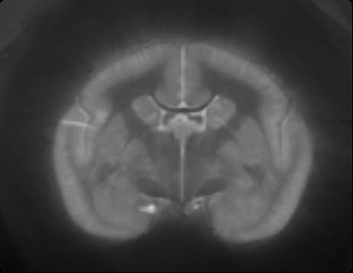
Image Registration
Blockface volume as reference frame.
Slice-wise affine registration of histology.
Blockface
Notes:
For the analysis we had to register all data, histology and MRI, to a reference frame.
The blockface volume was ideal for this purpose due to the identical slice alignment as the stained slices.
The blockface volume is created by making a photograph of the frozen brain each time after cutting off a slice for histology.
Those photos were then written in a 3D volume, used as the reference frame.
Everything was then downsampled to 200 µm resolution, the one achieved for the qMT data.

Slide 18
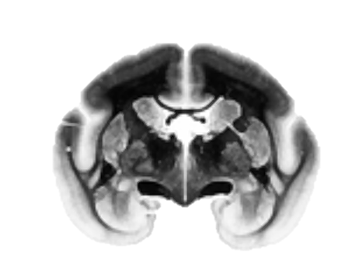
Image Registration
Blockface volume as reference frame.
Slice-wise affine registration of histology.
Gallyas silver stain
Notes:
The stained slices were registered linearely.

Slide 19
Image Registration
Blockface volume as reference frame.
Slice-wise affine registration of histology.
Non-linear registration of all parameter maps acquired at 3T.
Linear registration of
R₁^{obs} map acquired at 7T.
T₁^{obs} @ 3T
Notes:
The maps from the 3T scanner needed a non-linear registration. to correct spatial distortions caused by B0 inhomogenieties.
The T1 map from the 7T was registered linearely.
Over a range of around 50 corronal slices the registrations performed good enough to enable voxelwise analysis.

Slide 20
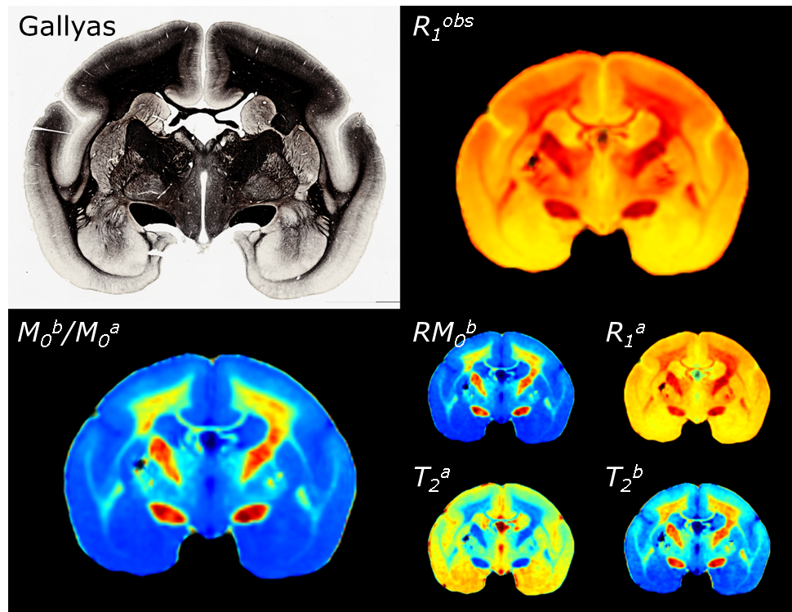
Pixel-wise Parameter Comparisons
3
s⁻¹
1
0.4
0.0
Notes:
Lets come to the results and discussion.
As mentioned we will concentrate on the silver staining, the longitudinal relaxation rate from the 7T and the relative semisolid pool size.
KLICK
Starting with these two.

Slide 21
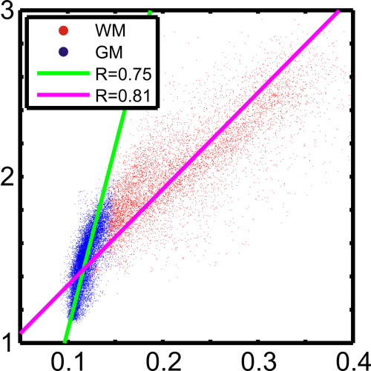
Pixel-wise Comparisons: M₀^{b}/M₀ª & R₁^{obs}
High correlation of M₀^{b}/M₀ª and R₁^{obs}:
GM: R=0.75; p<0.001;
WM: R=0.81; p<0.001.
3
s⁻¹
1
0.4
0.0
R₁^{obs}
M₀^{b}/M₀ª
Notes:
In the scatterplot of the semisolid poolsize versus the relaxation rate,
we observed a high correlation of both parameters…

Slide 22
Pixel-wise Comparisons: M₀^{b}/M₀ª & R₁^{obs}
High correlation of M₀^{b}/M₀ª and R₁^{obs}:
GM: R=0.75; p<0.001;
WM: R=0.81; p<0.001.
Different slopes for GM and WM!
3
s⁻¹
1
0.4
0.0
R₁^{obs}
M₀^{b}/M₀ª
Notes:
but different slopes when we separated the data for white and gray matter.
Other underlying effects than the myelin content could contribute to this result and may be found in further histological or MRI studies.

Slide 23
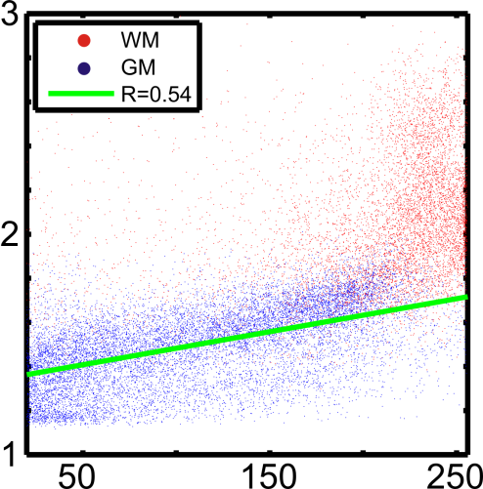
Pixel-wise Comparisons: R₁^{obs} & Histology
Linear correlation of gray values and R₁^{obs}:
GM: R=0.54; p<0.001;
WM: R=0.22; p<0.001
(Dynamic range limitations for Gallyas silver stain with 8-bit grayscale in WM!).
3
s⁻¹
1
R₁^{obs}
8-bit gray values
Notes:
The results in combination with the histology are shown for gray matter only since most of the contrast in the stainings covered gray matter.
White matter (on the other hand) has often a minimal contrast and showed behaviour that needs further investigation before we can use it to complete the analysis.
The scatterplot of silver staining and the longitudinal relaxation rate showed a good correlation of 0.54 .

Slide 24
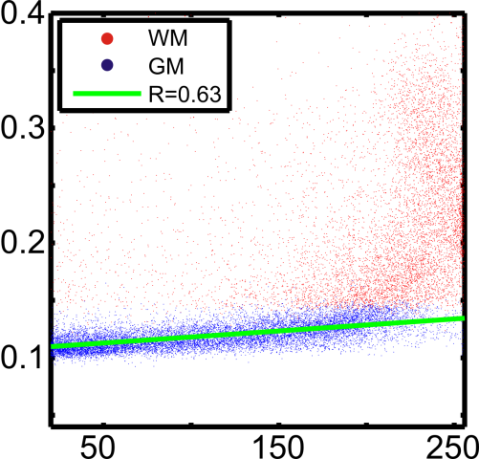
Pixel-wise Comparisons: M₀^{b}/M₀ª & Histology
Linear correlation of gray values and R₁^{obs}:
GM: R=0.63; p<0.001;
WM: R=0.17; p<0.001
(Dynamic range limitations for Gallyas silver stain with 8-bit grayscale in WM!).
0.4
0.0
M₀^{b}/M₀ª
8-bit gray values
Notes:
Switching to histology and the relative semisolid poolsize we get a higher correlation of 0.63,
again in gray matter.
We now take a look into another area, the visualization qualities of our methods in 200µm resolution.

Slide 25
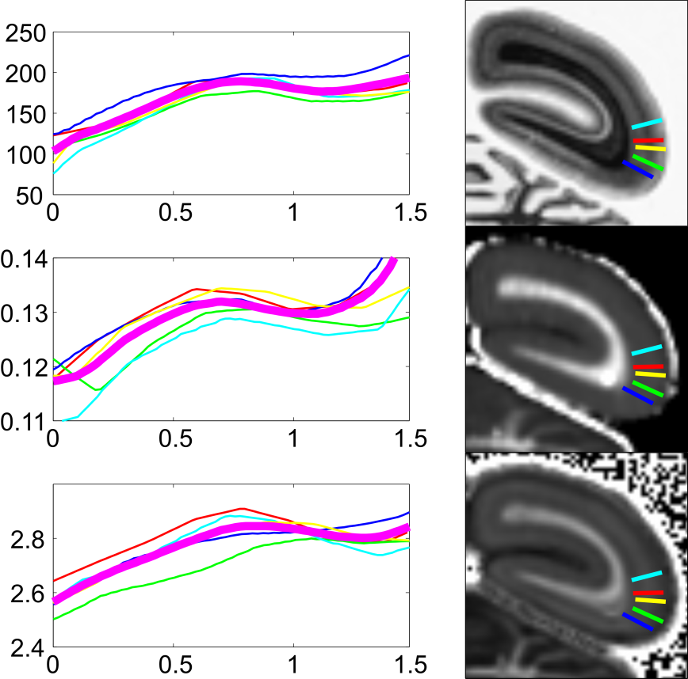
Intracortical Structures
Stria of Gennari
Gallyas
8-bit gray values
Profiles indicate sufficient resolution for visualization of cortical layering.
mm
M₀^{b}/M₀ª
mm
R₁^{obs} / s⁻¹
mm
Pial surface→GM/WM border
Mean profile
Notes:
Having a look at the intracortical structures in the occipital lobe as an example.
T1 imaging and qMT imaging performed well in this discipline.
We were able to resolve the stria of gennari, a highly myelinated structure, approximately 400 µm thick.
We confirmed this result with the histology.

Slide 26
Intracortical Structures
Stria of Gennari
Gallyas
8-bit gray values
Profiles indicate sufficient resolution for visualization of cortical layering.
Contrast with M₀^{b}/M₀ª lower than with R₁^{obs} (lower range of variation).
mm
M₀^{b}/M₀ª
mm
R₁^{obs} / s⁻¹
mm
Pial surface→GM/WM border
Mean profile
Notes:
One difference of our MRI methods is the difference in the contrast ranges in gray and white matter, making the optical distinction of intracortical structures with qMT imaging more difficult than with T1 imaging.

Slide 27
Summary
M₀^{b}/M₀ª and T₁ are highly correlated, however, with distinct differences in GM and WM.
qMTI and T₁ mapping both show high degree of correspondence with myelin-based histology in GM.
High-resolution qMTI maps permit visualization of intracortical structures in the post-mortem marmoset brain.
Notes:
We can conclude that the relative semisolid pool size from qMT and T1 are highly correlated but visible through the voxel wise analysis we can also observe distinct differences in gray and white matter.
And both shown MRI methods agree well with myelin based histology in gray matter of the post-mortem marmoset brain.
High-resolution qMT imaging permits visualization of intracortical structures in the post-mortem marmoset brain.

Slide 28
Thanks to …
Afonso Silva
Riccardo Metere
Katja Reimann
Thank you
for your attention!
Acknowledgement:
Funded by the Helmholtz Alliance ICEMED—Imaging and Curing Environmental Metabolic Diseases.
Notes:
Thank you for your attention.

