Slide 1
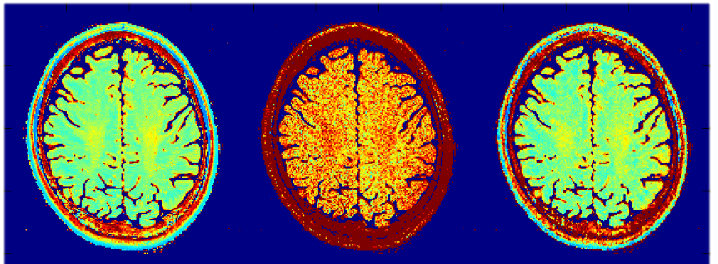

Adaptive Averaging of Non-Identical Image Series in the Wavelet Space
#3721
Computer
8
Henrik Marschner, André Pampel, & Harald E. Möller
Max Planck Institute for Human Cognitive and Brain Sciences, Leipzig, Germany
marschner@cbs.mpg.de
Adaptive Wavelet-based Enhancement of Signal Over Multiple Experiments
(AWESOME)
32 Element
Head Coil
Body Coil
Body Coil +
AWESOME
$T_{2}$ maps
ms

Slide 2
Overview: Adaptive Wavelet-based Enhancement of Signal Over Multiple Experiments (AWESOME)
Goal: Developing a Method for de-noising of MRI images of multiple measurements that does not alter quantitative information.
Idea: Utilizing the multitude of available images in several experiments (e.g. qMTI) to perform complex averaging by co-adding the different images. Shifting the complex averaging into the wavelet space to preserve experimentally controlled changes in the signals over the images.

Slide 3
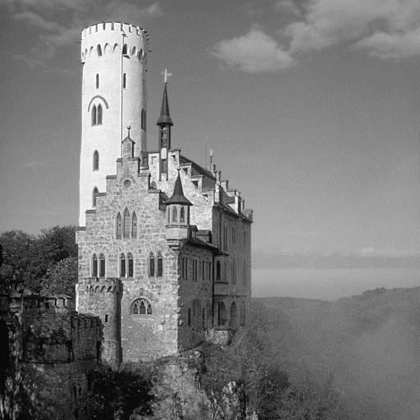
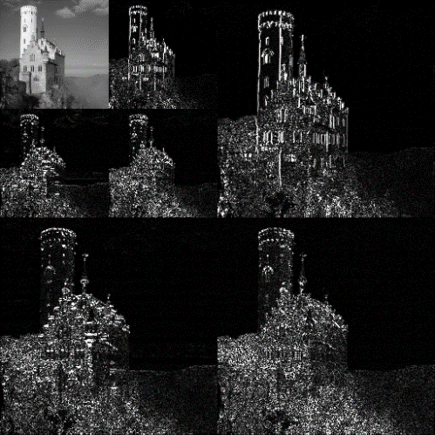
Background: Discrete Wavelet Transformation (DWT)
DWT
[1] By Andreas Tille, cropped by Alessio Damato (Image:Lichtenstein.jpg) [GFDL (http://www.gnu.org/copyleft/fdl.html) or CC-BY-SA-3.0 (http://creativecommons.org/licenses/by-sa/3.0/)], via Wikimedia Commons
[2] By Alessio Damato (Own work) [GFDL (http://www.gnu.org/copyleft/fdl.html), CC-BY-SA-3.0 (http://creativecommons.org/licenses/by-sa/3.0/) or CC BY-SA 2.5-2.0-1.0 (http://creativecommons.org/licenses/by-sa/2.5-2.0-1.0)], via Wikimedia Commons

Slide 4

Background: Discrete Wavelet Transformation (DWT)
Multiple Scales or Level
and
Multiple Sub-bands or
Directions of Analysis
Level 1
→
→
Level 2
→
→
→
→
[2] By Alessio Damato (Own work) [GFDL (http://www.gnu.org/copyleft/fdl.html), CC-BY-SA-3.0 (http://creativecommons.org/licenses/by-sa/3.0/) or CC BY-SA 2.5-2.0-1.0 (http://creativecommons.org/licenses/by-sa/2.5-2.0-1.0)], via Wikimedia Commons

Slide 5
Background: Discrete Wavelet Transformation (DWT)
Exploited properties of DWT in the presented application:
Preservation of signal phase from MR images
in their Wavelet-Representation ^{[3]}
Enhanced separation of “brain” and background noise
via use of multiple scales and analysis directions ^{[4]}
[3] Olsen et.al., Wavelet Applications II, Pts 1 and 2, (1995). [4] Weaver et.al., Magn Reson Med, (1991).

Slide 6
Background: MR Signal Properties
Exploited properties of MR signals in the presented application:
Predictability of signal phase enables phase corrections
to achieve phase coherence of MR images
across an image series
Knowledge on differences in distribution of MR data
allow for characterization of data, e.g. into noise and meaningful signals in image and wavelet space likewise
[5] Dekker, A.J. den; Sijbers, J.; Phys. Med. (2014)

Slide 7
Purpose of this Work
Combining advantages from two common approaches:
  Averaging via repetitions: “lossless” SNR improvement
  Wavelet de-noising via thresholding: Enhanced separation/characterization of data into noise or meaningful information in the wavelet space

Slide 8
Purpose of this Work
Avoiding disadvantages of two common approaches:
  Averaging via repetitions: Necessity for repetitions of experiments under identical conditions
  Wavelet de-noising via thresholding: Loss of small meaningful information hidden in the noise background.

Slide 9
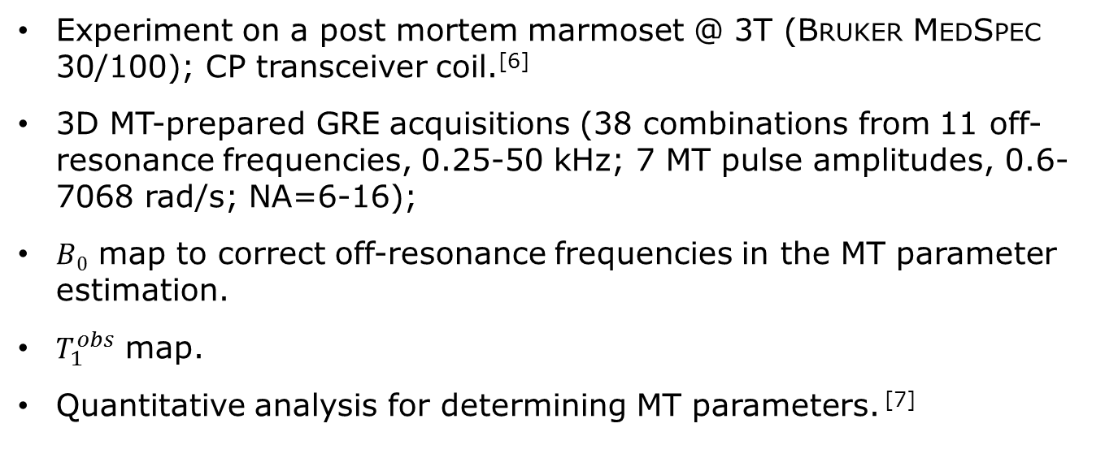
Application Example: Pulsed MT Imaging
Experiment on a post mortem marmoset @ 3T (Bruker MedSpec 30/100); CP transceiver coil.^{[6]}
3D MT-prepared GRE acquisitions (38 combinations from 11 off-resonance frequencies, 0.25-50 kHz; 7 MT pulse amplitudes, 0.6-7068 rad/s; NA=6-16);
$B0$ map to correct off-resonance frequencies in the MT parameter estimation.
$T_{1}^{obs}$ map.
Quantitative analysis for determining MT parameters. ^{[7]}
[6] R. Müller, Proc. ISMRM 21:4366, 2013. [7] D.K. Müller, A. Pampel, H.E. Möller. J. Magn. Reson. 230: 88 (2013).

Slide 10
AWESOME: Step 1 - Input
Multiple images comprising
magnitude and
phase information
Axial slices of 3 selected images of the 38 image qMTI application example; Magnitude (top) and Phase (bottom) are shown

Slide 11
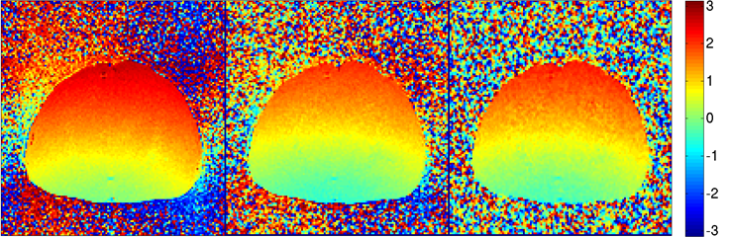
AWESOME: Step 2 – Registration and Phase Correction
Registration of images may be performed if necessary
Phase correction includes correction of differences in phase over the series as well as removal of an average phase map
Phase Correction
Application example only required phase correction due to non-moving post-mortem subject

Slide 12
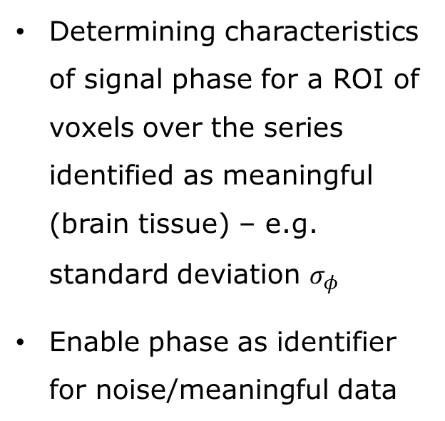

AWESOME: Step 3 – Signal Phase Analysis
Determining characteristics of signal phase for a ROI of voxels over the series identified as meaningful (brain tissue) – e.g. standard deviation $σ_{φ}$
Enable phase as identifier for noise/meaningful data
Phase Analysis
Application example shows a standard deviation of phase for meaningful data of $σ_{φ}=0.16$

Slide 13
AWESOME: Step 4 – Modeling 2D Classifier/Filter Function (Transfer Function)
Modeling a 2D classifier/filter function based on phase and intensity of an input value
Using any sigmoid function as modeling basis
Phase Filter
Application example shows a standard deviation of phase for meaningful data of $σ_{φ}=0.16$

Slide 14
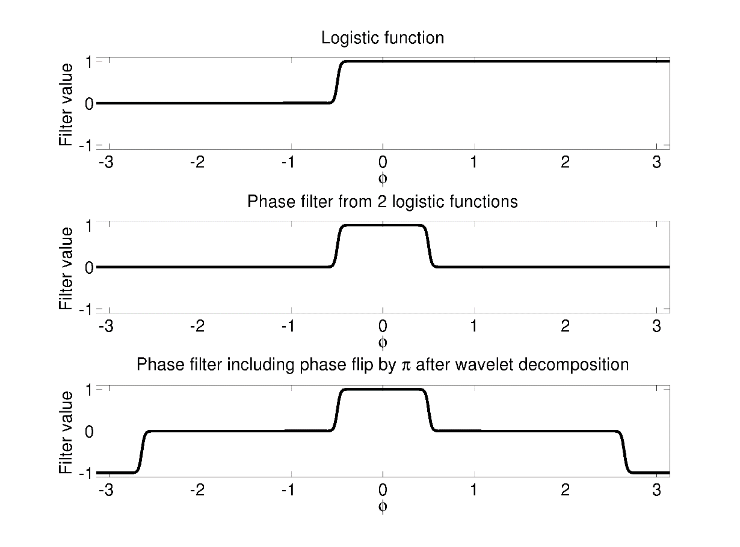
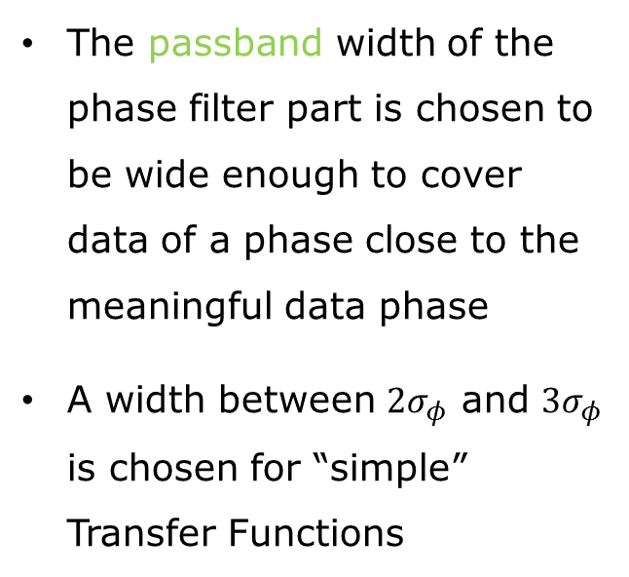
AWESOME: Step 4 – Modeling 2D Classifier/Filter Function (Transfer Function)
The passband width of the phase filter part is chosen to be wide enough to cover data of a phase close to the meaningful data phase
A width between $2σ_{φ}$ and $3σ_{φ}$ is chosen for “simple” Transfer Functions
Stopband
Passband
Example phase filter part of the 2D Transfer Function; modeling basis is a logistic function

Slide 15
AWESOME: Step 4 – Modeling 2D Classifier/Filter Function (Transfer Function)
The phase of data in the wavelet space can differ by 180°
Because of signs of local magnitude gradients in the image space and their effect on the wavelet transform
Stopband
Passband
Example phase filter part of the 2D Transfer Function; modeling basis is a logistic function

Slide 16
AWESOME: Step 4 – Modeling 2D Classifier/Filter Function (Transfer Function)
An extra passband around 180°is therefore necessary for correct data classification in the wavelet space
Stopband
Passband
Example phase filter part of the 2D Transfer Function; modeling basis is a logistic function

Slide 17
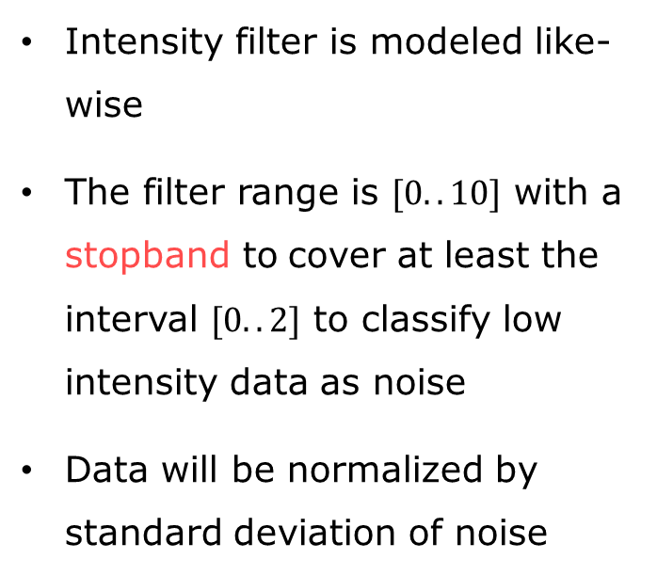
AWESOME: Step 4 – Modeling 2D Classifier/Filter Function (Transfer Function)
Intensity filter is modeled like-wise
The filter range is $[0..10]$ with a stopband to cover at least the interval $[0..2]$ to classify low intensity data as noise
Data will be normalized by standard deviation of noise
Combining
Intensity
and Phase
Filter
Example intensity filter part of the 2D Transfer Function; modeling basis is a logistic function

Slide 18
AWESOME: Step 4 – Modeling 2D Classifier/Filter Function (Transfer Function)
Product of Phase and Intensity Filter → 2D Transfer Function TF
The filter function can be refined

Slide 19

AWESOME: Step 5 – Wavelet Decomposition
Wavelet decomposition into $≥3$ level for good initial separation of noise and other data
“sym8” chosen

Slide 20
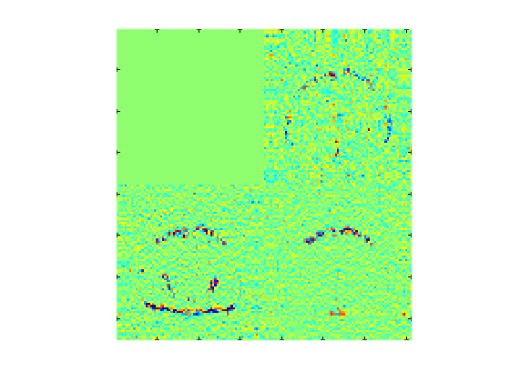
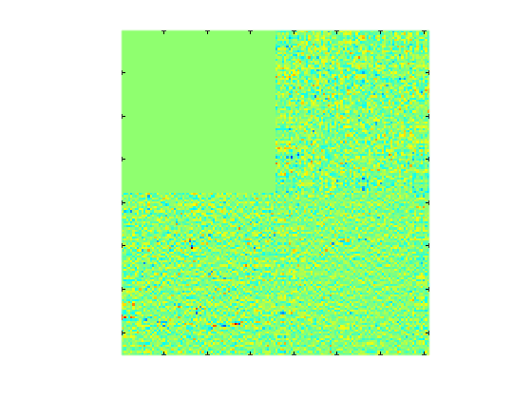
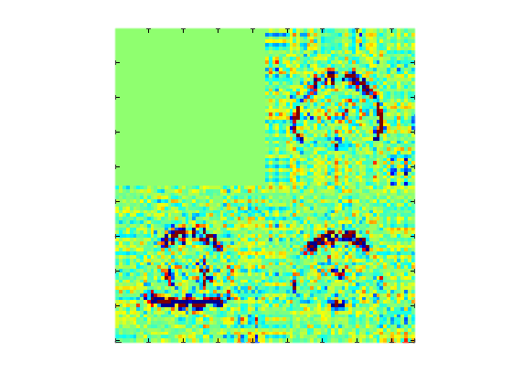
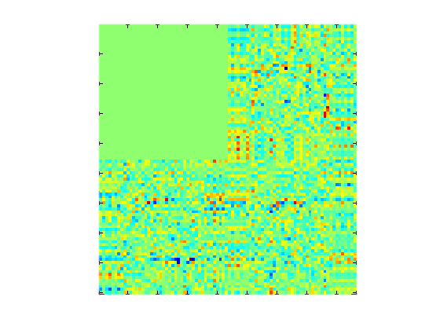

AWESOME: Step 5 – Wavelet Decomposition
Wavelet-Representation$WR$
Real wavelet coefficients
Imag. wavelet coefficients
Magnitude
Complex
DWT
Level 3-5
Level 3-5
Phase
Complex wavelet decomposition; 3 of 7 Sub-bands from Level 1 and 2 of 5 for example image

Slide 21
AWESOME: Step 5 – Wavelet Decomposition
Real
Level 3-5
Note: Wavelet coefficients of
meaningful data (brain) show
a phase close to 0°or 180°
as intended by the initial
phase correction

Slide 22
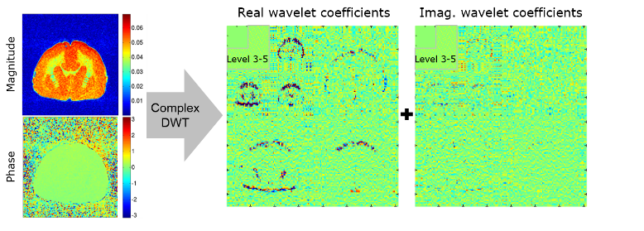
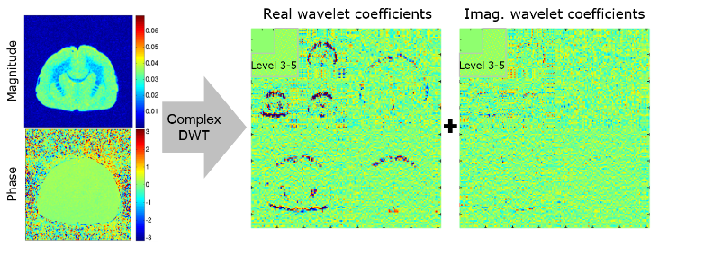
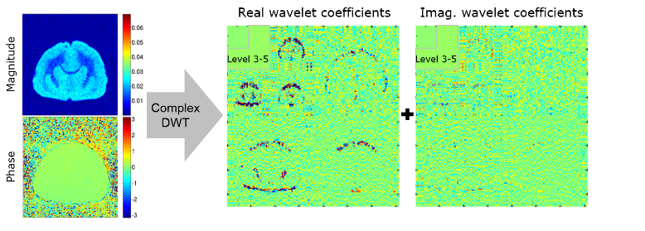
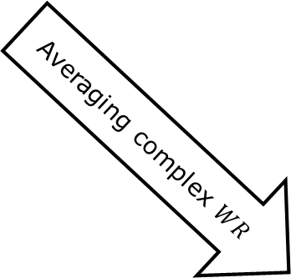
AWESOME: Step 5 – Wavelet Decomposition
Averaging complex $WR$
…
Complex wavelet decomposition; 3 Example images and wavelet-representations

Slide 23
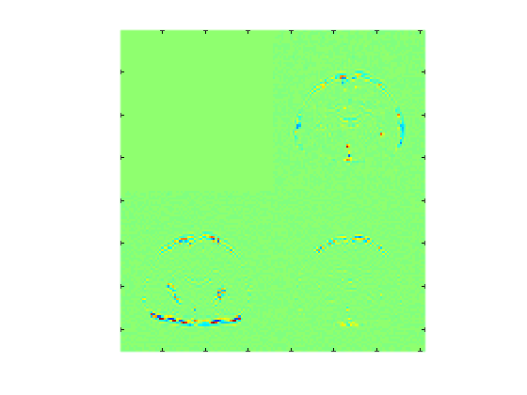
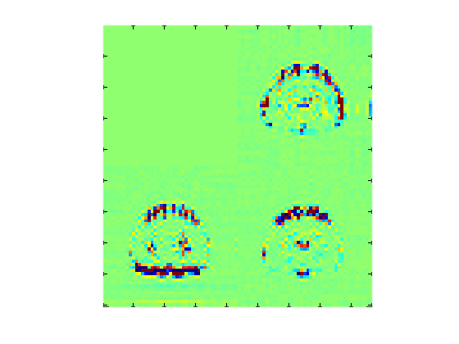

AWESOME: Step 6 – Averaging Wavelet-Representations
Real
Real
Level 3-5
Averaging (complex)
Level 3-5
$$WR_{AV}$$
Wavelet-representation of first example
image from series (left) Average wavelet-representation (right);

Slide 24
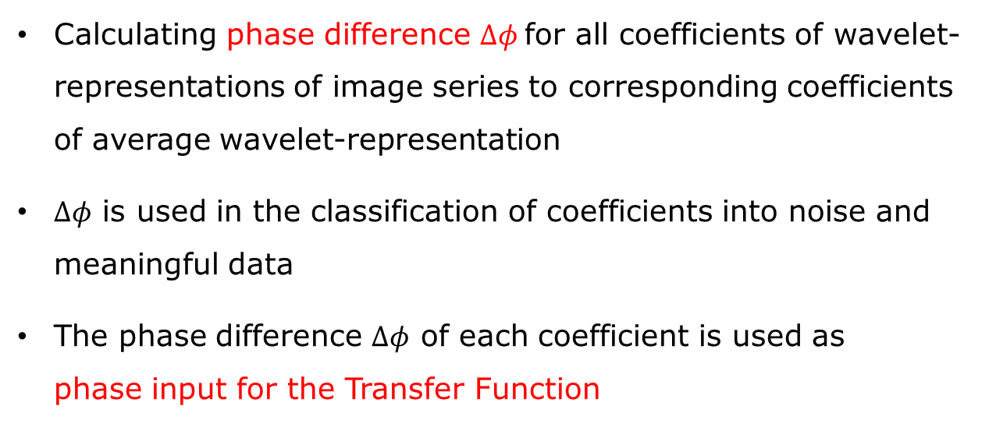
AWESOME: Step 7a – Analysis of Wavelet-Representations
Calculating phase difference $Δφ$for all coefficients of wavelet-representations of image series to corresponding coefficients of average wavelet-representation
$Δφ$ is used in the classification of coefficients into noise and meaningful data
The phase difference $Δφ$ of each coefficient is used as
phase input for the Transfer Function

Slide 25
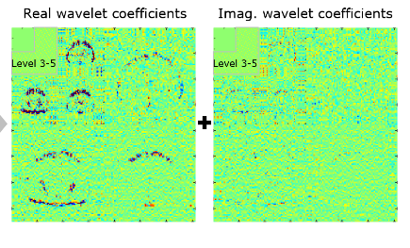
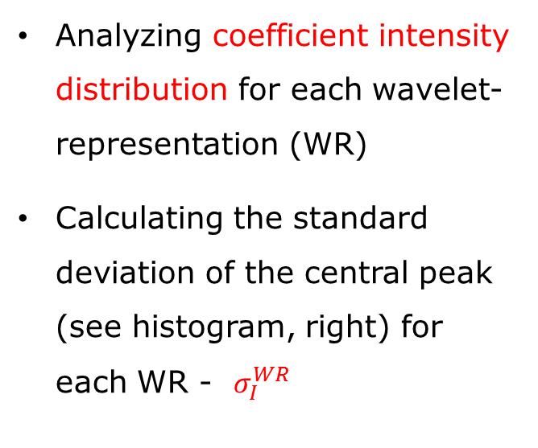
AWESOME: Step 7b – Analysis of Wavelet-Representations
Analyzing coefficient intensity distribution for each wavelet-representation (WR)
Calculating the standard deviation of the central peak (see histogram, right) for each WR - $σ_{I}^{WR}$
Intensity analysis

Slide 26
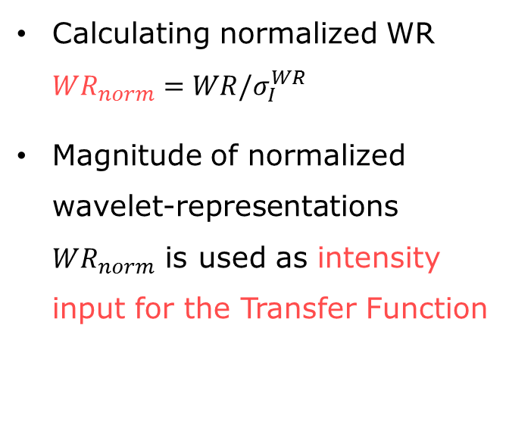

AWESOME: Step 7b – Analysis of Wavelet-Representations
Calculating normalized WR $WR_{norm}=WR/σ_{I}^{WR}$
Magnitude of normalized wavelet-representations $WR_{norm}$ is used as intensity input for the Transfer Function
Intensity analysis
$$σ_{I}^{WR}$$

Slide 27
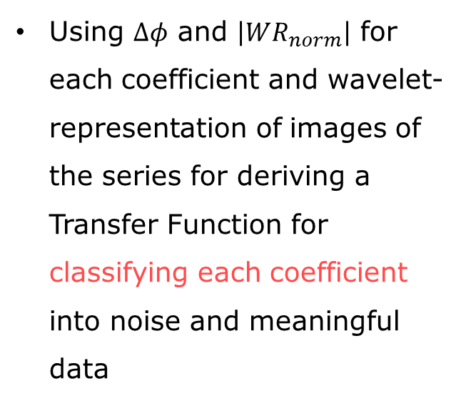
AWESOME: Step 8 – Applying Transfer Function
Using $Δφ$ and $\left|WR_{norm}\right|$ for each coefficient and wavelet-representation of images of the series for deriving a Transfer Function for classifying each coefficient into noise and meaningful data

Slide 28
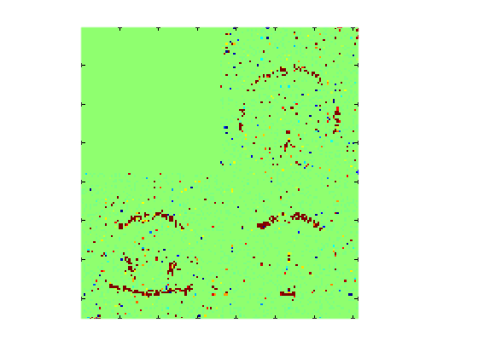
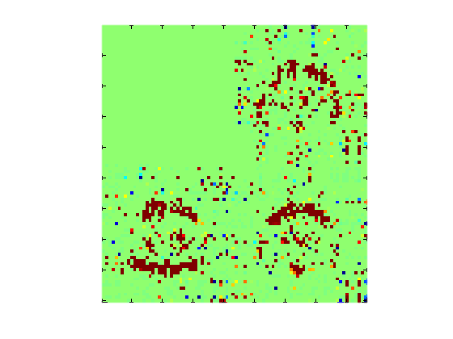
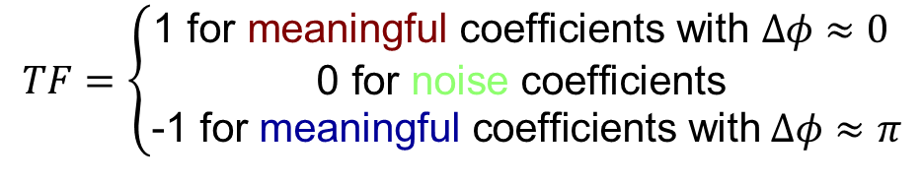

AWESOME: Step 8 – Applying Transfer Function
Level 3-5
$$TF=\left\{\begin{aligned}\text{1 }\text{for} \text{meaningful} \text{coefficients} \text{with} Δφ≈0 \\ \text{0 }\text{for} \text{noise} \text{coefficients} \\ \text{−1 }\text{for} \text{meaningful} \text{coefficients} \text{with} Δφ≈π\end{aligned}\right.$$
$$TF=TF(\left|WR_{norm}\right|,Δφ)$$

Slide 29
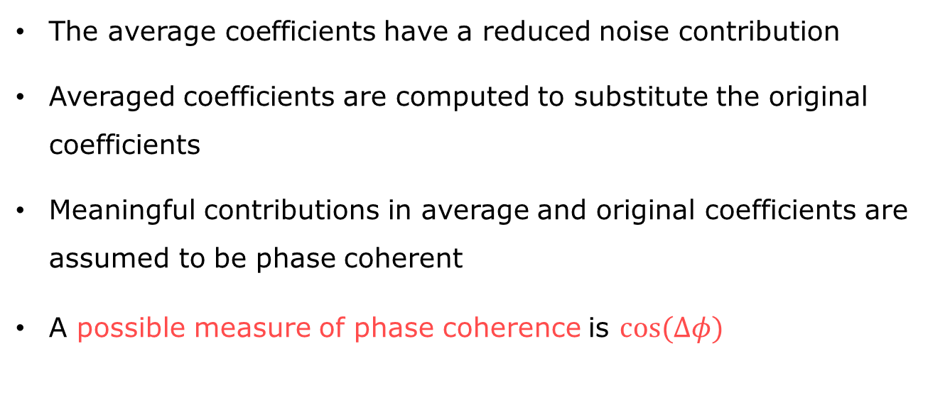
AWESOME: Step 9 – Calculating Scaling Factors
The average coefficients have a reduced noise contribution
Averaged coefficients are computed to substitute the original coefficients
Meaningful contributions in average and original coefficients are assumed to be phase coherent
A possible measure of phase coherence is $cos⁡(Δφ)$

Slide 30
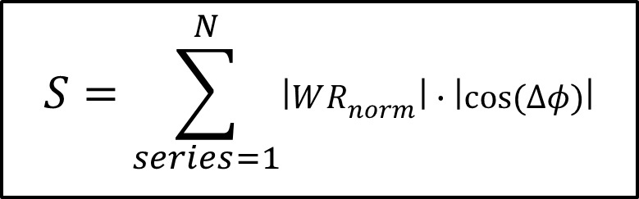
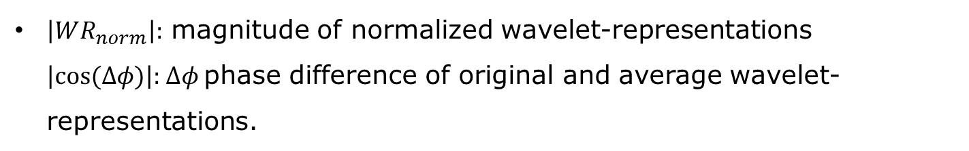
AWESOME: Step 9 – Calculating Scaling Factors
Using phase coherence property to calculate the sum of meaningful contributions (S) from original coefficients.
$$S=\sum_{series=1}^{N}{\left|WR_{norm}\right|∙\left|cos⁡(Δφ)\right|}$$
$\left|WR_{norm}\right|:$ magnitude of normalized wavelet-representations $\left|cos⁡(Δφ)\right|\text{: }Δφ$phase difference of original and average wavelet-representations.

Slide 31
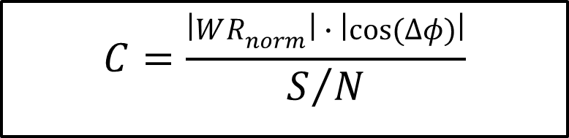
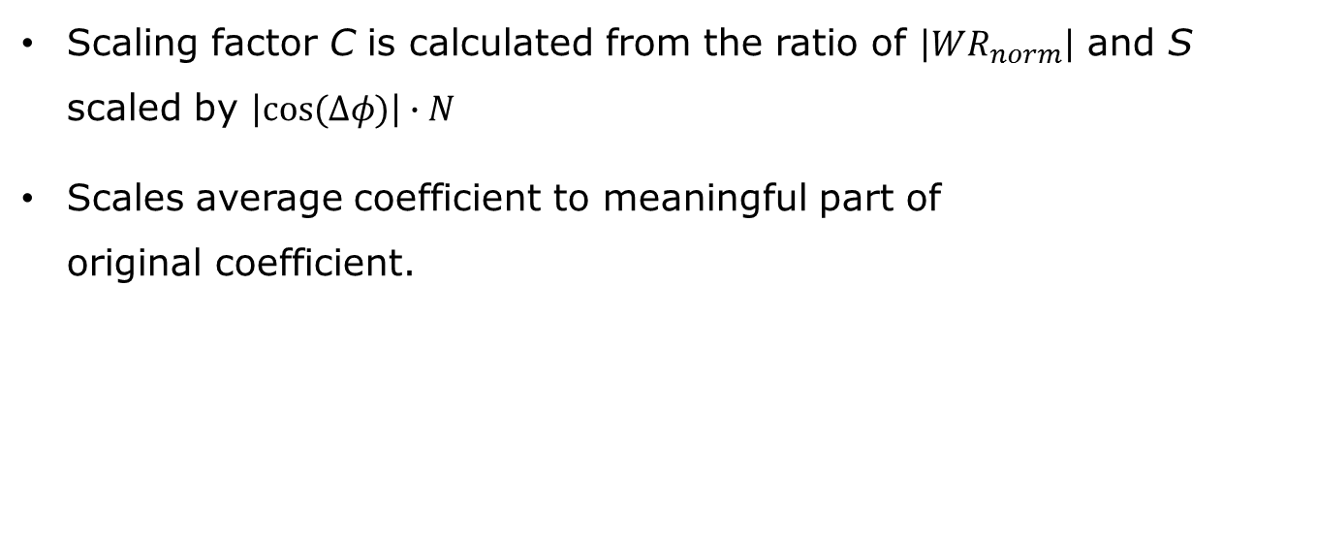
AWESOME: Step 9 – Calculating Scaling Factors
Scaling factor C is calculated from the ratio of $\left|WR_{norm}\right|$ and S scaled by $\left|cos⁡(Δφ)\right|∙N$
Scales average coefficient to meaningful part of
original coefficient.
$$C=\frac{\left|WR_{norm}\right|∙\left|cos⁡(Δφ)\right|}{S/N}$$

Slide 32
AWESOME: Step 10 – Calculating De-Noised Wavelet-Representations
Calculation aims to replace noisy coefficients in original wavelet-representations
Coefficients are classified as noise and meaningful data by Transfer Function
Average coefficients with better SNR are used in replacement
Average coefficients are scaled by scaling factors to have magnitude of possible meaningful parts in original coefficients

Slide 33
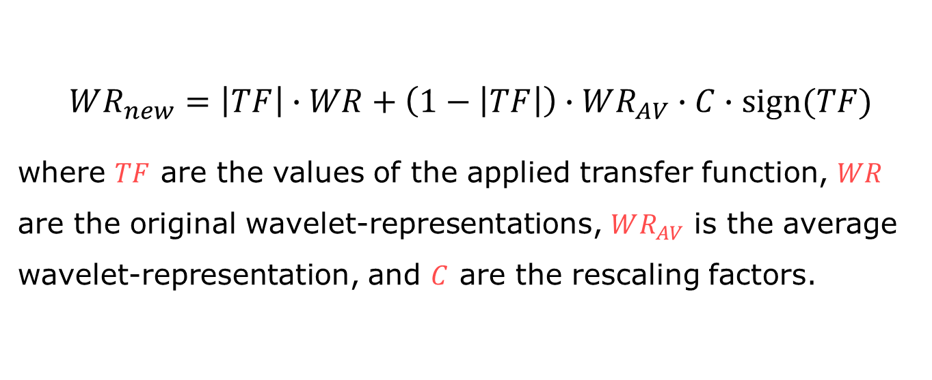
AWESOME: Step 10 – Calculating De-Noised Wavelet-Representations
$$WR_{new}=\left|TF\right|∙WR+\left(1−\left|TF\right|\right)∙WR_{AV}∙C∙sign(TF)$$
where $TF$ are the values of the applied transfer function, $WR$ are the original wavelet-representations, $WR_{AV}$ is the average wavelet-representation, and $C$ are the rescaling factors.

Slide 34
AWESOME: Step 10 – Calculating De-Noised Wavelet-Representations
Wavelet-representations of all images from the series are de-noised via AWESOME pipeline
Using unique transfer function values and rescaling factors for each image’s wavelet-representation in the pipeline

Slide 35
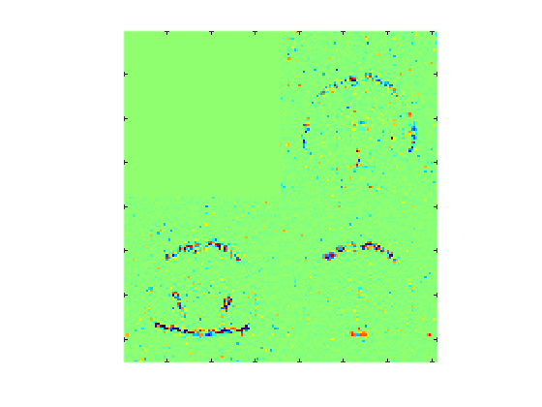
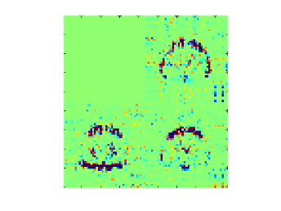
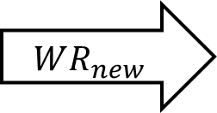
AWESOME: Step 10 – Calculating De-Noised Wavelet-Representations
Original
De-noised
Real wavelet coefficients
Real wavelet coefficients
Level 3-5
Level 3-5
$$WR_{new}$$

Slide 36
AWESOME: Step 11 – Wavelet Reconstruction and Post-Processing
Wavelet Reconstruction of de-noised wavelet-representations for each image
Optional: Reverse phase correction

Slide 37
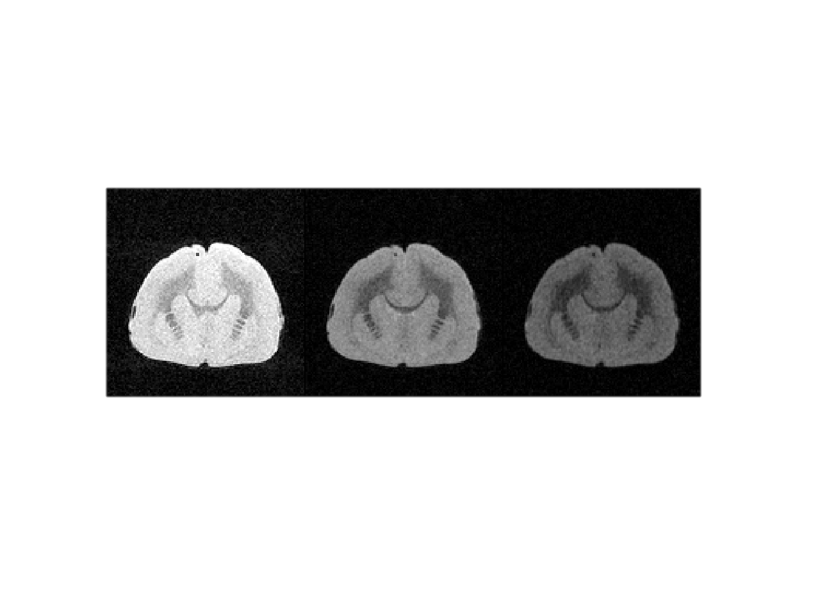

AWESOME: Step 11 – Wavelet Reconstruction and Post-Processing
Magnitude
Original
AWESOME

Slide 38
AWESOME: Optional Modifications
Modifications to the transfer function and/or the scaling factor calculation can be helpful if false positive classifications of noise as meaningful data occurs in the wavelet-representations
Misclassification is caused, e.g., by spurious signals due to insufficient spoiling
Spurious signals lead to partial correlation of noise → phase coherence similar to meaningful data

Slide 39
AWESOME: Optional Modifications
Phase coherence can be observed in the phase images of the original data
Non-Gaussian Noise
(e.g. patterned
phase distribution)
Gaussian Noise
(e.g. random phase
distribution)

Slide 40
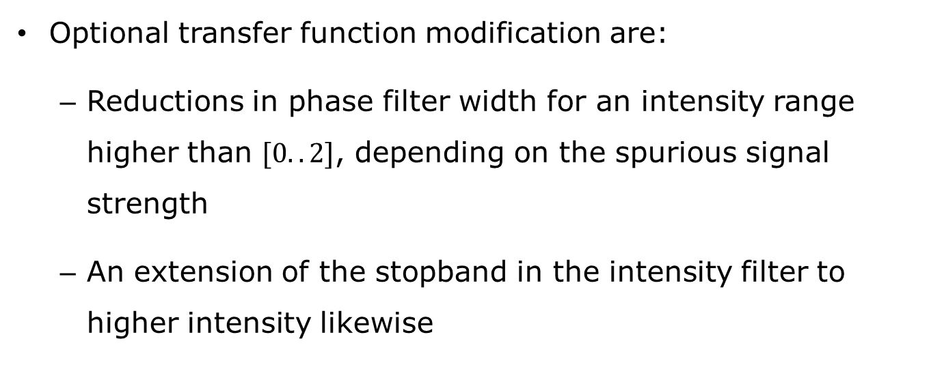
AWESOME: Optional Modifications
Optional transfer function modification are:
  Reductions in phase filter width for an intensity range higher than $[0..2]$, depending on the spurious signal strength
  An extension of the stopband in the intensity filter to higher intensity likewise

Slide 41
AWESOME: Optional Modifications
Broader phase filter widths above observed noisy coefficient intensities are optionally allowed
Phase coherence based risk of false positive classifications vanishes due to intensity limit of noise
Example „modified“ 2D Transfer Function; narrow phase filter for intensities <7

Slide 42
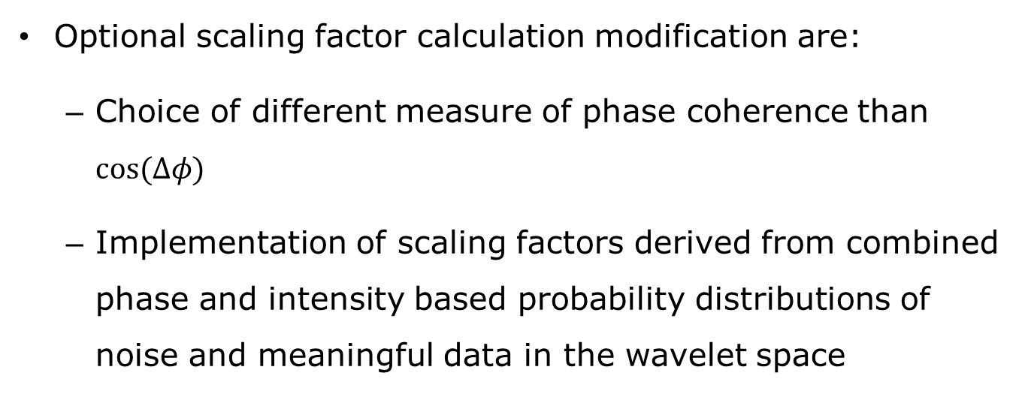
AWESOME: Optional Modifications
Optional scaling factor calculation modification are:
  Choice of different measure of phase coherence than $cos⁡(Δφ)$
  Implementation of scaling factors derived from combined phase and intensity based probability distributions of noise and meaningful data in the wavelet space

Slide 43
AWESOME: Results qMTI
Experiment:
1 post-mortem marmoset brain
3T (MedSpec 30/100, Bruker, Ettlingen, Germany)
(0.2mm)³ isotropic resolution
Signal reception with CP transceiver coil ^{[6]}
[6] R. Müller, Proc. ISMRM 21:4366, 2013.

Slide 44
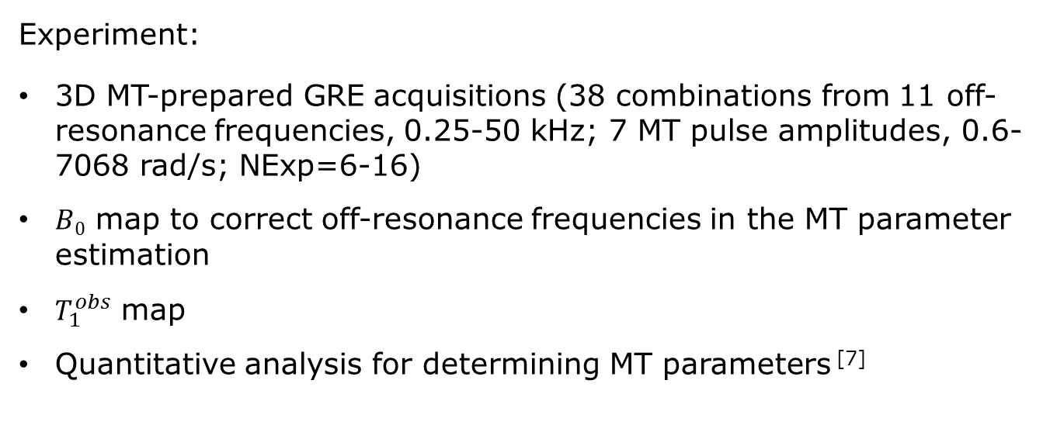
AWESOME: Results qMTI
Experiment:
3D MT-prepared GRE acquisitions (38 combinations from 11 off-resonance frequencies, 0.25-50 kHz; 7 MT pulse amplitudes, 0.6-7068 rad/s; NExp=6-16)
$B0$ map to correct off-resonance frequencies in the MT parameter estimation
$T_{1}^{obs}$ map
Quantitative analysis for determining MT parameters ^{[7]}
[7] D.K. Müller, A. Pampel, H.E. Möller. J. Magn. Reson. 230: 88 (2013).

Slide 45
AWESOME: Results qMTI
Results are shown for the presented pipeline of AWESOME
Results from measurements that were repeated up to 16x for classical averaging are used as reference
Additional results are shown for a modified AWESOME pipeline with above introduced modification of the transfer function
AWESOME modified
using reference as optimum

Slide 46
AWESOME: Results qMTI
Non-Gaussian noise in the application example is observed for images of high signal intensity
Gaussian noise is observed for images of low signal intensity
Non-Gaussian Noise
(e.g. patterned
phase distribution)
Gaussian Noise
(e.g. random phase
distribution)
Phase maps of example images

Slide 47
AWESOME: Results qMTI
Comparison of Magnitude Images
Shown images are 3 examples of
a series of 38 different images
For better visual comparison a
gray scale representation is shown

Slide 48


AWESOME: Results qMTI
Original
AWESOME
Averaged, Nexp=
AWESOME, modified
6x
6x
9x

Slide 49
AWESOME: Results qMTI
Original
AWESOME
Averaged, Nexp=
AWESOME, modified
6x
6x
9x
De-noising without noticeable blurring
Preservation of unique contrast and intensity features for different images

Slide 50
AWESOME: Results qMTI
Comparing non-averaged (low SNR, raw), AWESOME (awe) improved, and modified AWESOME (awemod) improved with averaging-via-repetition (high SNR, ref) improved images I_{n} of the series:
Calculating all following values for a mask, covering only brain tissue

Slide 51
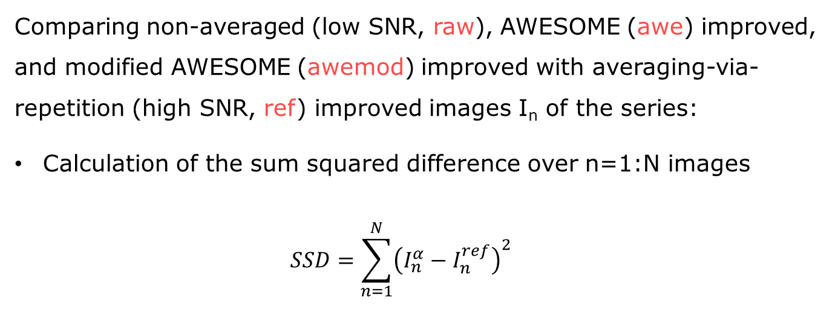
AWESOME: Results qMTI
Comparing non-averaged (low SNR, raw), AWESOME (awe) improved, and modified AWESOME (awemod) improved with averaging-via-repetition (high SNR, ref) improved images I_{n} of the series:
Calculation of the sum squared difference over n=1:N images
$SSD=\sum_{n=1}^{N}{{\left(I_{n}^{α}−I_{n}^{ref}\right)}^{2}}$

Slide 52
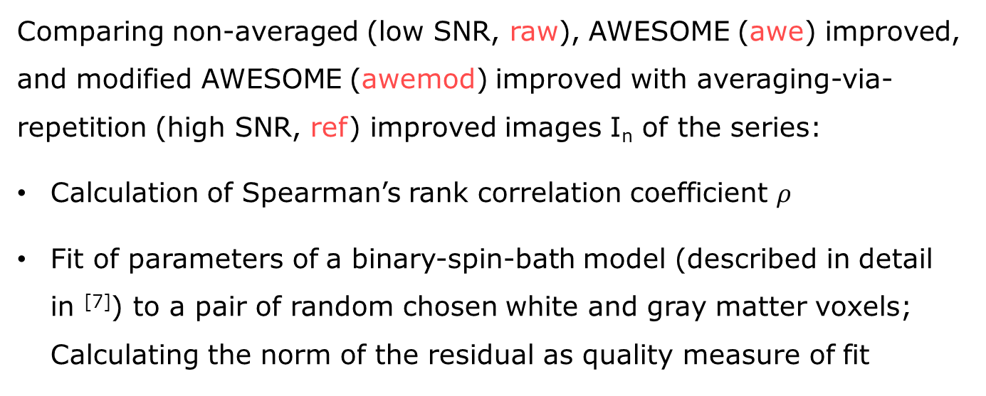
AWESOME: Results qMTI
Comparing non-averaged (low SNR, raw), AWESOME (awe) improved, and modified AWESOME (awemod) improved with averaging-via-repetition (high SNR, ref) improved images I_{n} of the series:
Calculation of Spearman’s rank correlation coefficient $ρ$
Fit of parameters of a binary-spin-bath model (described in detail in ^{[7]}) to a pair of random chosen white and gray matter voxels;
Calculating the norm of the residual as quality measure of fit
[7] D.K. Müller, A. Pampel, H.E. Möller. J. Magn. Reson. 230: 88 (2013).

Slide 53
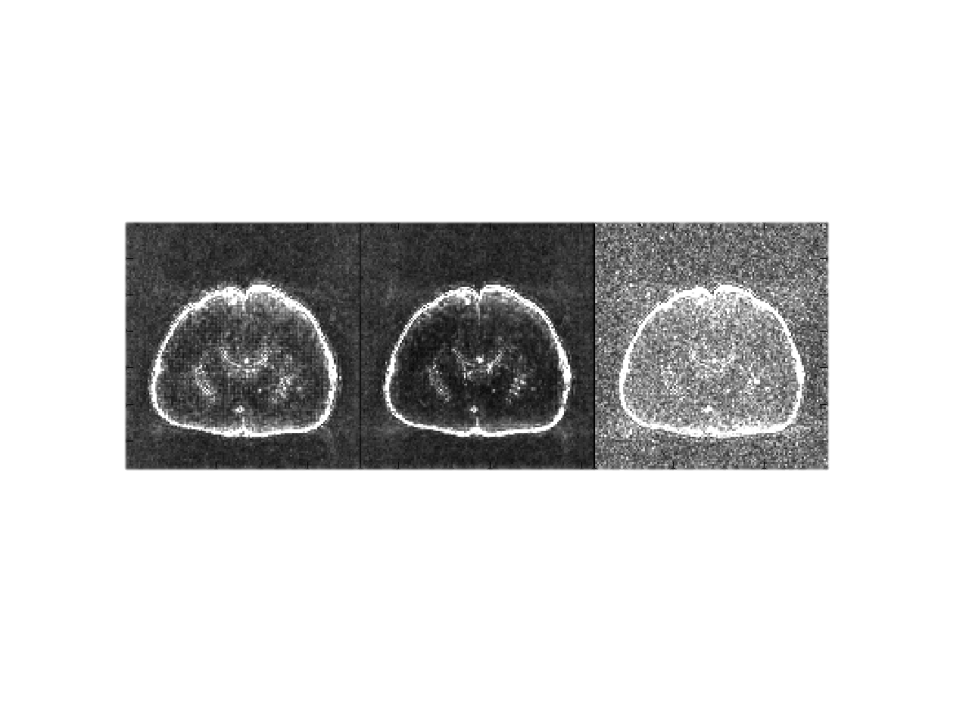
AWESOME: Results qMTI
Sum Squared Difference
A
B
C
Graphic shows SSDs of equal scale for following 3 cases:
A: SSD of unmodified AWESOME (Gaussian noise)
B: SSD of modified AWESOME (non-Gaussian noise)
C: SSD of non-averaged series

Slide 54
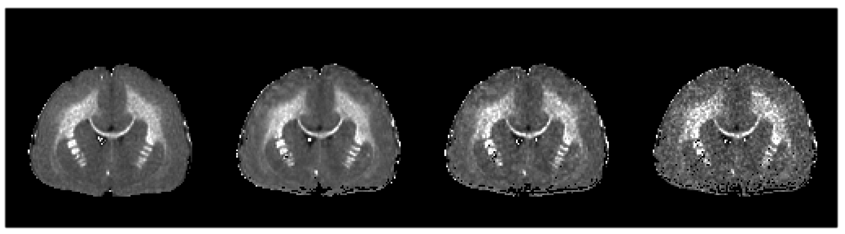
AWESOME: Results qMTI
qMT parameter example – M₀^{b}
relative size of semi-solid pool
A
B
C
D
Graphic shows M₀^{b} for equal scale and the following 4 cases:
A: Reference series
B: Modified AWESOME (non-Gaussian noise)
C: Unmodified AWESOME (Gaussian noise)
D: Non-averaged series

Slide 55
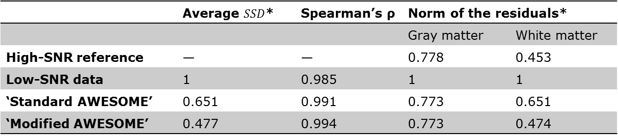
AWESOME: Results qMTI
 | Average $SSD$* | Spearman’s ρ | Norm of the residuals*
 |  |  | Gray matter | White matter
High-SNR reference | — | — | 0.778 | 0.453
Low-SNR data | 1 | 0.985 | 1 | 1
‘Standard AWESOME’ | 0.651 | 0.991 | 0.773 | 0.651
‘Modified AWESOME’ | 0.477 | 0.994 | 0.773 | 0.474
*Values normalized to the result from the low-SNR data without averaging and de-noising

Slide 56
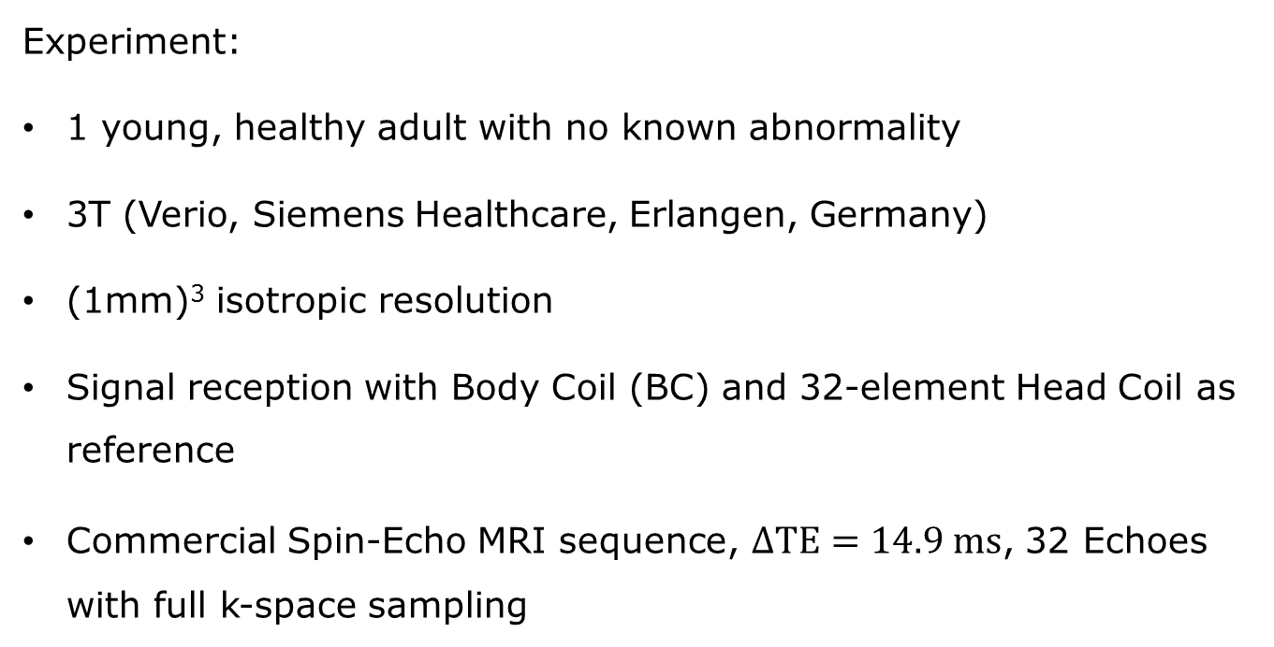
AWESOME: Results T₂
Experiment:
1 young, healthy adult with no known abnormality
3T (Verio, Siemens Healthcare, Erlangen, Germany)
(1mm)³ isotropic resolution
Signal reception with Body Coil (BC) and 32-element Head Coil as reference
Commercial Spin-Echo MRI sequence, $ΔTE=14.9 ms$, 32 Echoes with full k-space sampling

Slide 57
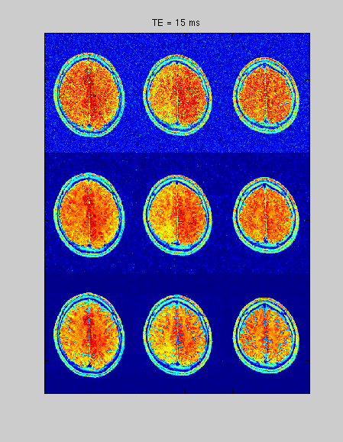
AWESOME: Results T₂
AWESOME for Gaussian noise (no modifications) is applied
Noise reduction is consistent over all echoes
BC
BC-AWESOME
REF

Slide 58
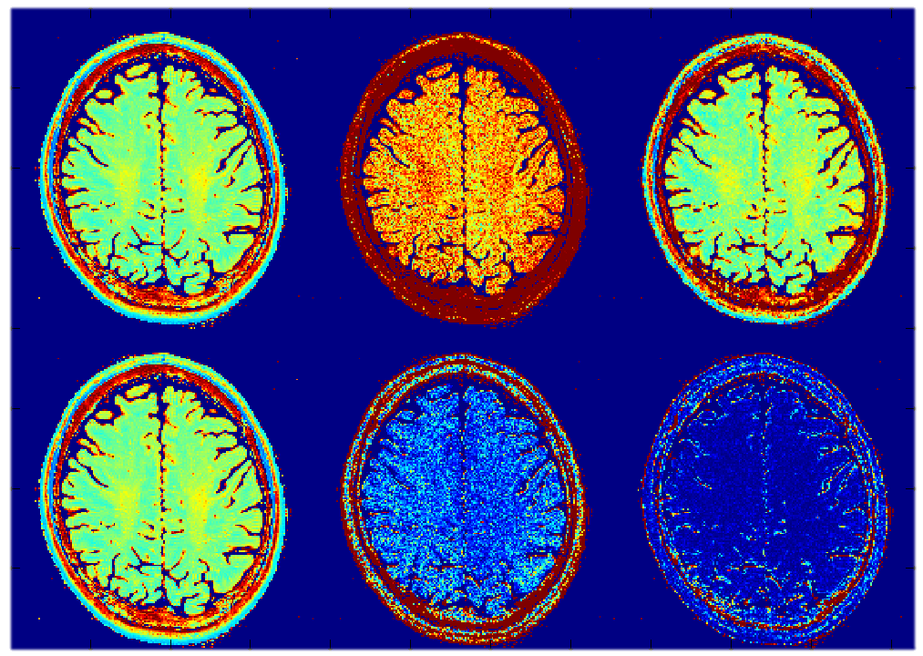




AWESOME: Results T₂
Estimated $T_{2}$ maps are subtracted from Head Coil reference for ${ΔT}_{2}$ maps
Gray scale image, the first echo from the Head Coil
32 Element
Head Coil
Body Coil
Body Coil +
AWESOME
$T_{2}$ maps
ms
$ΔT_{2}$ maps

Slide 59

AWESOME: Results T₂
Fits only
Normalized Signal Intensity
TE / ms
Spin-Echo Decay of a single WM voxel
32-Ch-Head Coil
Body Coil noise → single exponential fits differ from reference
Body Coil + AWESOME → fits almost identical compared to reference

Slide 60
Conclusion
AWESOME effectively reduces noise, as visible in the reduced SSDs
Main features, that need no improvement, stay untouched by exclusion from averaging via the transfer function
Hidden features are restored via approximation of rescaling factors, as observed in the increased correlation coefficient and improved fit error

Slide 61
Conclusion
AWESOME for Gaussian noise delivers good results also for partially non-Gaussian noise. The presented pipeline can be used as a basis version for application and modification.
Modifications to AWESOME for non-Gaussian noise may be performed individually…

Slide 62
Outlook
AWESOME should be investigated on experiments of repetitive imaging:
qMTI and CEST (in progress)
fMRI, where imaging of the brain is repetitively performed
Other experiment, in which image data are repetitively recorded as a function of time, e.g., in perfusion imaging with ASL or DSC techniques, blood volume mapping by VASO, …

Slide 63
Thank you
for your interest!
Acknowledgements:
Funded by the Helmholtz Alliance ICEMED—Imaging and Curing Environmental Metabolic Diseases.

