Slide 1

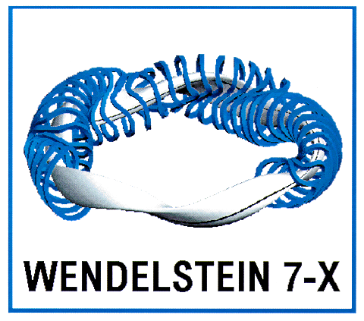
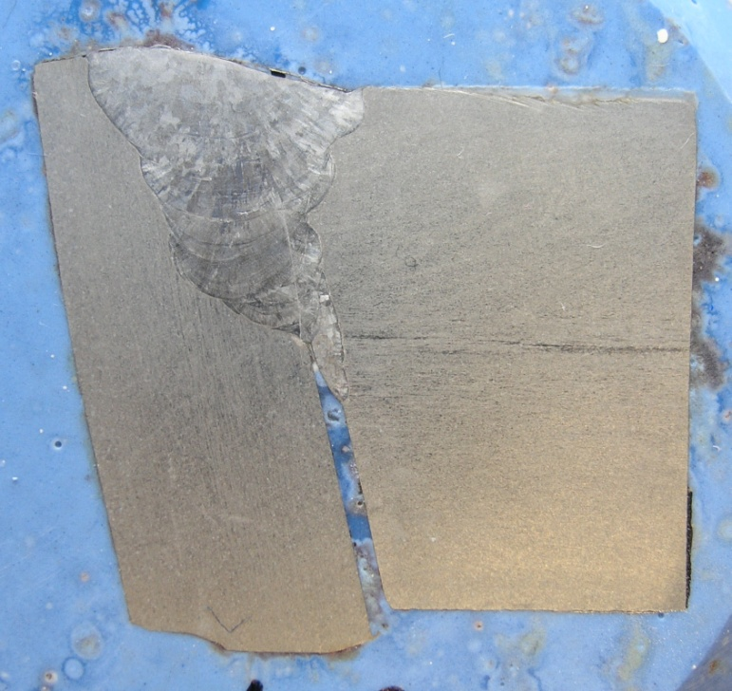
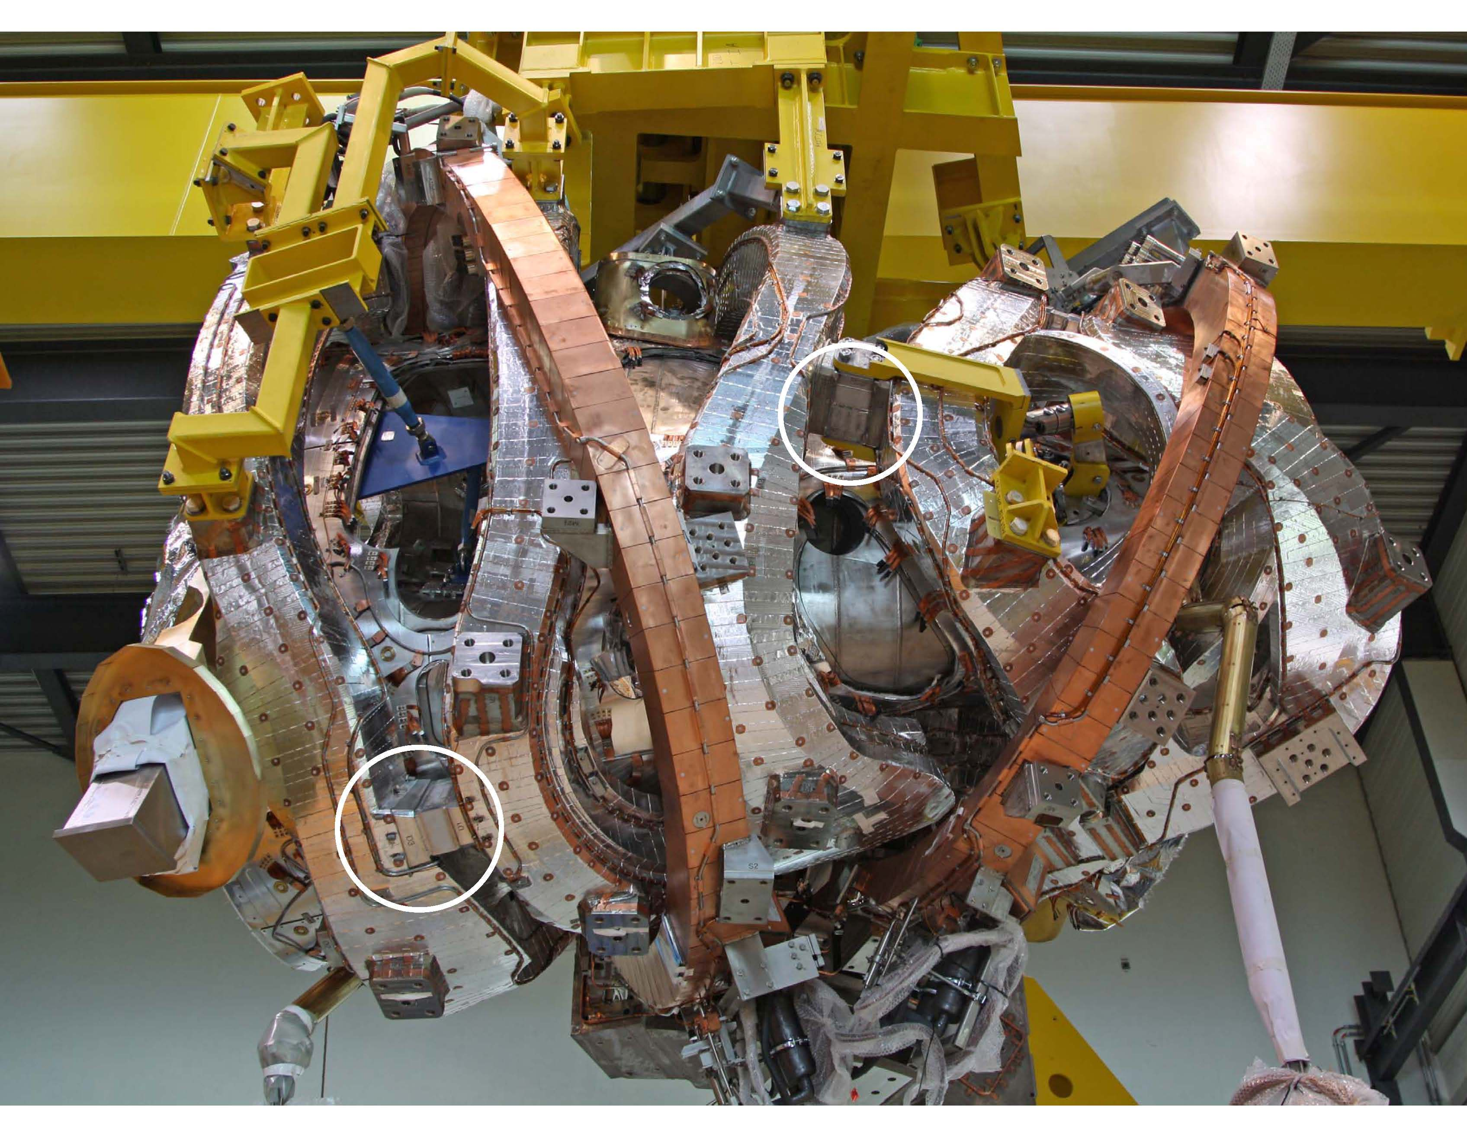
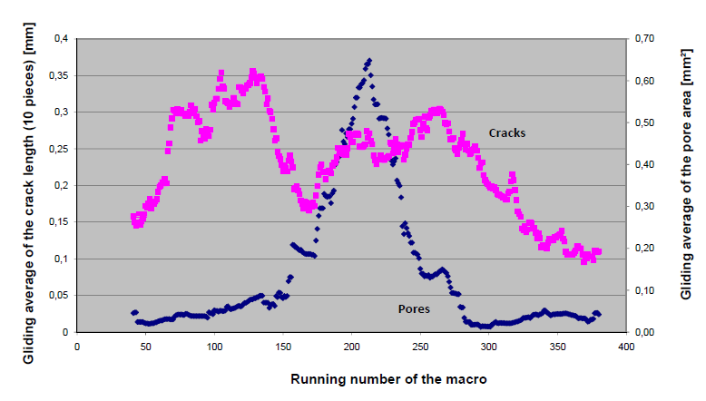
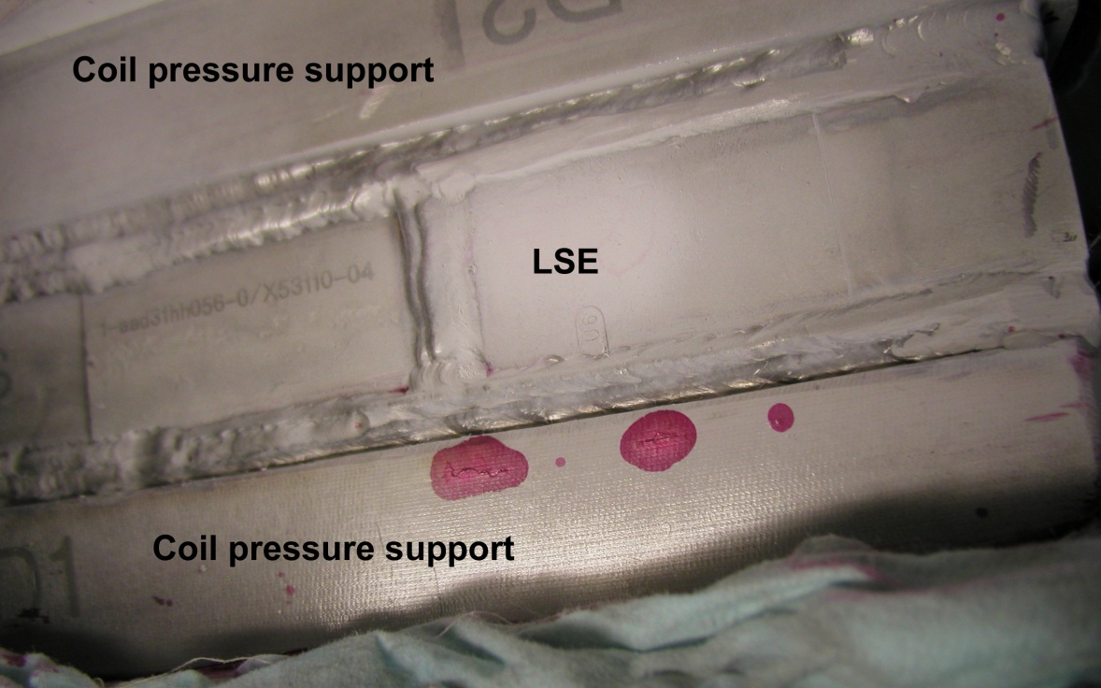
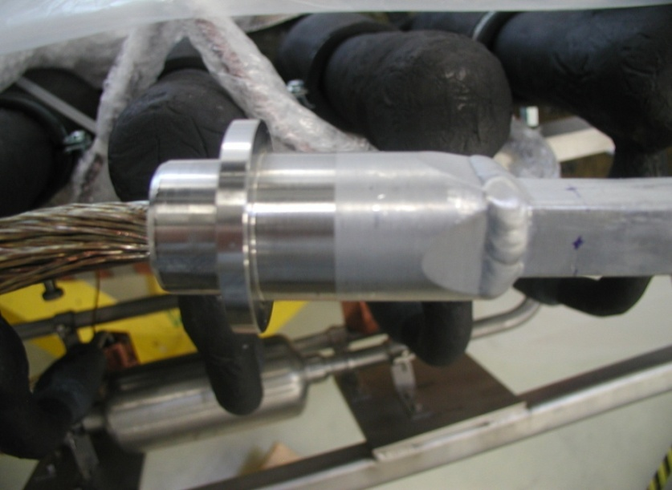
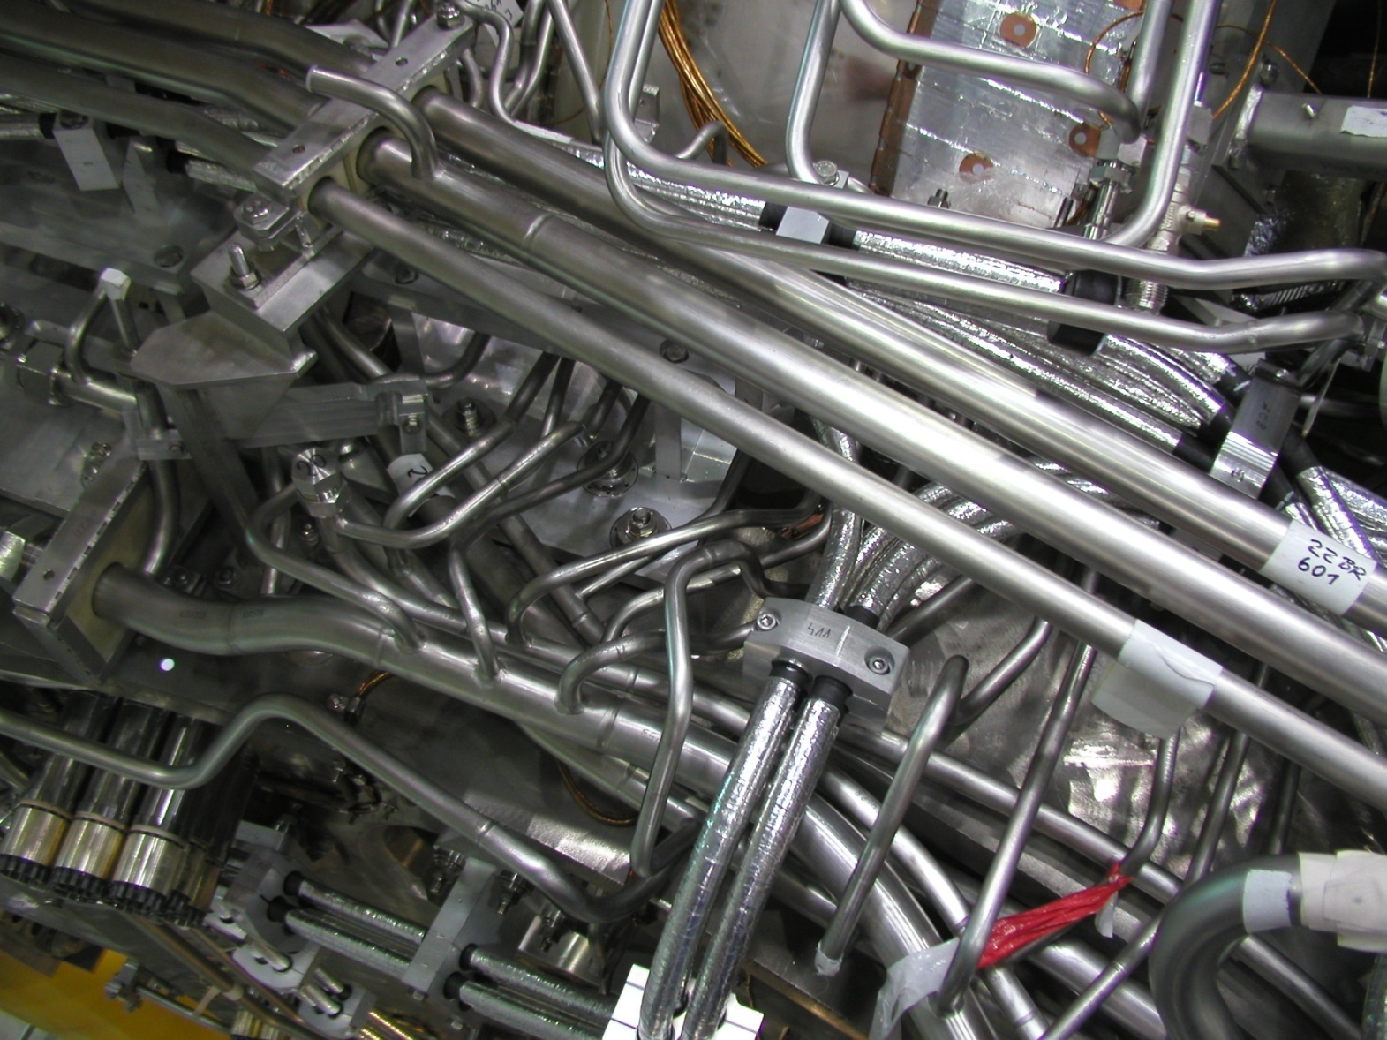
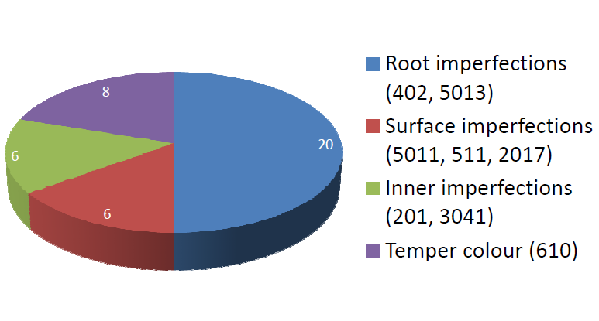
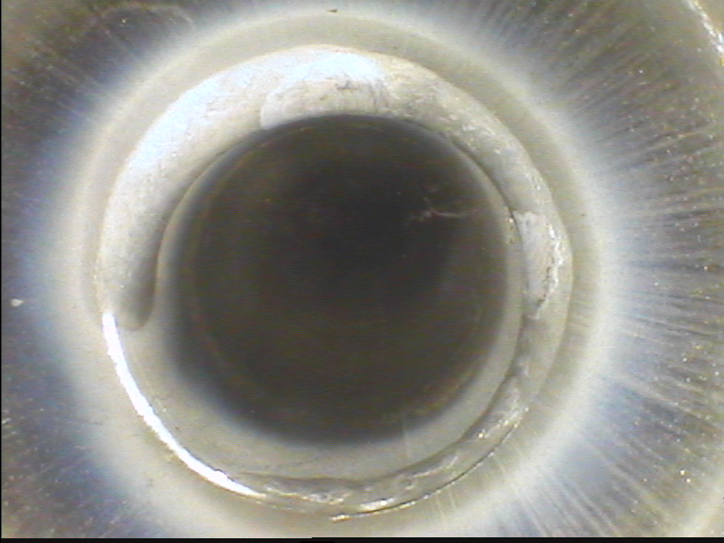
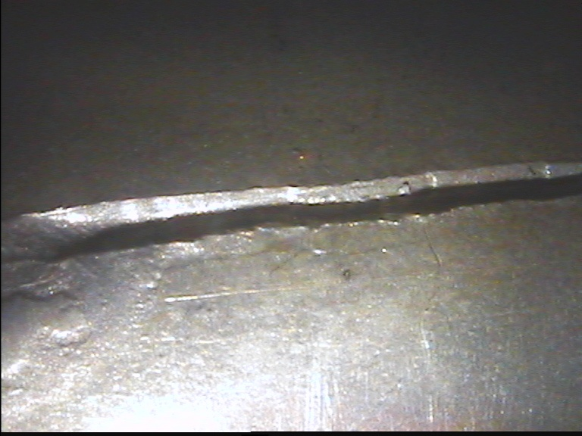
P3.68
Max-Planck-Institut für Plasmaphysik, EURATOM Association
Quality assurance of welding work during the assembly of Wendelstein 7-X
M. Schröder, W7-X Team
Abstract
Welding is one of the most important processes during the assembly of Wendelstein 7-X. Many weld seams are essential for the functionality of the experiment. The different weld testing methods assure the weld quality and are similarly the base for the detection and correction of defects. The main test methods are visual testing (VT), penetrant testing (PT), radiographic testing (RT), ultrasonic testing (UT), leak testing (LT), permeability testing and macros. For the application of the different test methods a test-appropriate design is necessary. The use of the different test methods requires trained and experienced staff, suitable test equipments, and well proven test instructions. (➔ see P3-66)
Cryostat welds
The cryostat consists of the plasma vessel, the outer vessel with domes and the ports. All components are welded with each other by TIG. The material of all components is 1.4429. The rules and standards for the manufacture and tests are AD2000. (➔ see P3-67)
Plasma Vessel (PV) and Outer Vessel (OV)
Wall thickness 17mm (PV), 25 mm (OV)
              Full penetrated welds
Tests: VT (100%, all passes), PT (100%, root and final pass), RT (100%, if accessible), UT (100%, if accessible), LT (100%), permeability testing (10%)
Removing of the penetrant residue is possible and necessary
UT with DAC method by an expert inspector of MAN for austenitic welds
Dome – Outer Vessel welds
Domes which are located in the separation plane between lower and upper shell have to be welded during assembly
Not full penetrated welds
Tests: VT (100%, all passes), PT (100%, final pass), UT (if accessible, limited significance), permeability testing
Port - Plasma Vessel welds
HU-weld (not full penetrated)
Tests: VT (100%, all passes),
PT (final pass),
permeability testing
No PT of the root because
of not removable penetrant
residue
Port
PV
Macro of a HU-weld
Welds in the magnet system
Al-welds on the superconductor
Superconductors with Al-jacket are connected by joints composed of stainless steel (SS)
From 382 transition pieces (Al-SS) are welded 284 pieces
Tests: VT, LT, macros
One working proof sample was tested before every welding on a coil
Observation of changes of the weld quality by gliding averages of the crack lengths and amount of pores
Main problem:
micro hot cracks
Lateral Support Elements (LSE)
Welded connection of the non-planar coils
              Weld seam between 1.3960 (coil casing) and 1.4429 (LSE)
              MAG welding process (few heat, low weld distortion)
              Typical casting defects can open by the heat influence of the welding
              Tests: VT (100%, all passes), PT (100%, final pass)
              Evaluation: limits of crack lengths on the base of calculations
              Results: all 50 LSE welded;
              most imperfections resulted
              from indications of the
              casting; with PT 2.5 times
              more indications were
              found than with VT
PT indications in the HAZ 1.3960 after LSE welding
Configuration of LSE in the coil system
Welded transition piece
History of the quality, crack length and pores in Al-welds
Pipe welds
Cryo-pipes for the coil system (conductor cooling, cooling of coil casings, the central support structure and the panels of the thermal insulation)
              Water pipes for cooling and bake out of the PV and the ports and for the cooling of the components in the PV
Assembly and test conditions
Dimension Ø9x1 to Ø42x3 mm
Complicated 3D geometry
Hardly accessible and hardly repairable in later operation
Single pass TIG or TIG orbital
Forming gas: Ar-H₂ mixture
Weld imperfections and tests
Mostly root and outer surface imperfections
Only few and small inner imperfections like pores or tungsten inclusions
Temper colours (risk of corrosion)
Tests (independently of handmade or orbital weld): VT (100% outside and inside by videoscope), RT (if videoscopy is impossible), LT (100%)
Test results (first 3 modules)
1278 weld seams - 99% orbital welded
40% inner VT by videoscope
Reduction of the repair ratio from 4.3% to 2.6%
Assembly conditions of the cryo-pipes
Videoscopy of an orbital weld with front and side view
40 Imperfections found in cryo-pipe welds
26th SOFT, 27 September – 01 October, Porto, Portugal

