Slide 1

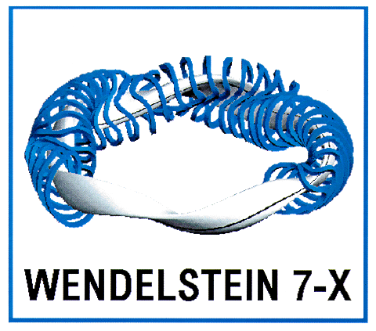
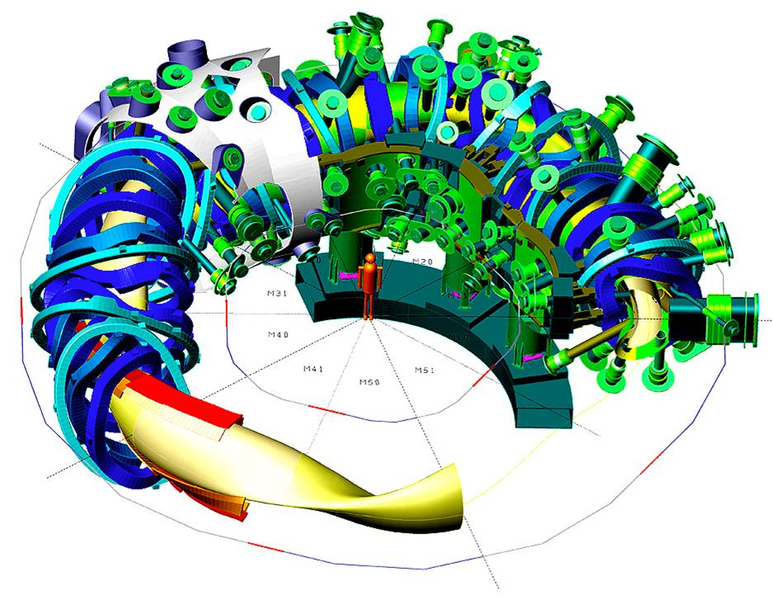
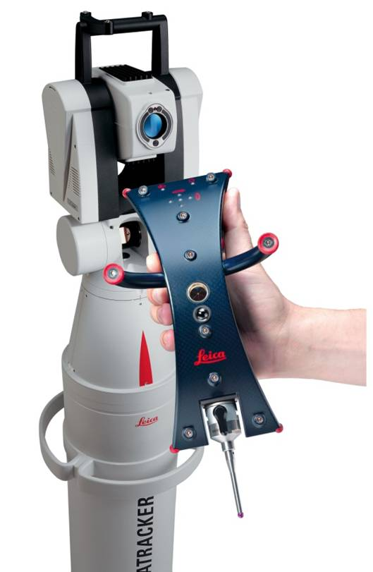
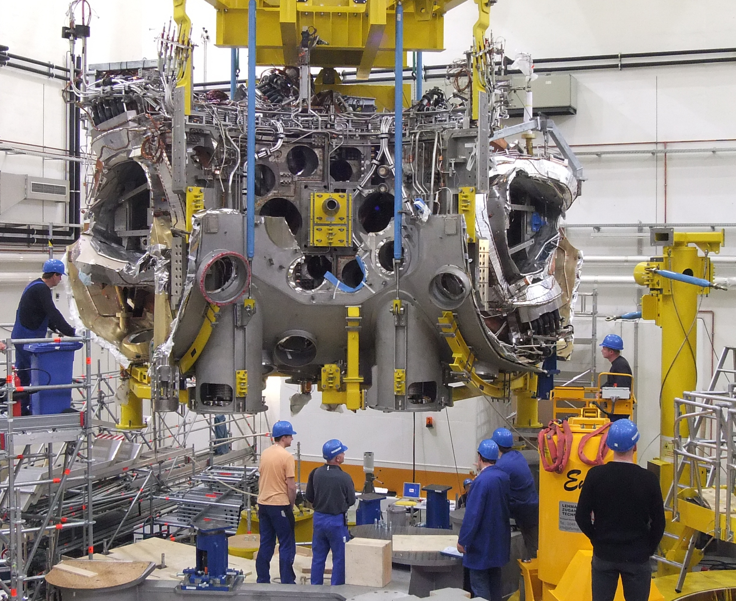
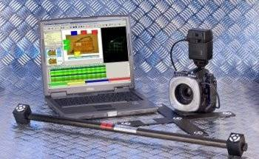
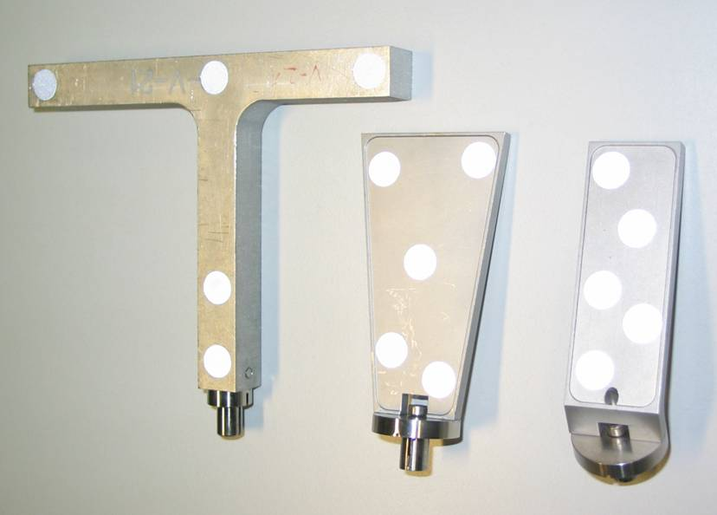
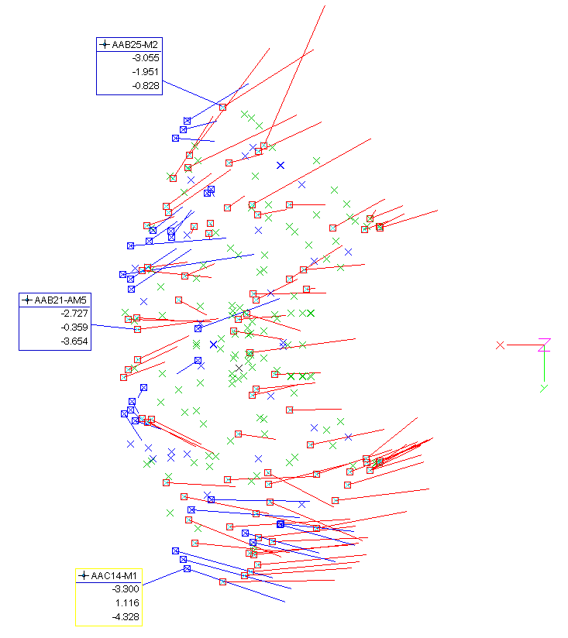
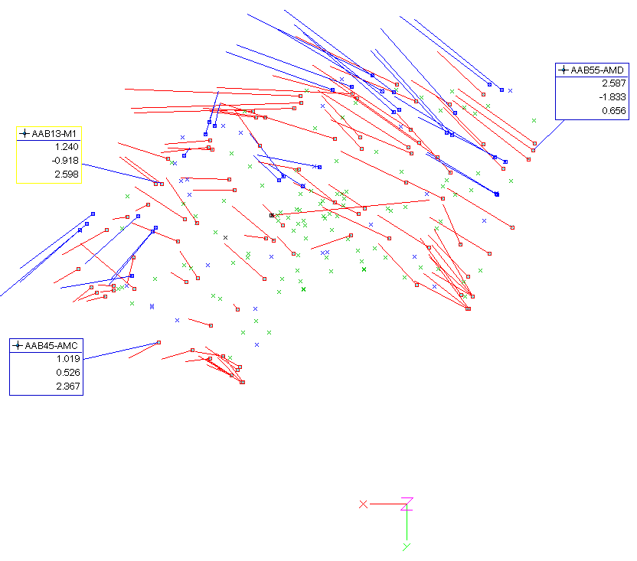
Max-Planck-Institut für Plasmaphysik, EURATOM Association
Alignment of the first two magnet system
modules of Wendelstein 7-X
T. Bräuer, T. Andreeva, M. Endler
torsten.braeuer@ipp.mpg.de
Present status of Wendelstein 7-X assembly
4 (out of 5) magnet system modules of Wendelstein 7-X are completed
5th magnet system module is under construction
Two of the ready assembled modules are preliminarily positioned on machine base
Total assembly tolerance up to module adjustment is r < 4.2 mm
To optimize the quality of the magnet field the magnet modules get new optimized positions and orientations for last adjustment step
For module adjustment the required tolerance is r < 1.5 mm
Optimization of magnet field
After completion of each magnet system module a geometry check is performed
Calculation of the resulting magnetic field and its errors using the actual geometry data of completed modules or nominal data of modules under assembly
Optimization of the magnetic field quality by variation of module position and orientation
Maximum displacements for optimization (in any point of the module) is r < 5 mm
Main Measurement systems for component adjustment
Laser-Tracker with T-Probe:
  practical accuracy in torus hall, including using of adapters and system orientation into torus hall co-ordinate system < 0.8 mm
Photogrammetry system AICON 3D Studio:
  practical accuracy in the volume of ≈ 10 x 5 x 5 m of the assembly stand, including using of adapters (without global orientation): < 0.3 mm
Schematic view of the Wendelstein 7-X experiment
M1 in MST IV
M5 in MST IV
Module #1
Conclusion
At machine base adjustment of magnet system modules can be done inside r < 1.5 mm in comparison to optimized co-ordinates
Maximum deviation of single ref.-points of coils can be kept below r < 6.2 mm in comparison to design co-ordinates
For optimization of magnetic field, magnet system modules are shifted and rotated at maximum by 3 mm and 0.3 mm / m respectively
Number of accessible original ref.-points decreases dramatically down to 2 points per coil. A second order target point system is necessary
For an efficient adjustment procedure auxiliary measurement points are used very close to the adjustment elements. Target co-ordinates of these points are calculated by a best-fit transformation of the actual to the reference position of the main ref.-points. In this way the number of iterations to reach the final position of the modules could be kept low, generally 2 ... 4 times
Module #5
Comp to Design
Comp to Optimization
Comp to Optimization,
second order Survey
26th SOFT, Porto, 27.9.-01.10.2010

