Slide 1

Prateek Mahalwar
Bio-Medical Section representative, PhDnet

Slide 2
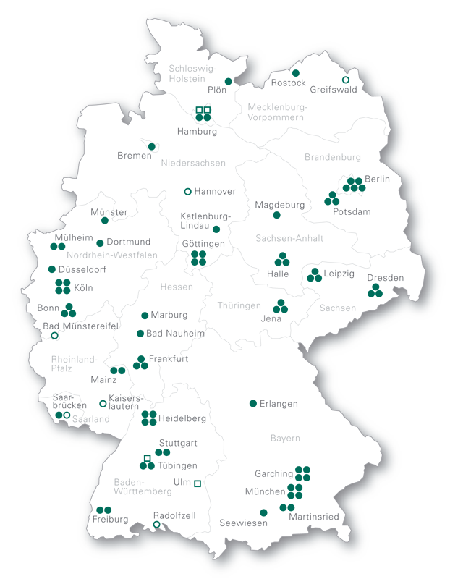
Representation in the MPS
PhDnet
  PhDnet organization
    Local representation
PhD candidates at each MPI
elect PhD representatives
  represents towards directors
  represents within the PhDnet
organize local events, seminars meetings, activities

Slide 3
PhDnet structure
PhDnet
  PhDnet organization
    Organigramm
6000+
PhD candidates
All PhD candidates
within the MPS and IMPRS
Working groups
Communication:
  survey (and other small surveys)
  Direct contact with local representatives
  Annual meeting
  Conferences
  Newsletter, webpage, maxNet etc
Annual meeting
PhD representatives
Communication
& strategy
Secretary
Fi
Secretary general
HS
Survey
Financial Officer
Event
BMS
SP
CPTS
Seminars
Web
General
meeting
Offspring

Slide 4
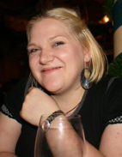
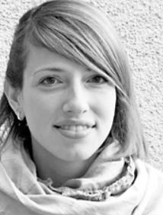
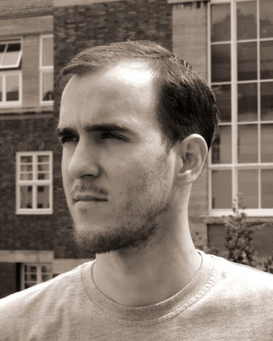
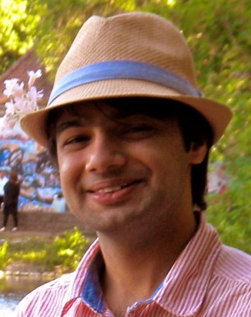
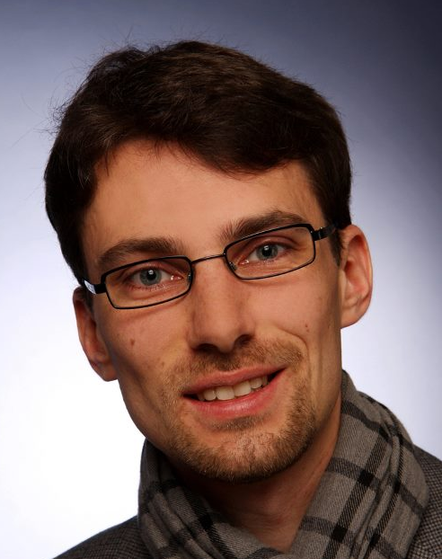
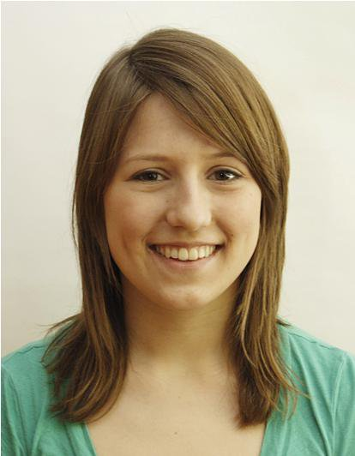
PhDnet steering group 2014
PhDnet
  PhDnet organization
    Steering group 2014
PhDnet spokesperson:
Andreea Scacioc, MPI f. Biophysical Chemistry, Göttingen
Section Representative Humanities:
Ana Carolina Alfinito Vieira, MPI f .the study of societies, Cologne
Section Representative Chemistry, Physics and Technology:
Clemens Buss, MPI f. dynamics and self-organization, Göttingen
Section Representative Biology and Medicine:
Prateek Mahalwar, MPI f. developmental biology, Tübingen
Financial Officer:
Jan Grieb, MPI f. extraterrestrial physics, Garching
General Secretary:
Friederike Wrobel, MPI f. solid state research, Stuttgart

Slide 5





PhDnet steering group 2015
PhDnet
  PhDnet organization
    Steering group 2015
Spokesperson HS BMS CPTS Gen. Secretary Financial Off.
Spokesperson
Prateek Mahalwar (MPI for Developmental Biology, Tübingen)
BMS representative
Xixi Feng (MPI for Psychiatry, München)
CPT representative
Adrin Jalali (MPI for Informatics, Saarbrücken)
HUM representative
Martin Grund (MPI for Human Cognitive and Brain Sciences, Leipzig)
Financial Officer
Roman Prinz (MPI for Human Development, Berlin)
General Secretary
Sven Weyer (MPI for Evolutionary Anthropology, Leipzig)

Slide 6
PhDnet activities
PhDnet: information dissemination
  Goals for 2014
Visions in Science
Offspring magazine
Open Science
Good practice examples collection
  Parents in Science
  Supervision
  Interviews with Lindau conference participant; youngest PhD candidate etc
  Activities
Information dissemination

Slide 7
PhDnet goals
PhDnet
  Goals for 2014
MPS guidelines for doctoral education and supervision – input in the presidential commission
How do we do science?
  Culture of Science
  Work place atmosphere
  Open Access etc.

Slide 8
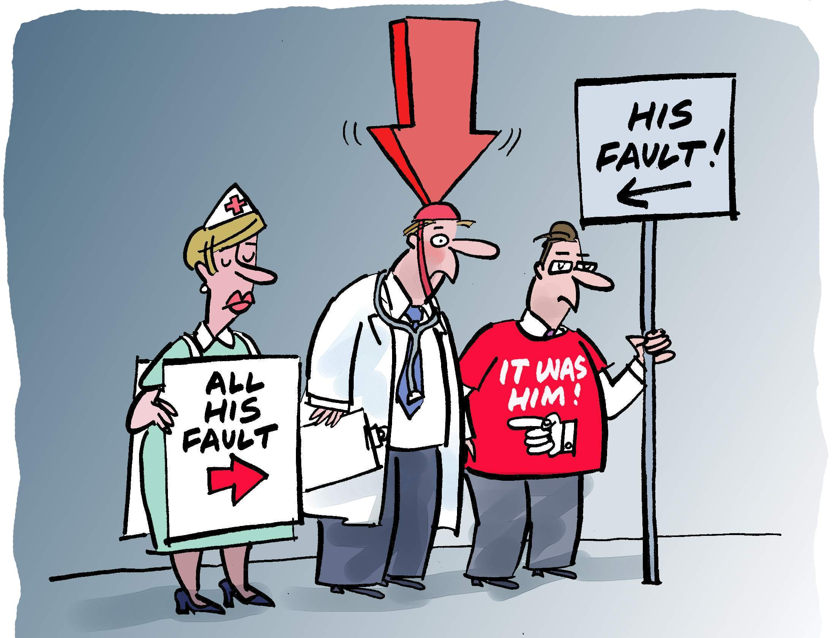
Reproducibility of the data

Slide 9
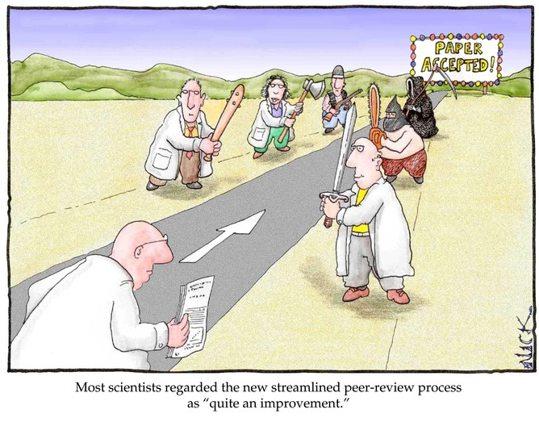
Peer review process

Slide 10


Slide 11
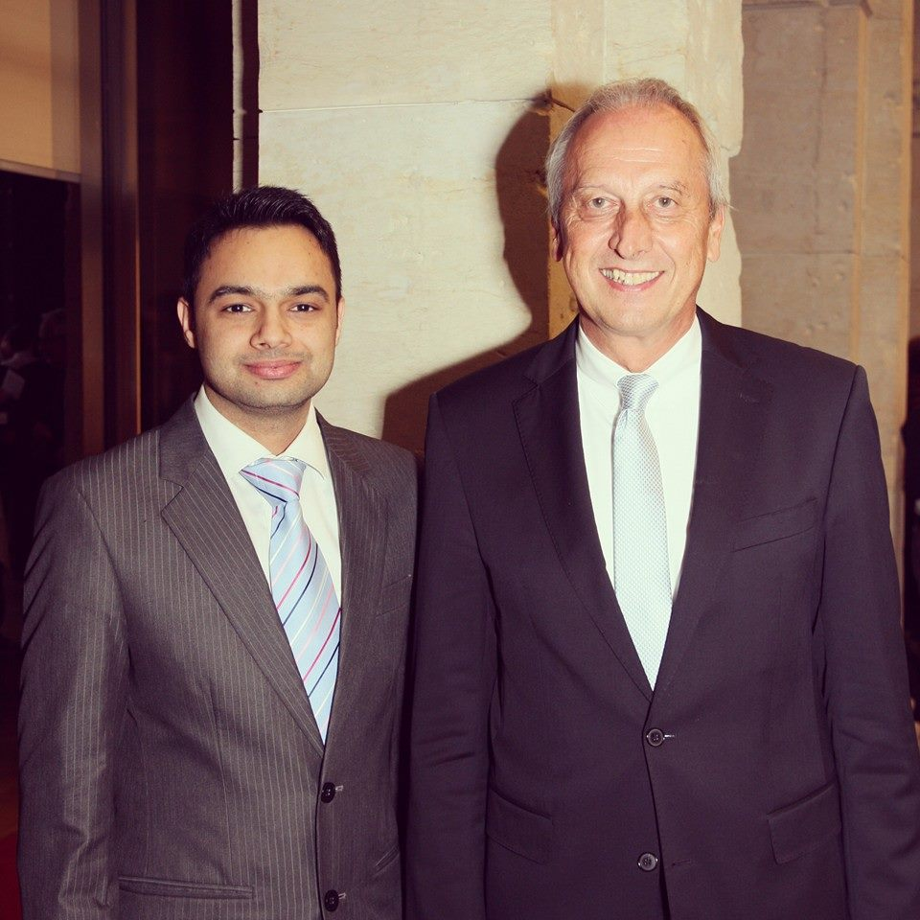
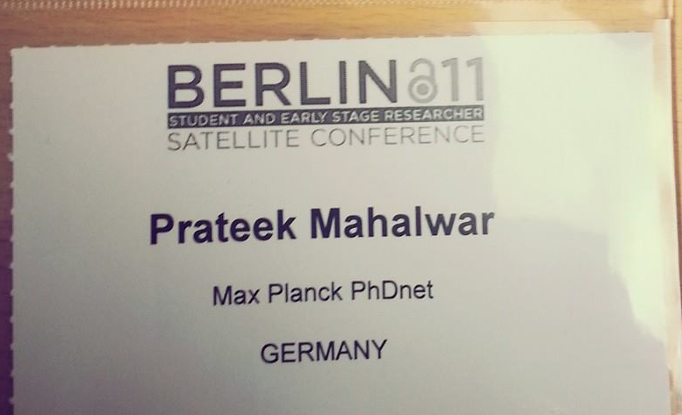
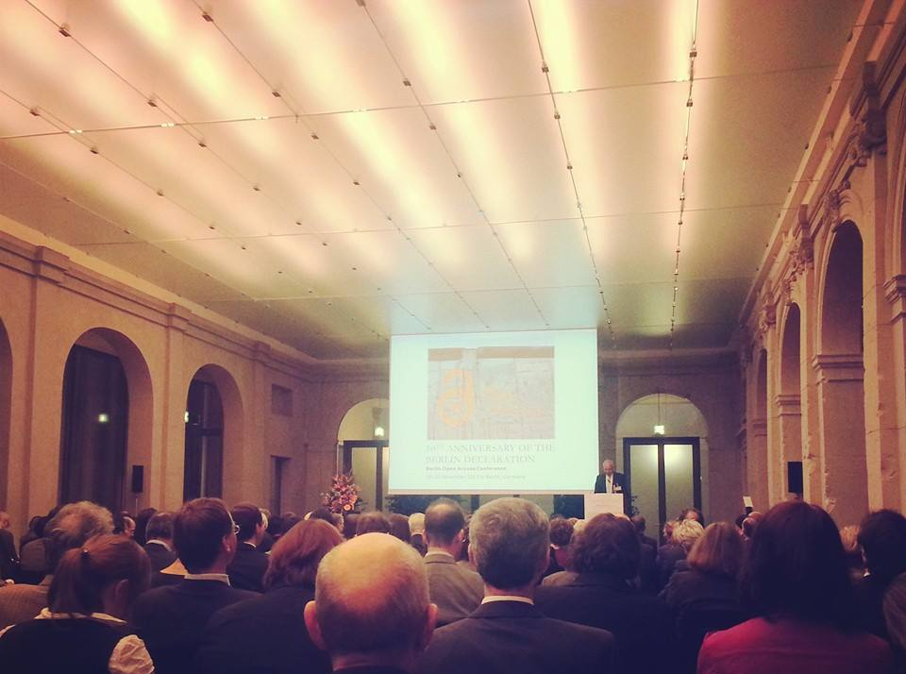
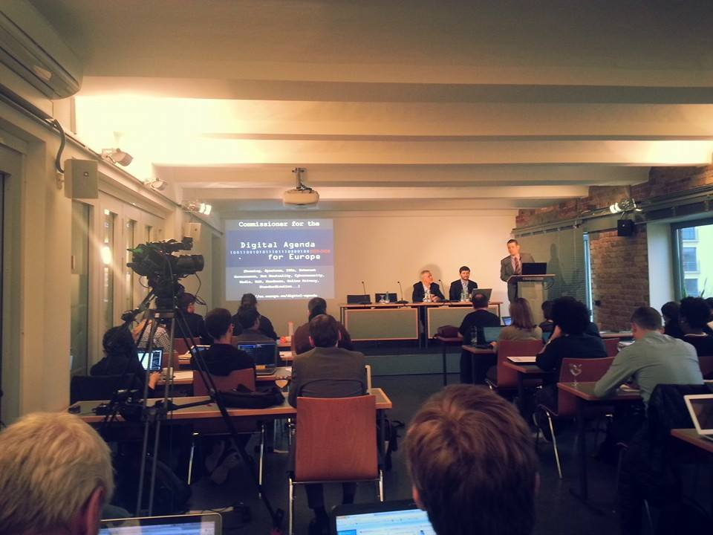

Slide 14


Slide 15
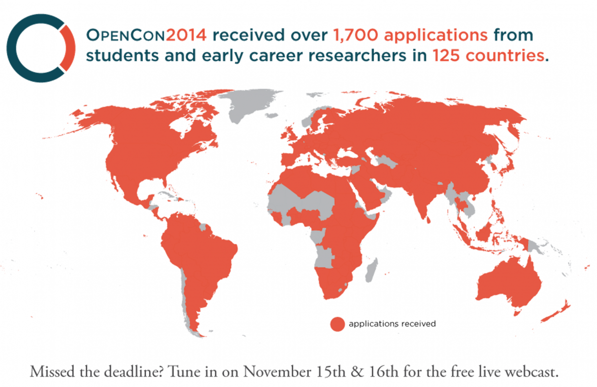

Slide 16
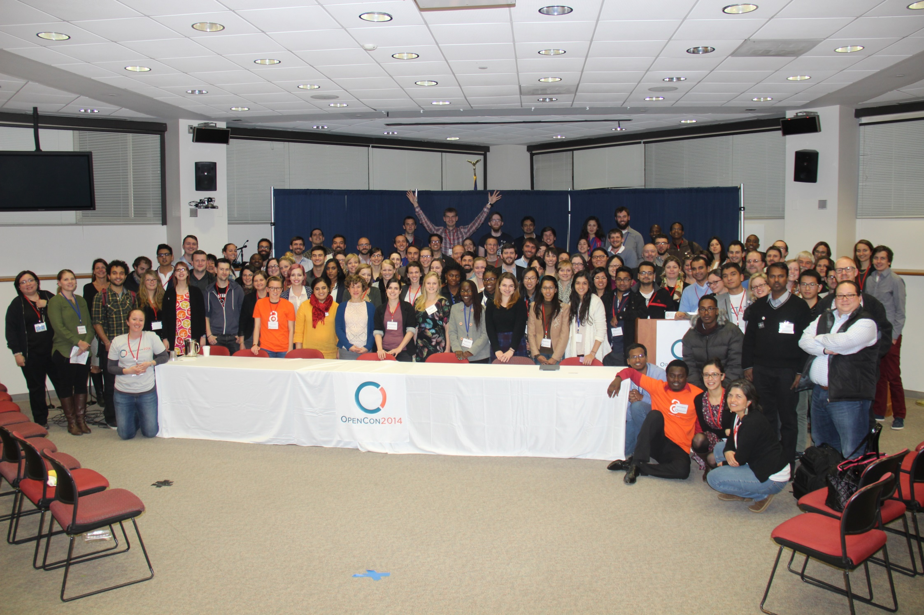

Slide 17
Early-stage researchers are the future of science and could revolutionize the research communication
Thanks !

Slide 18
AIN (author identification number) or SNP ( Scientist No. Plate)
Prateek Mahalwar-89-01
One could instantly track all publications of a given scientist (including those not referenced in pubmed…)
One could get hold of their current email address (and hence ask them directly for reprints of their papers)
Citation indexes could take auto citations into account
Various indexes could be devised that would very advantageously replace the Impact factor :-)

