Slide 1
DORA the reformer – prospects for new approaches to research assessment
OA Ambassadors Conference, November, 2014
Mark Patterson, Executive Director, eLife

Slide 2

Disclaimer – this is not about…
http://fantheories.wikia.com/wiki/File:Dora-the-explorer-logo1.jpg
CC BY-SA

Slide 3
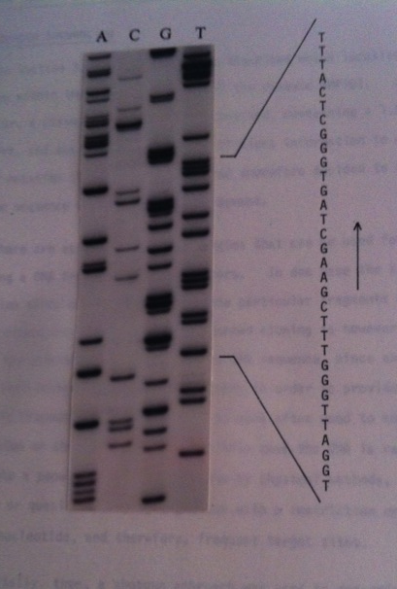
Genomics circa 1985
Sequencing in Manchester
Sequence comparison in London

Slide 4
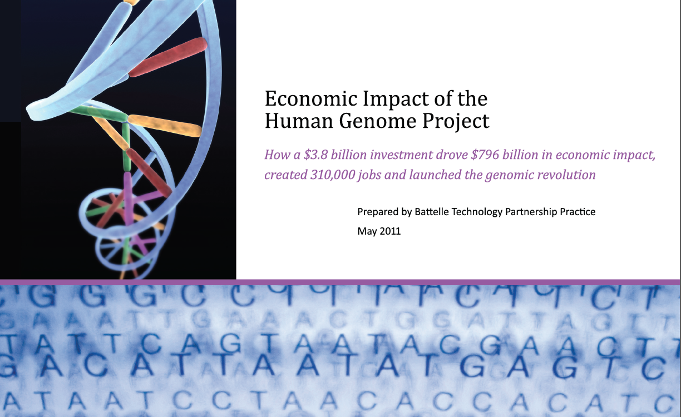

Slide 5

a journal-based metric
proprietary
incomplete
http://www.flickr.com/photos/m2w2/191545978/sizes/z/in/photostream/

Slide 6
Growth of open access publishing
http://oaspa.org/growth-of-fully-oa-journals-using-a-cc-by-license/

Slide 7
%PubMed available as open access in PMC

Slide 8
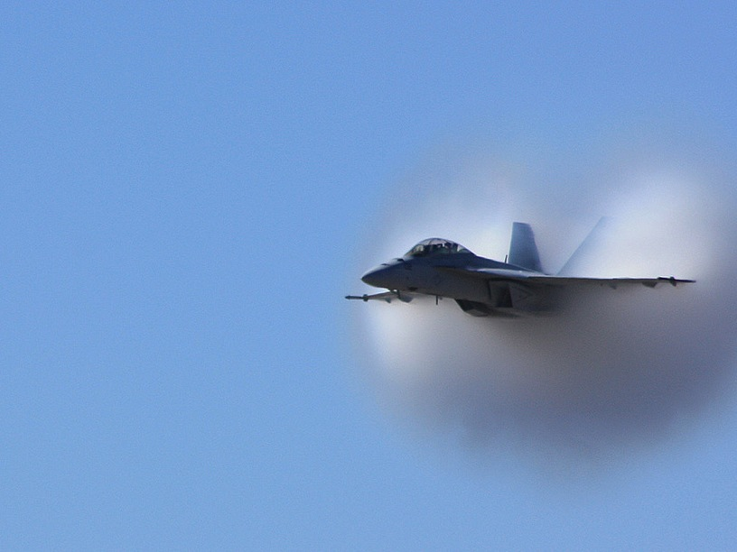
The barrier to overcome is research assessment based on impact factors
a journal-based metric
proprietary
incomplete
https://flic.kr/p/8umuyU
http://www.flickr.com/photos/m2w2/191545978/sizes/z/in/photostream/
CC BY-NC-ND

Slide 9






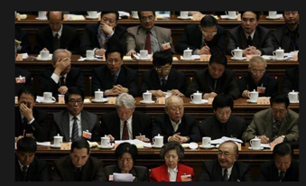


Research assessment
Researchers (authors and readers)
Institutions
Librarians
Funders
The public
Policy makers
Publishers

Slide 10
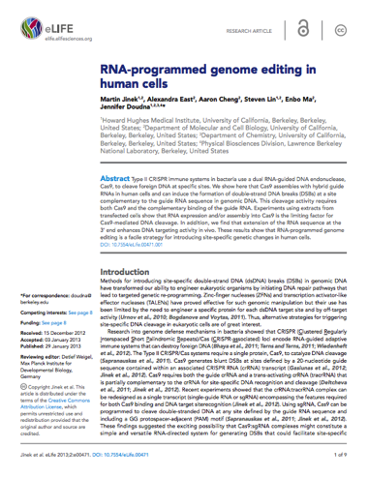
What
journal?
What impact factor?

Slide 11
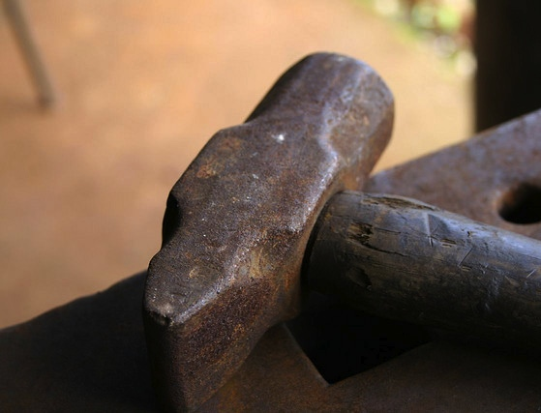
The impact
factor is…
http://www.flickr.com/photos/m2w2/191545978/sizes/z/in/photostream/

Slide 12
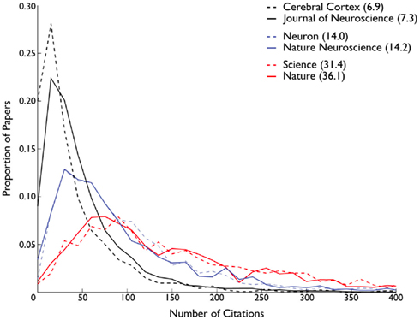
Problem 1 – the skewed distribution
Front. Comput. Neurosci., 05 December 2011 | doi: 10.3389/fncom.2011.00055

Slide 13
Problem 2 – the denominator
Impact factor 2013…
Citations in 2013 to ALL articles published in 2011 and 2012
Number of CITABLE articles published in
2011 and 2012

Slide 14
Problem 3 – lack of reproducibility
“Show me the data”
Rossner M., van Epps, H., Hill, E. J. Cell Biol. 2007
Just as scientists would not accept the findings in a scientific paper without seeing the primary data, so should they not rely on Thomson Scientific's impact factor, which is based on hidden data.

Slide 15
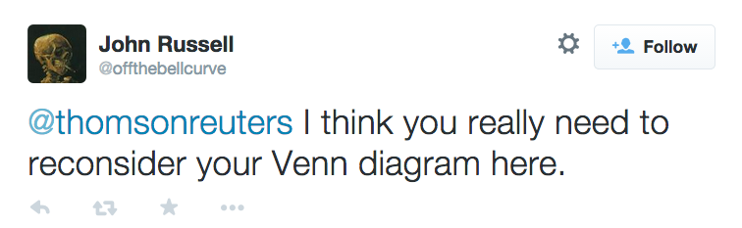
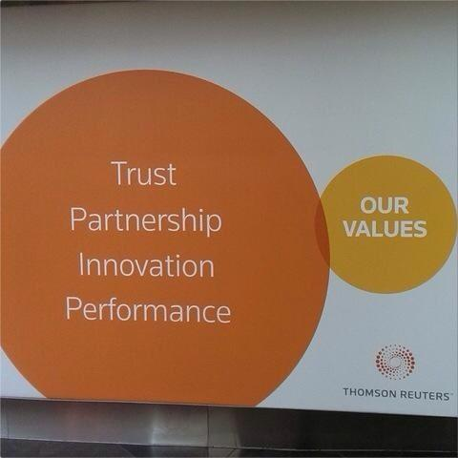

Slide 16
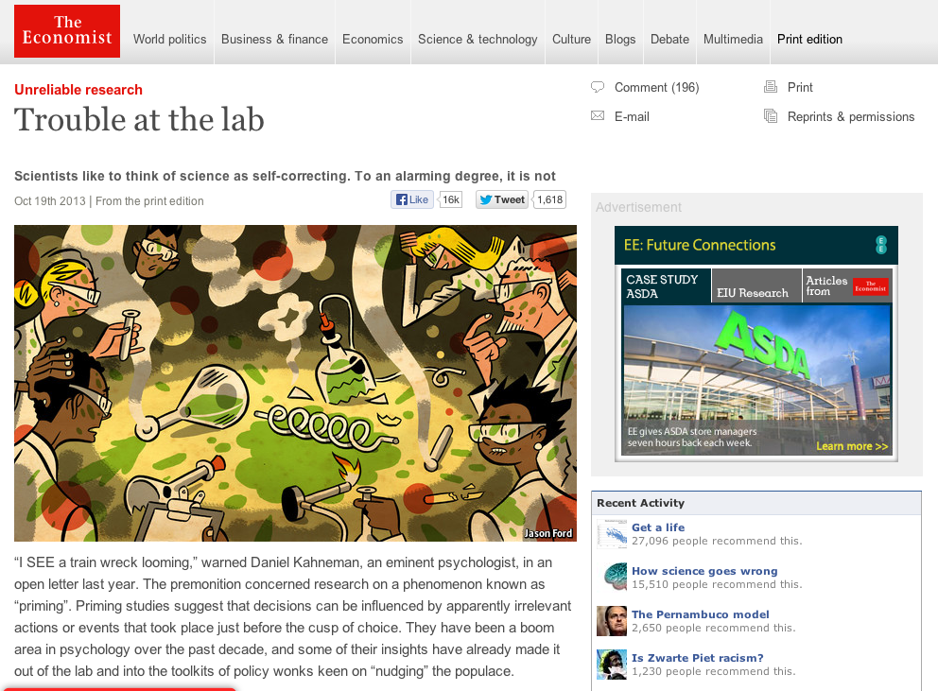
a journal-based metric
proprietary
incomplete
http://www.flickr.com/photos/m2w2/191545978/sizes/z/in/photostream/

Slide 17

Three reasons to be optimistic that new approaches are emerging
https://flic.kr/p/9dRxju
CC BY-NC-ND

Slide 18





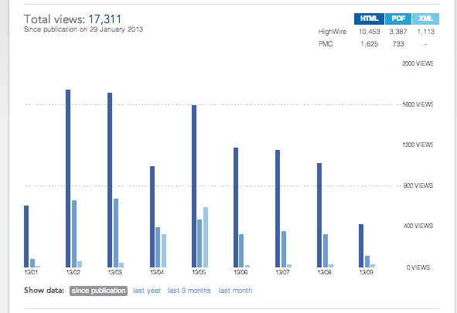

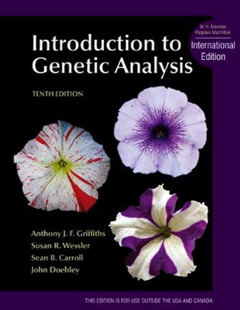


Citations
Policy and practice
Media
Usage
Twitter
Textbooks
Reference managers
Wikipedia

Slide 19
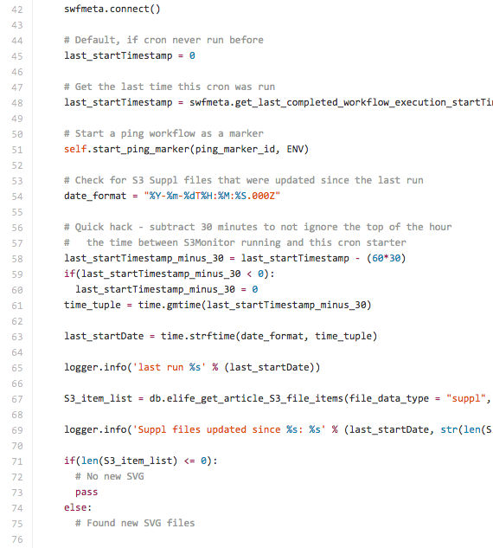
Citations
Policy and practice
Media
Usage
Twitter
Textbooks
Reference managers
Wikipedia

Slide 20
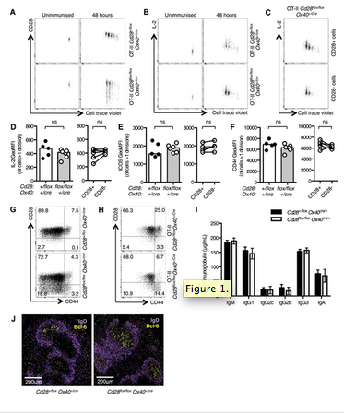
Citations
Policy and practice
Media
Usage
Twitter
Textbooks
Reference managers
Wikipedia

Slide 21
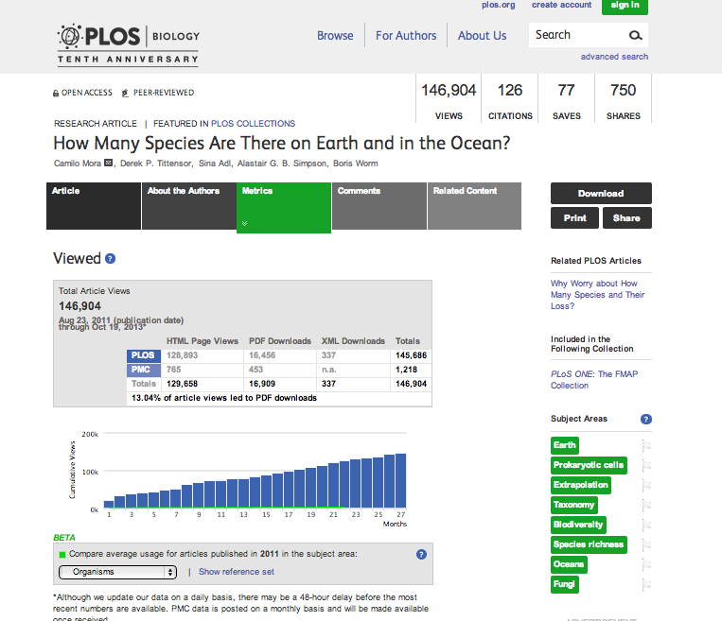
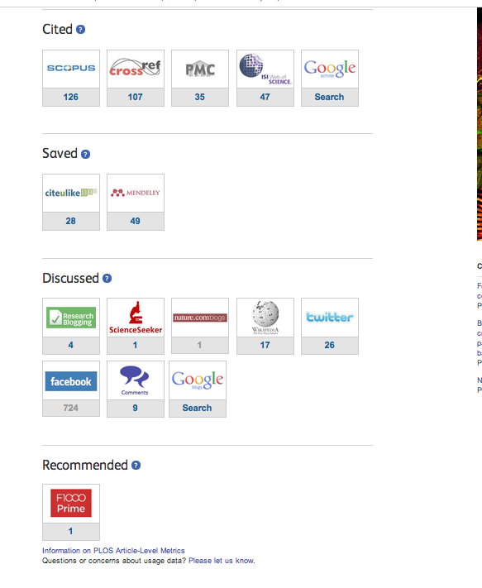

Slide 22




Metrics service providers

Slide 23

https://flic.kr/p/aq7Voo
CC BY-NC-SA

Slide 24
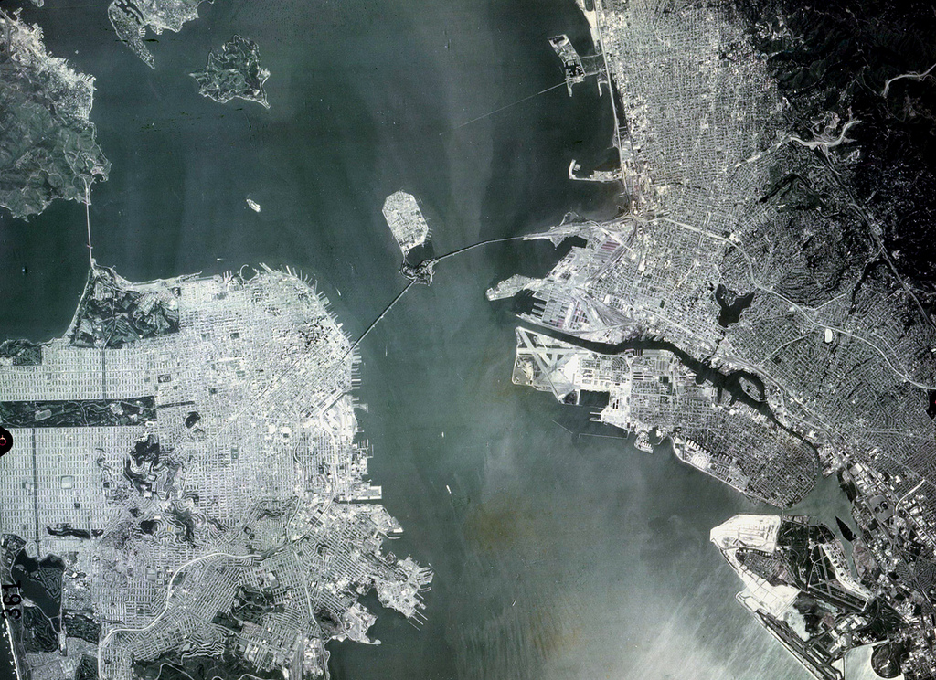
Recommendations for publishers, funders, institutions, metrics suppliers, and researchers
>12,000 signatories
http://www.ascb.org/dora/
http://www.flickr.com/photos/24736216@N07/7758828268/ (CC BY-NC)

Slide 25
Three themes
eliminate the use of impact factors in decisions about funding and careers
opportunities provided by online publication (such as new indicators of significance and impact)
assess research on its own merits

Slide 26
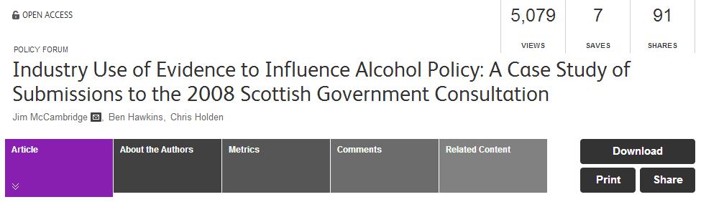
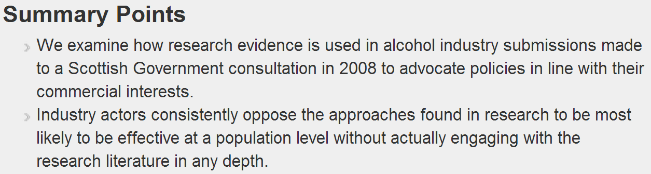

Current use of altmetrics at Wellcome
Engagement/Influence beyond citations
Adam Dinsmore, 2014
Notes:
Jim McCambridge one of our RCDFs (2009)

Slide 27
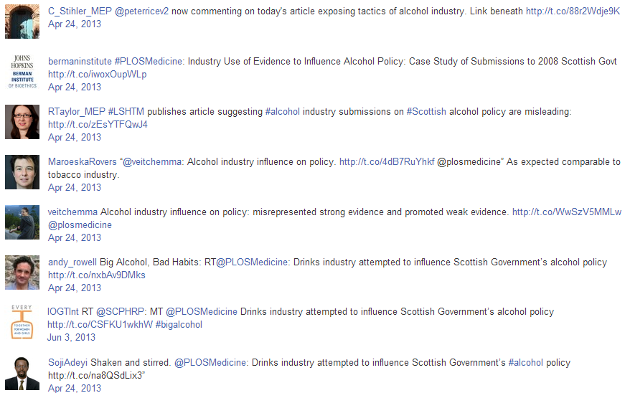
Engagement/Influence beyond citations
MEP
Centre for Bioethics
MEP
Professor of EBM
Journal editor
Health journalist
NGO
Health, Population & Nutrition @ The World Bank
Adam Dinsmore, 2014
Notes:
Of these twitter accounts, only the attention of the Centre for Bioethics and possibly the journal editor are likely to be visible to ciation metrics (eventually).
Our next job as 'the Evaluation Team' in a funder - having presented such examples - would be to track whether any policy changes were effected following this publication and tweet etc. Quicker.

Slide 28
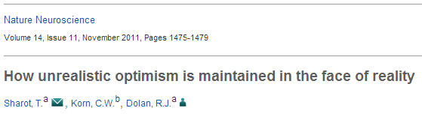
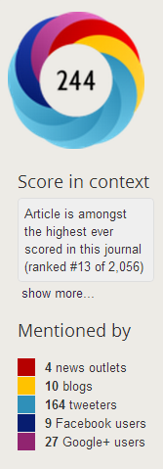






Engagement/Influence beyond citations
Paper cited 9 times to year end 2012.
However, tweeted about 164 times; among the highest ever for Nat. Neuroscience.
Identity of tweeters possibly indicative of impact on policy, public debate.
Science journalist, Author
Editor, Medical History
Intelligence Consultant
Adam Dinsmore, 2014

Slide 29
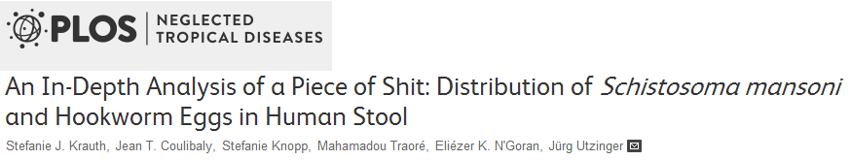
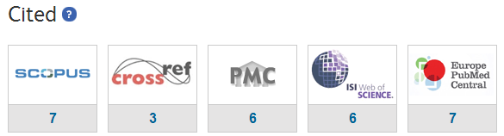
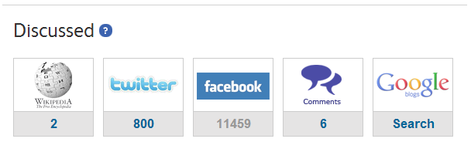
2012 Trust-associated paper in PLOS Neglected Tropical Diseases.
Cited very few times, but discussed extensively on social media.
However, likely due to funny title rather than genuine public engagement.
Adam Dinsmore, 2014

Slide 30
New altmetrics
Adam Dinsmore, 2014
Analysis: Statistical Cybermetrics Research Group,
University of Wolverhampton.
Notes:
Jim McCambridge one of our RCDFs (2009)

Slide 31
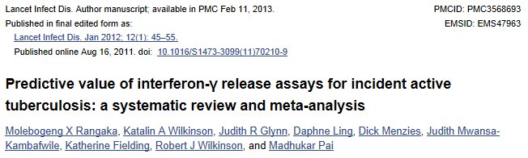
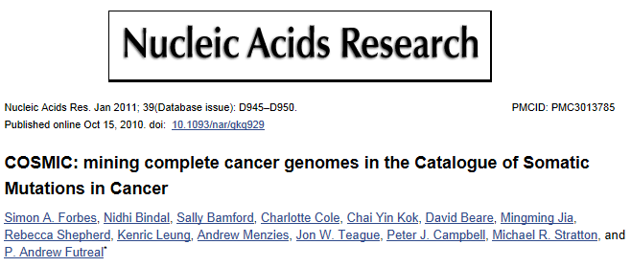
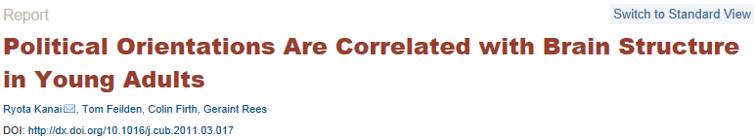
New altmetrics
Adam Dinsmore, 2014
Notes:
Again, the numbers aren’t especially important on their own. But they allow us to dig in and access stories of impact.

Slide 32

Taking steps to improve assessment (NIH)
“Varmus wants to replace a section that now lists major publications with a narrative describing the investigator's five major accomplishments.”
Science, 25 October 2013

Slide 33
Taking steps to improve assessment (Institutions)
Sandra L. Schmid, chair of the Department of Cell Biology at the University of Texas Southwestern Medical Center.
“We believe we can recognize excellence that has been missed by journal editors.”
Applicants for faculty positions provide a cover letter describing:
most significant scientific accomplishment as a graduate student
most significant scientific accomplishment as a postdoc
overall goals/vision for their research program
experience and qualifications that make them able to achieve those goals
Science Careers, 3 September 2013

Slide 34

Taking steps to improve assessment (HEFCE)
No sub-panel will make any use of journal impact factors, rankings, lists or the perceived standing of publishers in assessing the quality of research outputs.
An underpinning principle of the REF is that all types of research and all forms of research outputs across all disciplines shall be assessed on a fair and equal basis.

Slide 35
Taking steps to improve assessment (EMBO)
The application process for EMBO Long-Term Fellowships emphasizes the most important outcomes and impact of the applicant’s work rather than where it is published and specifically states that journal impact factors should not be provided:
From “Helpful Notes for Applicants”
In the ‘achievements of PhD’ section please provide your own summary of what you consider the most important outcome(s) of your PhD work and the impact of your work on and beyond the respective scientific field.
In your publication list, you should indicate your three most important publications, i.e. the three primary research papers that in your view provided the most important and original contributions to scientific knowledge irrespective of journal name and impact factor. Do NOT add the journal impact factor. Citations to the article or other article level metrics with source may be listed, but are not essential.
From the FAQs
Are journal impact factors or journal name taken into account when evaluating applications?
Journal impact factors or name are not used in the evaluation and selection of applications. EMBO encourages evaluation of the quality of the scientific work and its impact on the field, rather than the journal in which it was published.

Slide 36
DORA recommendations for publishers
don’t promote the impact factor (ideally)
provide new metrics and indicators
make reference lists available as open data
promote responsible authorship and author contributions

Slide 37
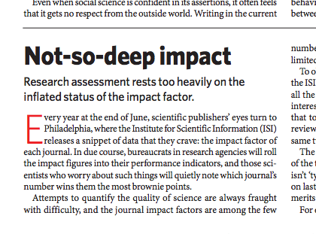
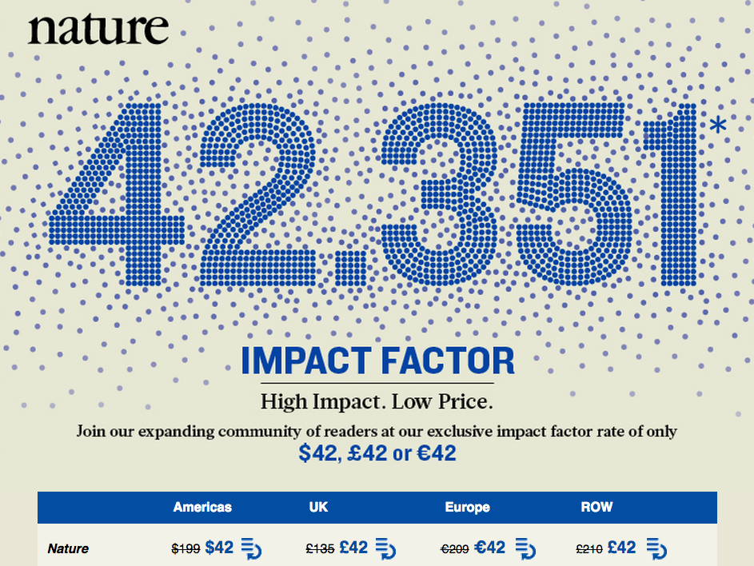

Slide 38
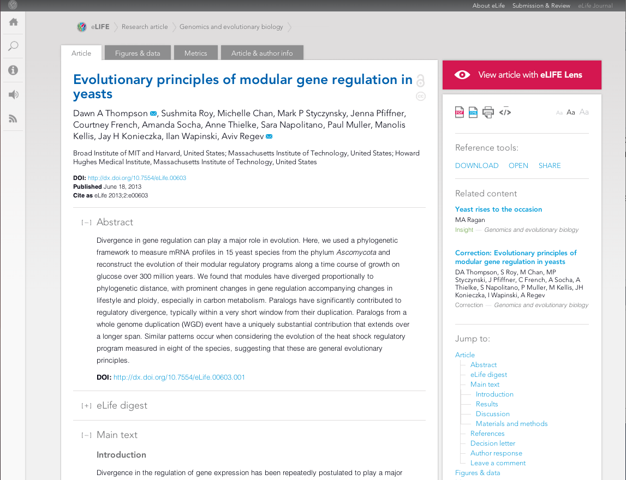

Slide 39
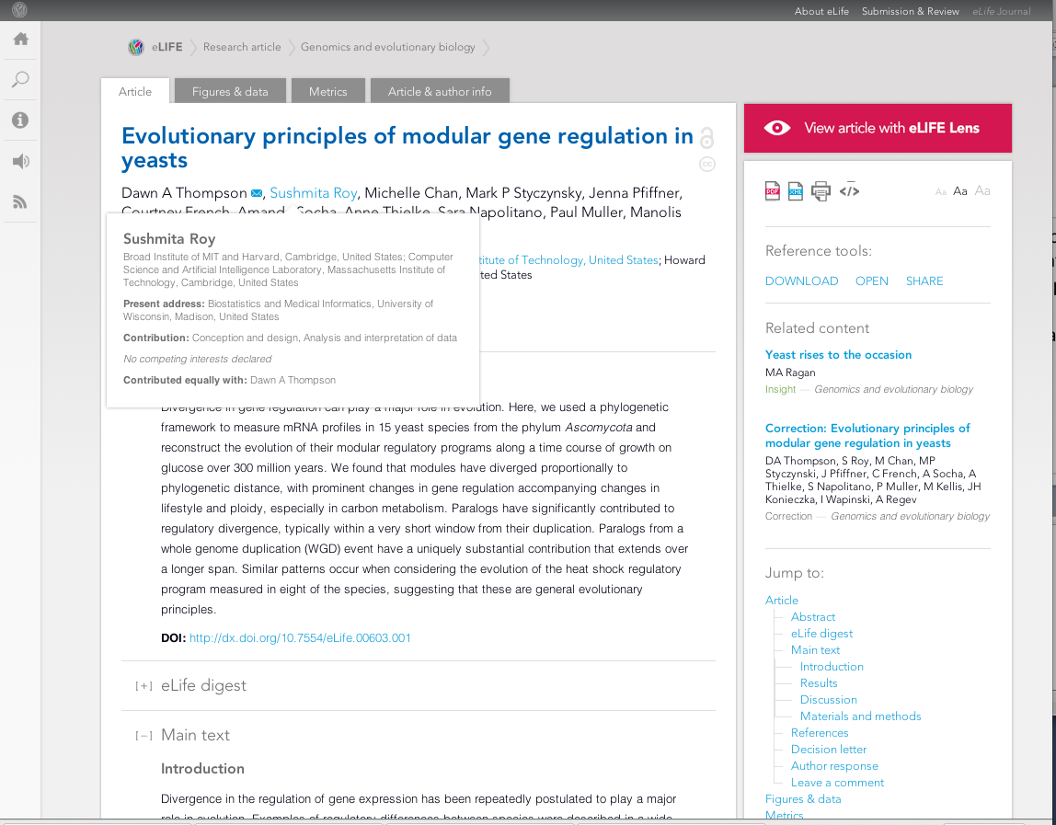

Slide 40
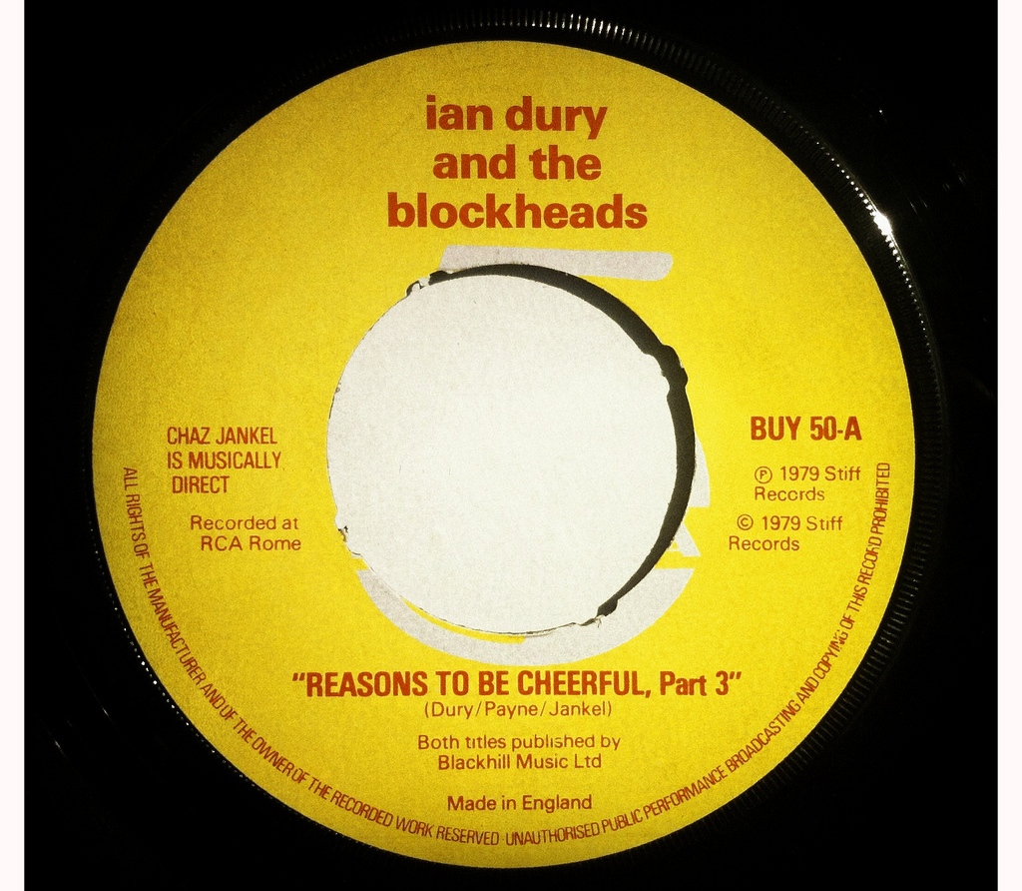
https://flic.kr/p/a6j8CE
CC BY-NC

Slide 41
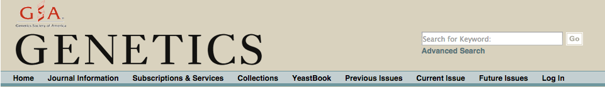
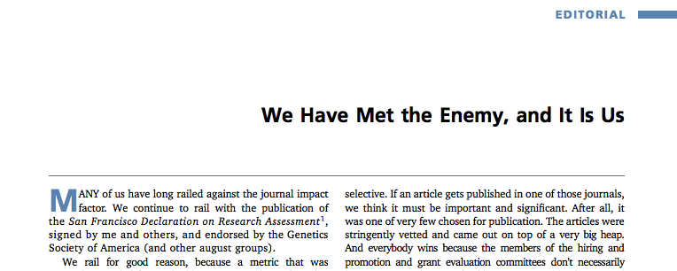



Slide 42
DORA recommendations for researchers
challenge use impact factor in research assessment
promote assessment on the basis of research content
use new metrics/indicator to support your own career

Slide 43

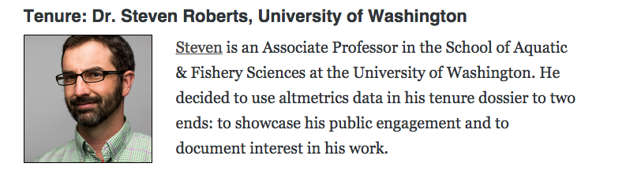

Slide 44
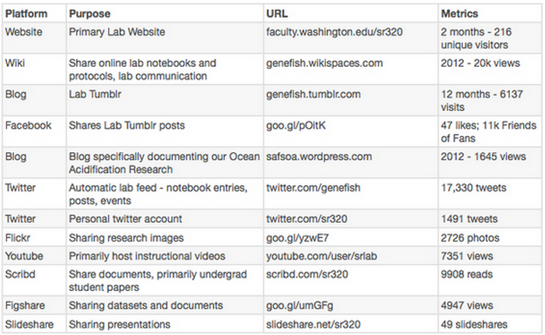
Dr Steve Roberts – education and outreach

Slide 45
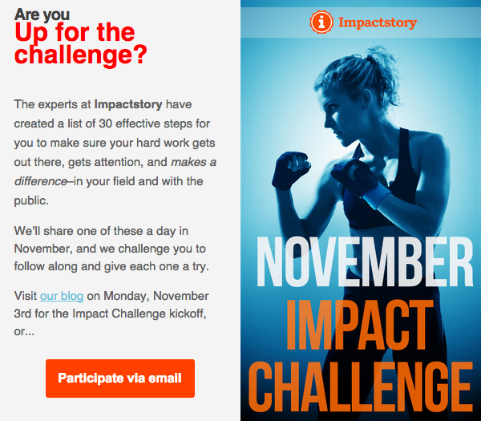

Slide 46
What can you do?
Sign DORA, and encourage others to do the same
Point out the weaknesses of JIF, and the potential to do much better
Make your own research outputs open
Try some of the tools to track their impacts
Thank you
Mark Patterson
m.patterson@elifesciences.org

