Slide 1
Scanning post mortem fixed whole human brain for advanced higher order diffusion modelling using a 300 mT/m whole-body MRI scanner
Luke J. Edwards¹, Evgeniya Kirilina^{1,2}, Carsten Jäger^{1,3}, Kirsten Garus⁴, Markus Cremer⁴, Katrin Amunts^{4,5}, Nikolaus Weiskopf^{1,6}
[1] Department of Neurophysics, Max Planck Institute for Human Cognitive and Brain Sciences, Leipzig, Germany
[2] Center for Cognitive Neuroscience Berlin, Freie Universität Berlin, Germany
[3] Paul Flechsig Institute of Brain Research, Leipzig University, Germany
[4] Institute of Neuroscience and Medicine (INM-1), Research Centre Jülich, Germany
[5] C. and O. Vogt Institute for Brain Research, University Hospital Düsseldorf, Heinrich Heine University Düsseldorf, Germany
[6] Felix Bloch Institute for Solid State Physics, Faculty of Physics and Earth Sciences, Leipzig University, Germany
Notes:
Hello everyone, I'm Luke Edwards. Today I'll tell you about our post mortem diffusion protocol which could be used to validate advanced diffusion models.

Slide 2
Post mortem validation of diffusion imaging
Post mortem diffusion imaging can validate diffusion models and tractography.
Challenges: reduced diffusivity, increased relaxivity.
Ultra-strong gradients: high diffusion weighting with short diffusion-encoding time.
Brain part of the BigBrain initiative [1]:
  tissue of exceptional quality,
  extensive histology will be performed,
  extensive relaxometry protocol [2].
[1] https://bigbrainproject.org/
[2] Kirilina, et al., ISMRM 2021 digital poster #2161.
Notes:
Postmortem imaging can be used for validation because the tissue can be scanned with extensive imaging protocols and histologically processed afterwards.
However, compared to in vivo, post mortem diffusion imaging is challenging because fixation causes reduced diffusivity -- requiring very high diffusion weightings -- and increased relaxivity -- requiring very short diffusion encoding times.
These problems can be overcome using whole-body systems with ultra-strong gradients.
Just as important is the quality of the tissue.
The brain scanned here is part of the BigBrain project and is of exceptional quality. It will be processed using the BigBrain histological pipeline to create a microscopic resolution 3D atlas of the whole brain, allowing us to validate diffusion models on the microstructural level.
To make the most of this opportunity to link MRI to a microscopic resolution atlas, we also scanned this brain with an extensive relaxometry protocol. The data from that can be seen at poster number 2161.

Slide 3
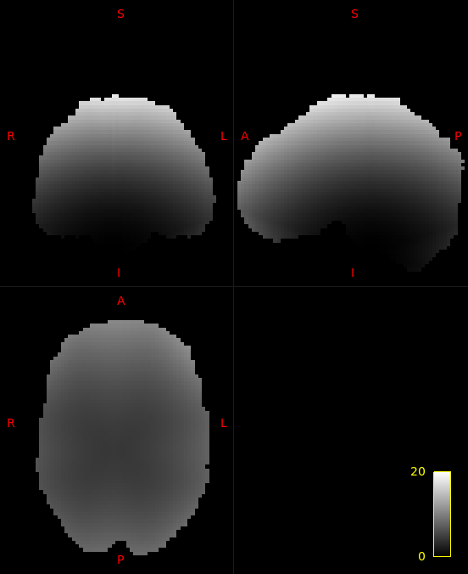
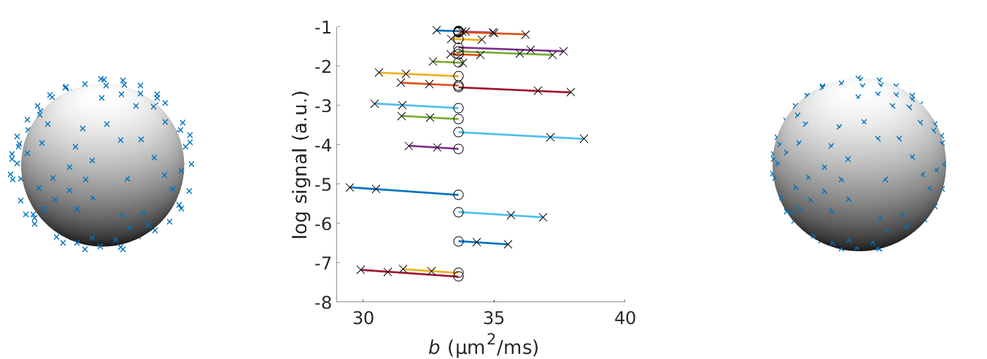
Gradient nonlinearity correction of diffusion weighting
Record additional data at (b − 1 ms/µm²).
Interpolate signals to mean b.
Retains angular resolution of the data.
20%
0%
Maximum gradient deviation over the brain
Gradient vectors deviate because of nonlinearity
Interpolation maps signal to vectors on a sphere
Notes:
An important consideration when using ultra-strong diffusion gradients is gradient nonlinearity.
The figure on the [left] shows that the maximal percent deviation in the gradient vectors can be significant, especially around the edge of the brain.
This causes the sampled diffusion vectors to no longer lie on a sphere [left].
This will cause errors in any diffusion or tractography model which assumes sampling on the sphere.
By acquiring a second shell of data close to the first [centre], we can interpolate the measured data (x's) to the mean b-value over the shell (circles) to obtain a dataset on the sphere [right].
The mathematical justification of this procedure -- a cumulant expansion around the mean b-value -- can be found in all its gory detail in the abstract of this poster.
Importantly, because the expansion is around the mean b, unlike previous methods which use the diffusion or kurtosis tensor for interpolation, this procedure retains the angular resolution of the data.

Slide 4
Diffusion weighted imaging protocol
3T Siemens Connectom, 32ch Rx head coil.
Formalin fixed brain scanned in container filled with PBS.
b = 6, 30 ms/µm²; 120, 240 directions (respectively); 2.5 mm resolution; whole-brain coverage; TE 66 ms; TR 3500 ms; Gmax 273 mT/m; TA 24 min [1].
Repeated with max b = 9, 10, 19, 20, 29 ms/µm²:
  Multi-shell protocol for advanced diffusion models,
  Pairs of b (9, 10), (19, 20), (29, 30) for correction of gradient nonlinearity in diffusion weighting.
[1] Based on the axon diameter mapping protocol from Veraart, et al., HBM (2021).
Notes:
Now we come to the measured protocol.
Using the whole-body Siemens Connectom system we can obtain 2.5 mm data with ultra-high b-values in reasonable scan time.
We scanned the brain in phosphate buffer solution (PBS) rather than aprotic solution to avoid the tissue potentially drying out and becoming damaged.
Because the diffusivity of post mortem tissue can range from 3--10 times lower than in vivo, a b-value of 30 ms/µm2 could be equivalent to in vivo 3 ms/µm2.
We repeated the protocol with lower maximum b-values to have a multi-shell protocol for advanced model fitting, and to have pairs of b-values for each gradient direction which will enable interpolation to mitigate gradient nonlinearity effects as discussed on the previous slide.

Slide 5
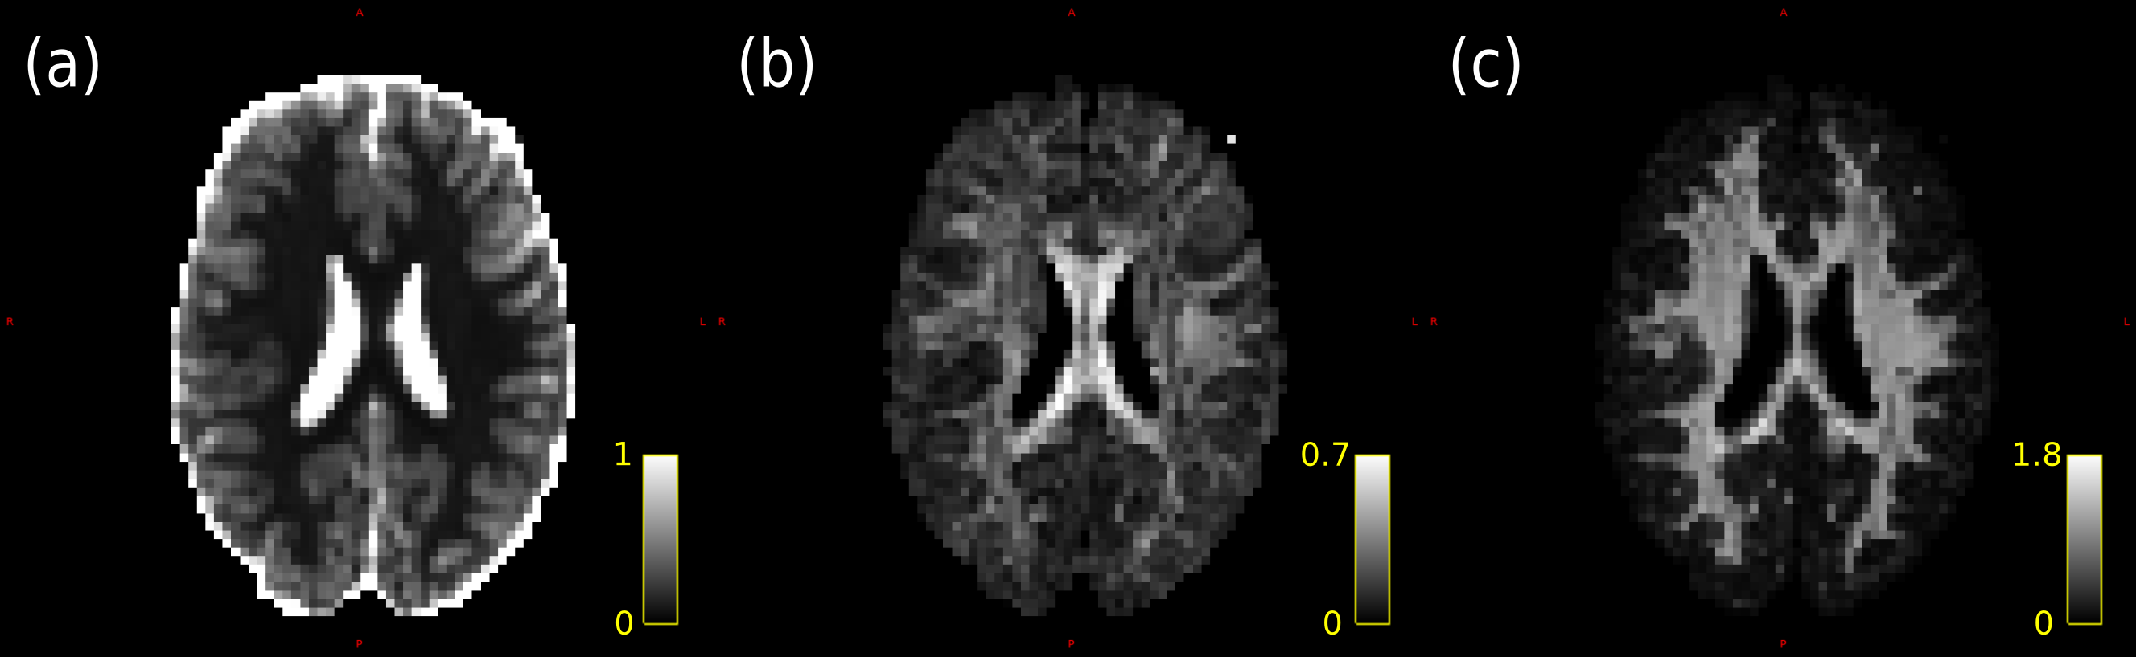
Diffusion kurtosis tensor fitting [1]
MD
FA
MK
µm²/ms
[1] Fitted using MDT (Harms, et al., Neuroimage (2017)).
Notes:
Shown here are maps from a diffusion kurtosis tensor fit -- an extension of the diffusion tensor model which accounts for some non-Gaussianity -- computed using the whole data set.
These figures show the good data quality and the quality of the tissue, with clear features distinguishable in the white matter of the [FA] and mean kurtosis (MK).
The mean diffusivity [MD] over the white matter is 0.13 µm²/ms, approximately 10-times lower than in vivo, confirming our b selection is appropriate for kurtosis fitting compared to in vivo.

Slide 6
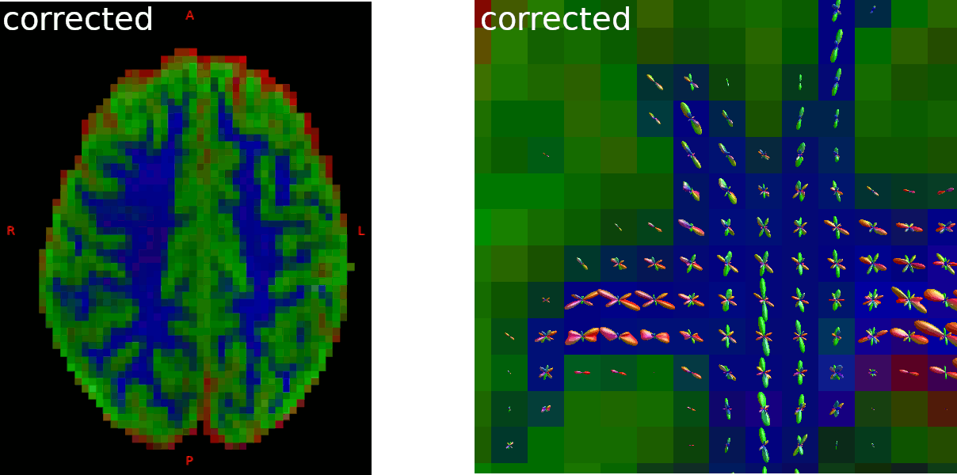
Gradient nonlinearity correction and tractography
Correction performed in Matlab after preprocessing. MT-CSD computed using MRtrix3 (Dhollander, et al., ISMRM 2019 #555; Tournier, et al., Neuroimage (2019)).
Notes:
Here, on the left we see a segmentation of tissue classes from multi-tissue CSD (MT-CSD), another higher order diffusion model, with grey matter in green, white matter in blue, and the PBS solution around the brain in red.
The segmentation is clear, demonstrating that the protocol is sufficient for MT-CSD.
MT-CSD assumes data has been collected on the sphere, and thus will be affected by gradient nonlinearity.
Indeed, the effect of the correction is to make this segmentation crisper.
There might even be a translation, suggesting that the correction is also capturing some scanner drift effects.
The effect of the correction can also be seen on the right, where the shapes and directions of the fibre orientation distribution functions become narrower and thus more specific.
This has implications for tractography, as small local changes can cause large global changes.
Because of current limitations of MRtrix, the gradient directions were not updated on a per-voxel basis, though.

Slide 7
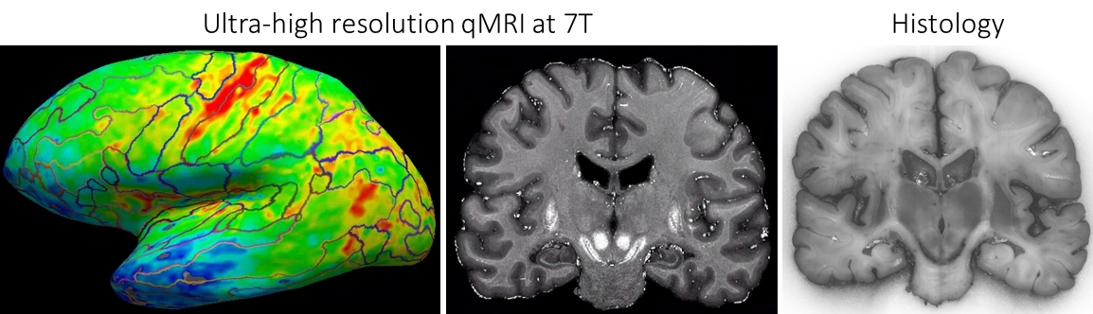
Conclusions
Ultra-strong diffusion gradients and excellent tissue quality allowed characterisation of diffusional kurtosis in whole human post mortem brain for the first time.
Novel correction scheme interpolated signals onto diffusion shells (with 2x acquisition time).
  Will incorporate per-voxel gradient direction deviations.
Extensive histological analysis will allow investigation into diffusion models with future BigBrain atlases.
For tissue preparation for scanning and relaxometry, see: Kirilina, et al., ISMRM 2021 digital poster #2161.
Notes:
To sum up: Using the Connectom scanner we were able to acquire sufficiently high quality data to fit advanced diffusion models.
The low diffusivity of the tissue justified post-hoc our choice of b-values.
By doubling the acquisition time we could mitigate the effects of gradient nonlinearity on the diffusion signal.
In future, we will also incorporate per voxel gradient direction deviations in the fODF estimation.
The brain is currently undergoing an extensive histological protocol which will provide an atlas on the microscopic scale for the validation and development of advanced diffusion models based on this data.
The brain was also scanned with an extensive relaxometry protocol. Information on this can be found in Evgeniya Kirilina's poster, number 2161; as a teaser, [here] is a figure showing some of the 7T R1 data and preliminary histology.

Slide 8


Acknowledgements
This project has received funding from the European Research Council under the European Union's Seventh Framework Programme (FP7/2007-2013) / ERC grant agreement no. 616905.
This project has received funding from the BMBF (01EW1711A & B) in the framework of ERA-NET NEURON.
This project has received funding from the European Union's Horizon 2020 Framework Programme for Research and Innovation under the Specific Grant Agreement No. 945539 (Human Brain Project SGA3).
Notes:
This project has received funding from the ERC and the BMBF.
Thank you for your attention.

