Slide 1

Prosodic Entrainment Influences Sentence Comprehension
^{Yulia Lamekina & Lars Meyer}

Slide 2
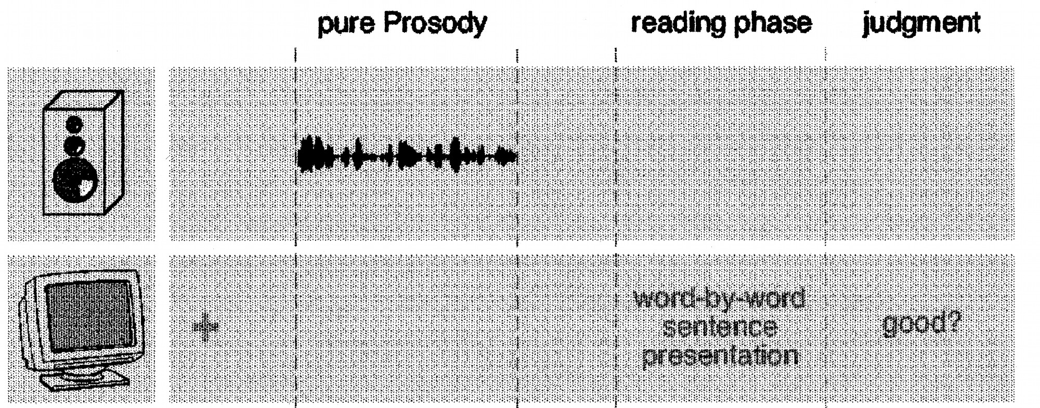
Prosody and sentence comprehension
Speech prosody (i.e. intonation, pauses, duration changes etc.) plays a significant role in online sentence comprehension
Moreover, previously presented prosodic rhythm affects comprehension of upcoming written sentences:
Steinhauer & Friederici, 2001

Slide 3

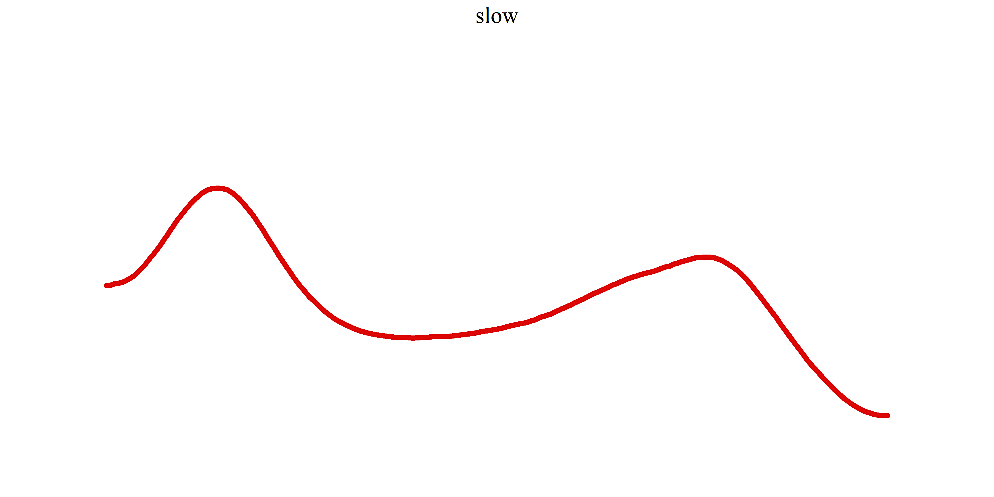
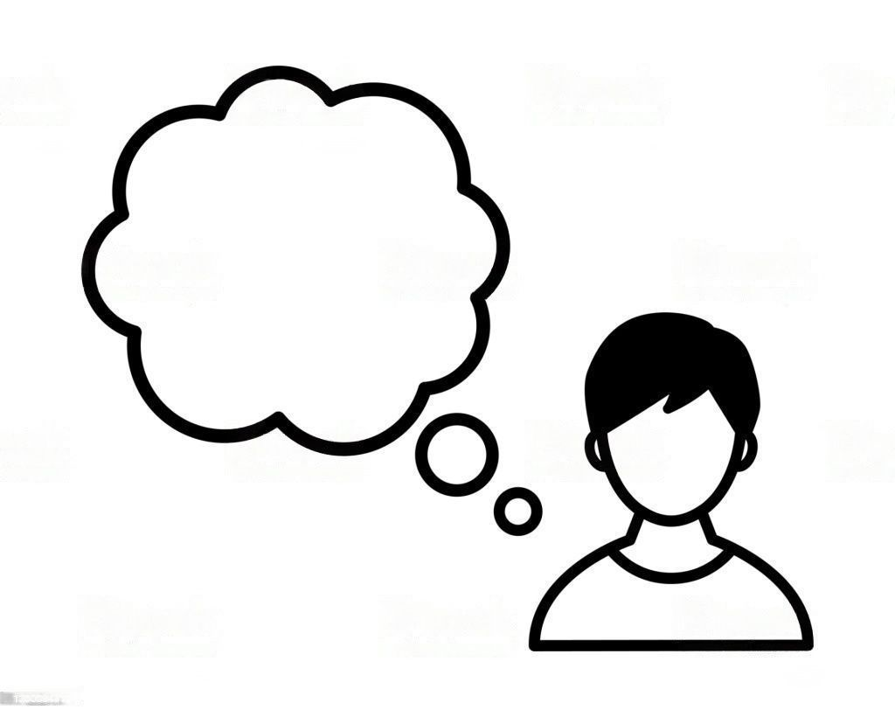
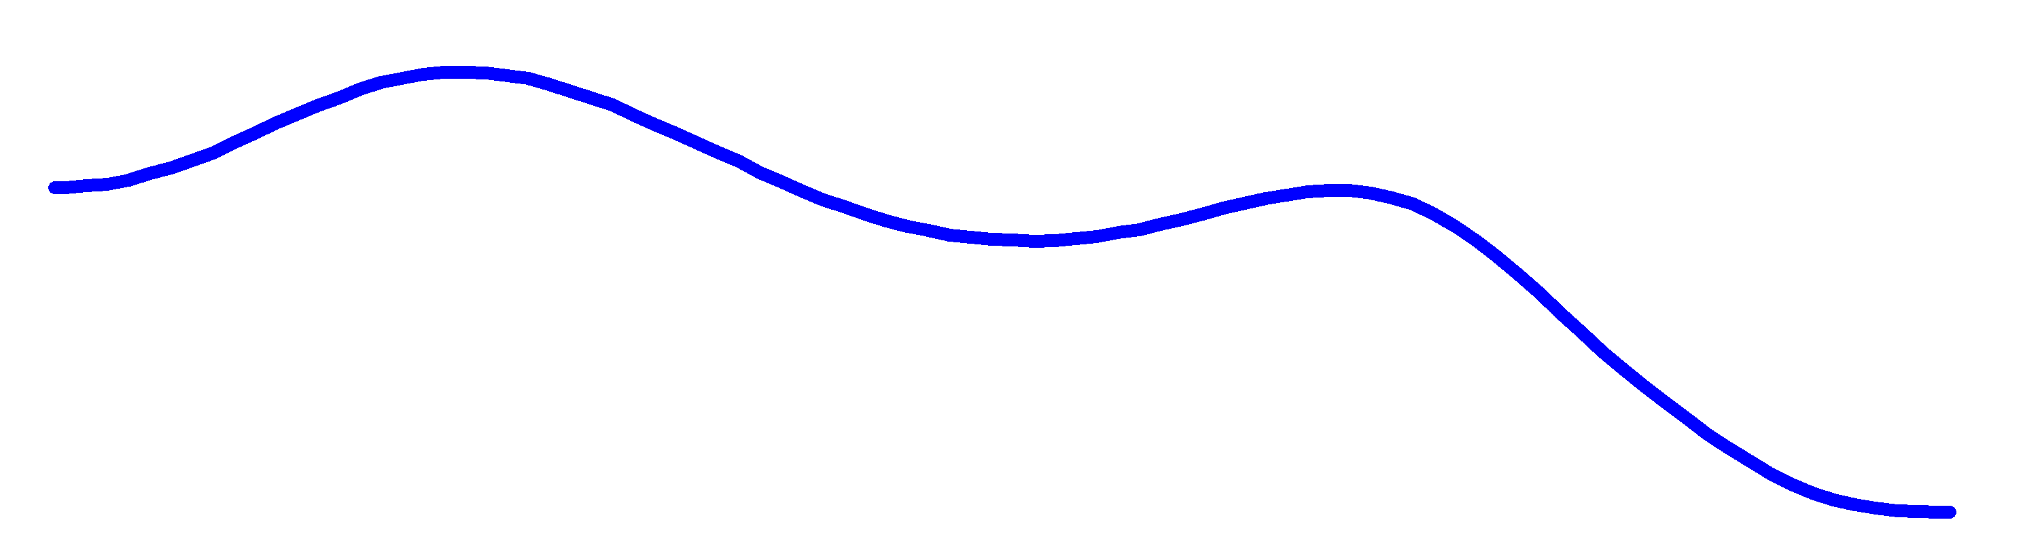
The predictive function of prosody
Previous prosody triggers a rough prediction of the duration of the upcoming stimulus (Grosjean 1983, Lamekina & Meyer, 2022);
Rhythmic prosodic stimulus allows for rhythmic temporal prediction:
long prosodic contours → prediction of longer segments:
”Max sees Tom and Karl laughs…”
Prosodic contour (long)
short contours → prediction of shorter segments:
”Max sees Tom and Karl…”
Prosodic contour (short)
Lamekina & Meyer, 2022

Slide 4
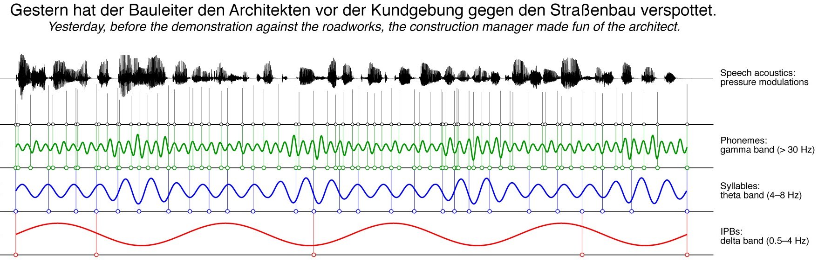
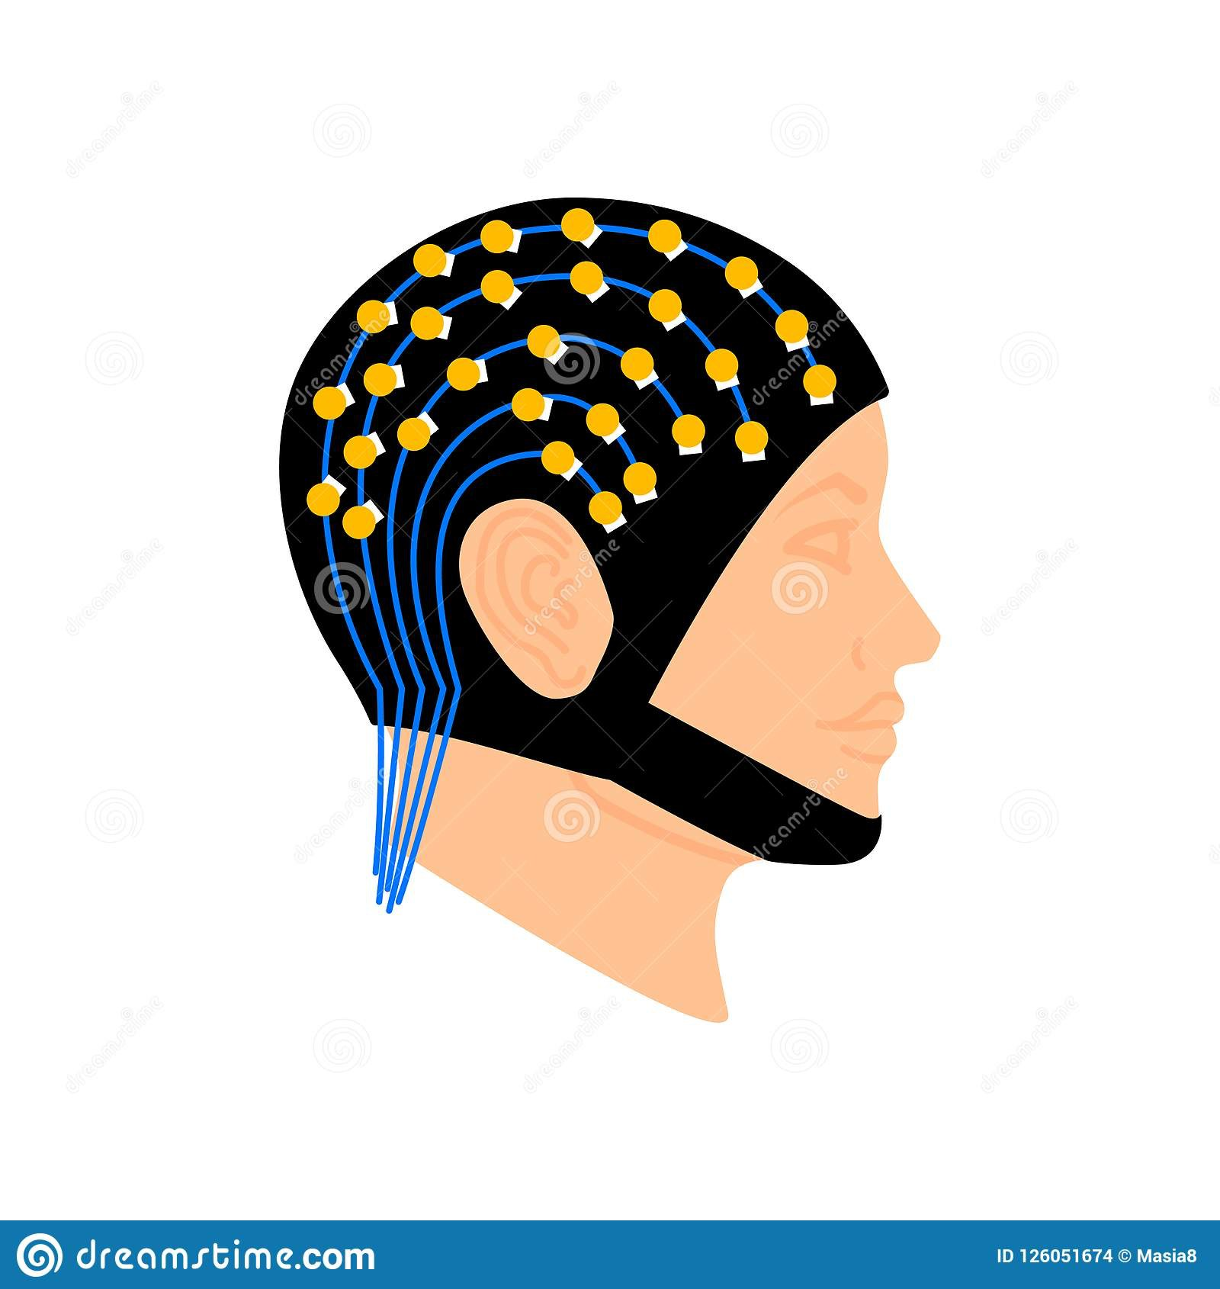
Neural oscillations: tracking speech
Speech processing in brain can be continuous rather than discrete
Neural oscillations: periodic fluctuations in charge–discharge cycle in neuronal ensembles
Oscillations keep their period at least for a couple of cycles
Cycle durations from short to long = different operation windows (e.g., phonemes vs prosody)
EEG
Giraud & Poeppel, 2012; Meyer, 2018

Slide 5
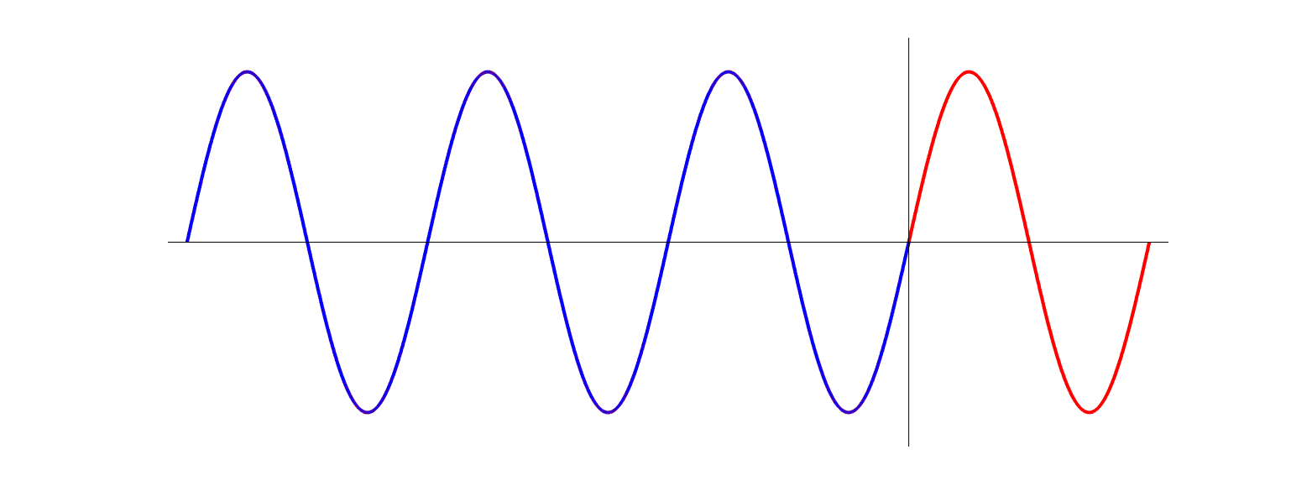

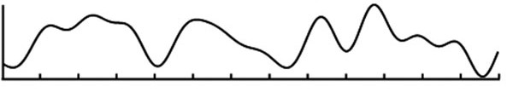
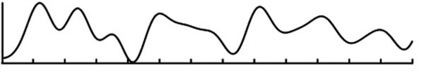
Rhythmic prediction via oscillatory entrainment?
Oscillations can inherit a stimulation frequency to persist after stimulus offset
Entraining an oscillation - setting it to a particular frequency/phase by preceding repeating stimuli
Delta-band oscillations (i.e., < 4 Hz)
track prosodic contours in speech (Bourguignon et al., 2013, Meyer et al., 2018, etc.)
Delta oscillations could be involved in temporal predictions
Is it possible to entrain the delta-rhythm with prosody and influence subsequent sentence comprehension?
ACOUSTIC OFFSET
Acoustic
stimuli
Acoustic
stimuli
Acoustic
stimuli
Persisting
oscillation?
Speech
signal
Amplitude
Intonation
(pitch)
contour
Brain
signal
Time
Bourguignon et al., 2013; Lamekina & Meyer, 2022

Slide 6
Experimental paradigm
Prosodic contour repeated 3 times to induce entrainment, followed by time-matched visual presentation of the sentence.
Conditions for the prosodic contour:
Conditions for the visual sentence:
SLOW contour x SHORT sentence → omission effect.
FAST (0.9 Hz)
and SLOW (0.6 Hz);
LONG
and SHORT
Lamekina & Meyer, 2022

Slide 7
Procedure (n = 39, MEG recording)
Sentence phase
(word presentation)
Entrainment phase
Max
(audio contour)
Comprehension task
sieht
+
Sieht Max Karl?
Tom
JA
NEIN
und
Karl
lacht
Lamekina & Meyer, 2022

Slide 8

Data analysis and hypotheses – phase coherence
Whole brain analysis of pitch – MEG coherence (Bourguignon et al., 2013):
Cluster permutation statistics between two conditions;
Post hoc t-tests within conditions separately for every hemisphere.
Hypotheses:
delta-band oscillations coherent to the rate of the contours in the entrainment phase;
this frequency still detectable in the MEG for the sentence phase.
Entrainment phase
Sentence phase
Intonation
(pitch)
contour
stimulus off
brain signal still on
Amplitude
pitch – brain coherence
Brain
signal
Time

Slide 9
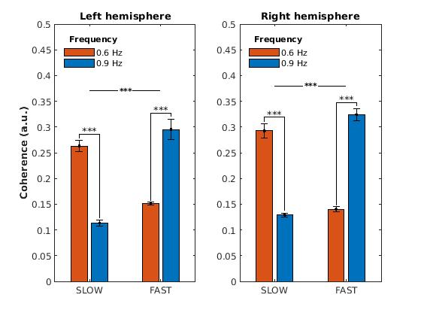
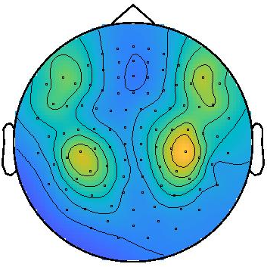
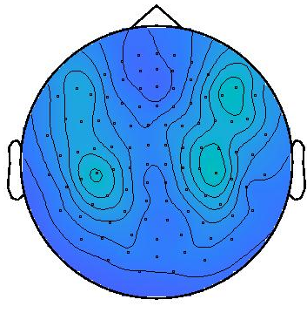

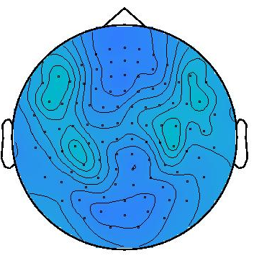
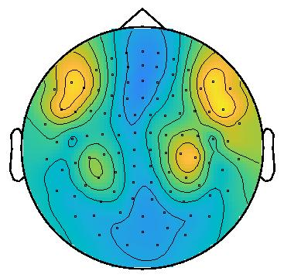
Results - coherence (entrainment phase)
SLOW 0.6 FAST 0.6
SLOW 0.9 FAST 0.9
Significant differences in the whole brain:
under SLOW entrainment, the coherence is stronger at 0.6 Hz,
under FAST entrainment – at 0.9 Hz

Slide 10
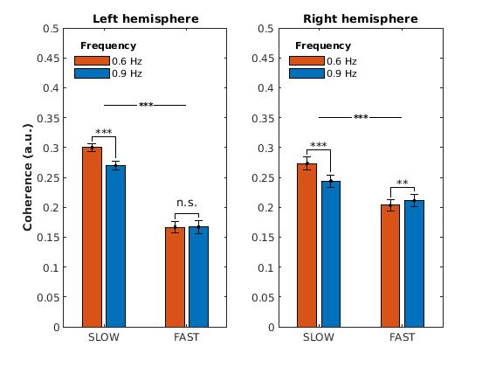
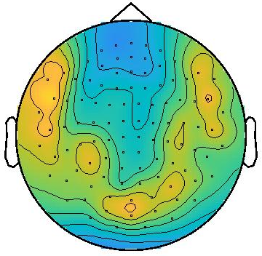
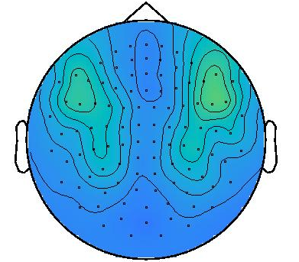
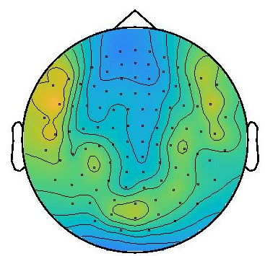
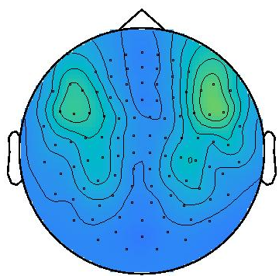
Results - coherence (sentence phase)
SLOW 0.9 FAST 0.9
SLOW 0.9 FAST 0.9
Significant differences between SLOW and FAST conditions in the whole brain;
Differences within the FAST condition – only in the right hemisphere (fronto-temporal cluster)

Slide 11
Data analysis and hypotheses - ERF
Analysis of SLOW vs. FAST entrainment conditions for SHORT sentences;
Timepoint – onset of the missing verb;
Timelock analysis to derive ERFs
Max sees Tom and Karl
Hypothesis:
Omission ERF response under the expectation of a long sentence in the SLOW entrainment condition

Slide 12
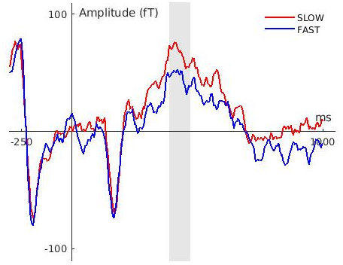
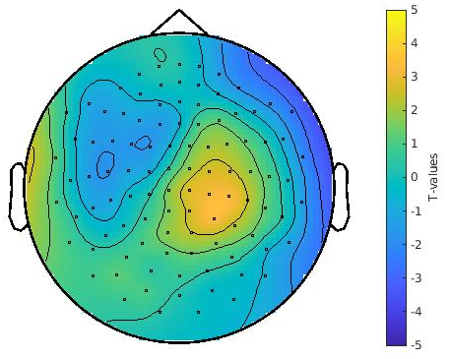
Results - ERF (sentence phase)
Significant positive cluster in right centro-parietal area at 390-470 ms latency
M300/M600 ERF on omission of predicted verb

Slide 13
Discussion
Sustained prosodic entrainment in delta-band affects subsequent sentence comprehension;
The stimulation frequency is conserved by brain areas associated with higher-level linguistic and prosodic processing (right fronto-temporal)
shift from bottom-up (= auditory) to top-down (= predictive) brain regions;
M300/M600 ERF (SLOW contour x SHORT sentence) - omission response under the expectation of a long sentence (Ragazzoni et al., 2019; Sassenhagen & Fiebach, 2019)
Prosody may serve a predictive function via entrainment (cf. Lamekina & Meyer, 2022)
Future directions:
Source reconstruction in order to verify the neural substrates hypothesis.

Slide 14
Thank you very much for your attention!

Slide 15
Data analysis pipeline
Low-pass filter at 90 Hz;
Artifact removal, ICA for blinks and heartbeat detection;
Fourier transform to derive the analytical phase;
Whole brain analysis of pitch – MEG coherence (Bourguignon et al., 2013);
Timelock analysis to derive ERFs (baseline correction -250 to 0 ms);
Cluster-permutation paired samples t-test between conditions, min 3 electrodes, 5000 runs (for both coherence and ERFs)
Coherence: post hoc t-tests within conditions for electrodes with maximum 5 values separately for every hemisphere

Slide 16
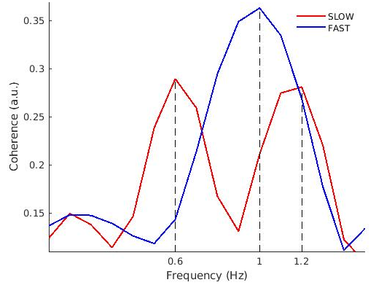
Results - coherence (entrainment phase)
Increased coherence at stimulation frequency

Slide 17
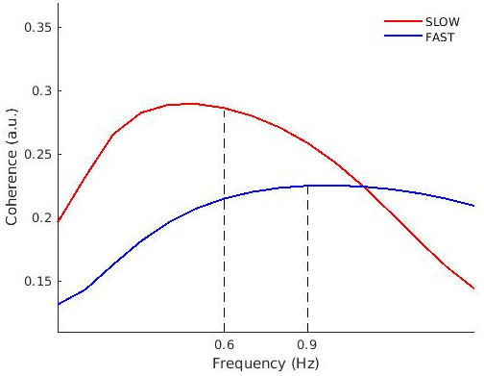
Results - coherence (sentence phase)
Frequency-selective coherence persists into target phase

