Slide 1

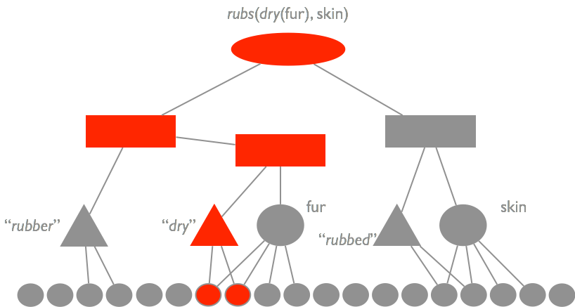
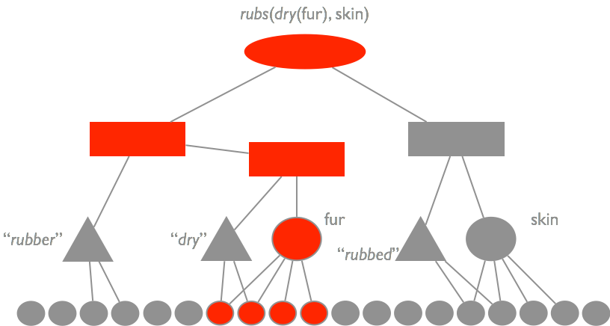
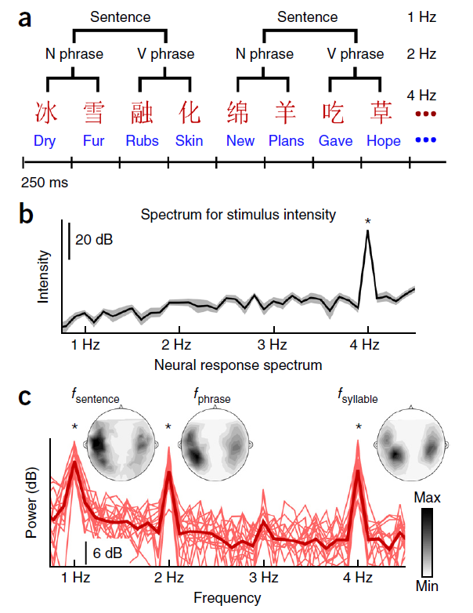
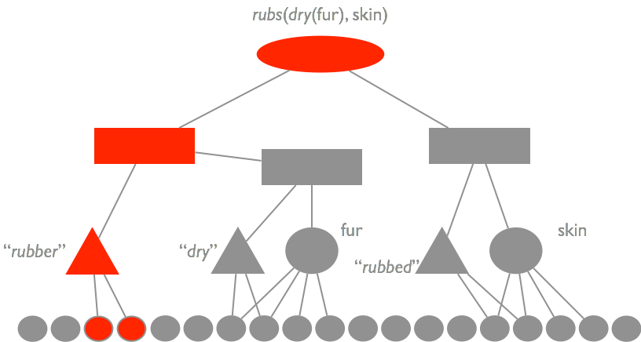
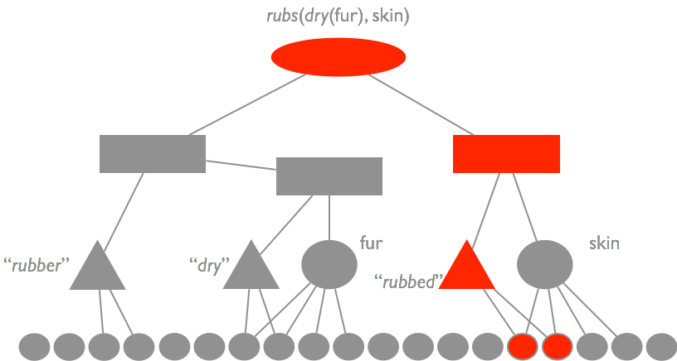
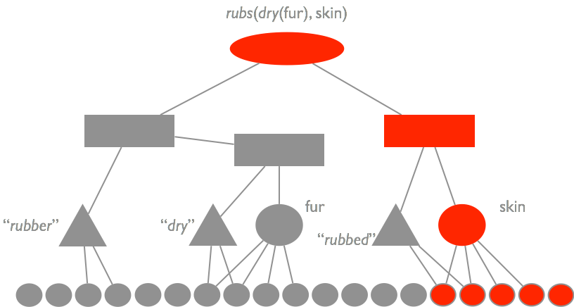
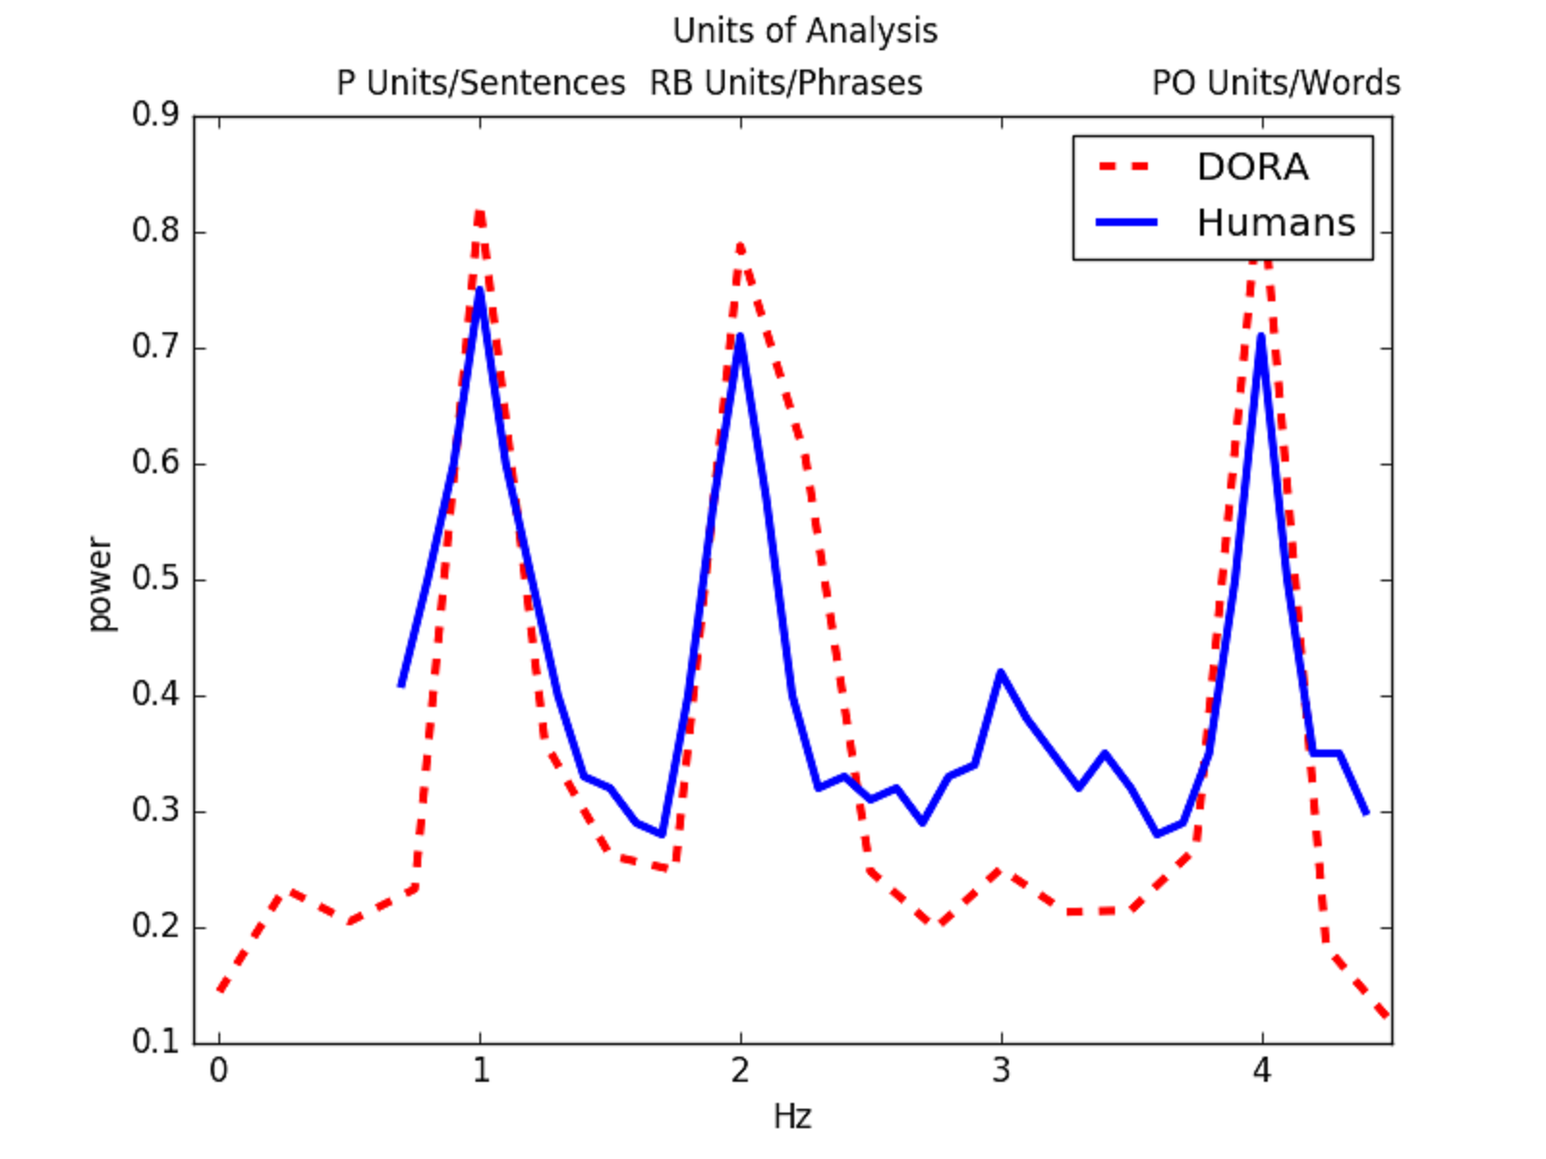
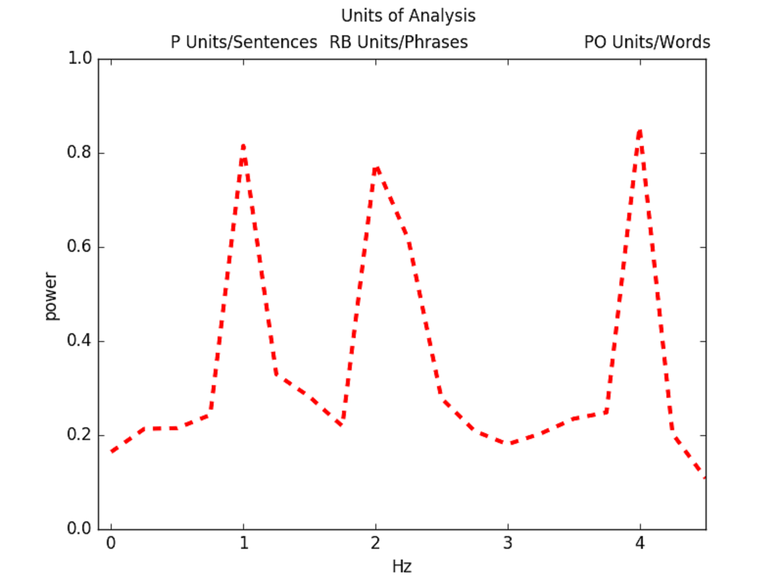
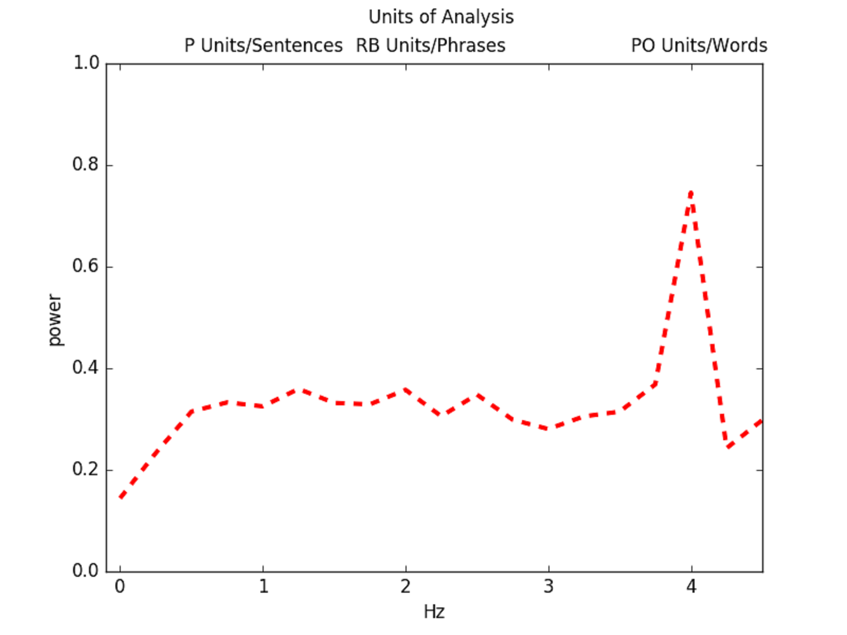
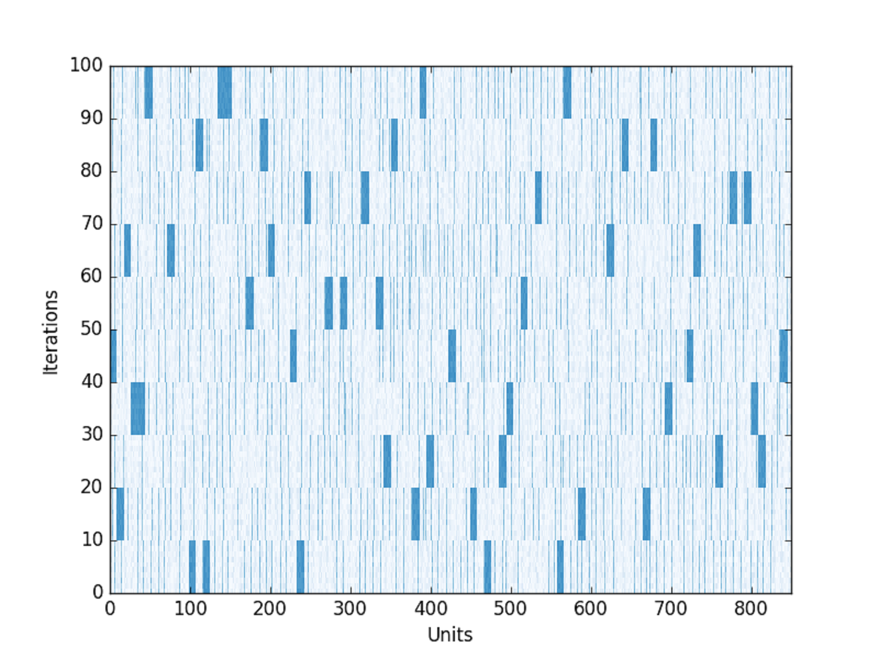
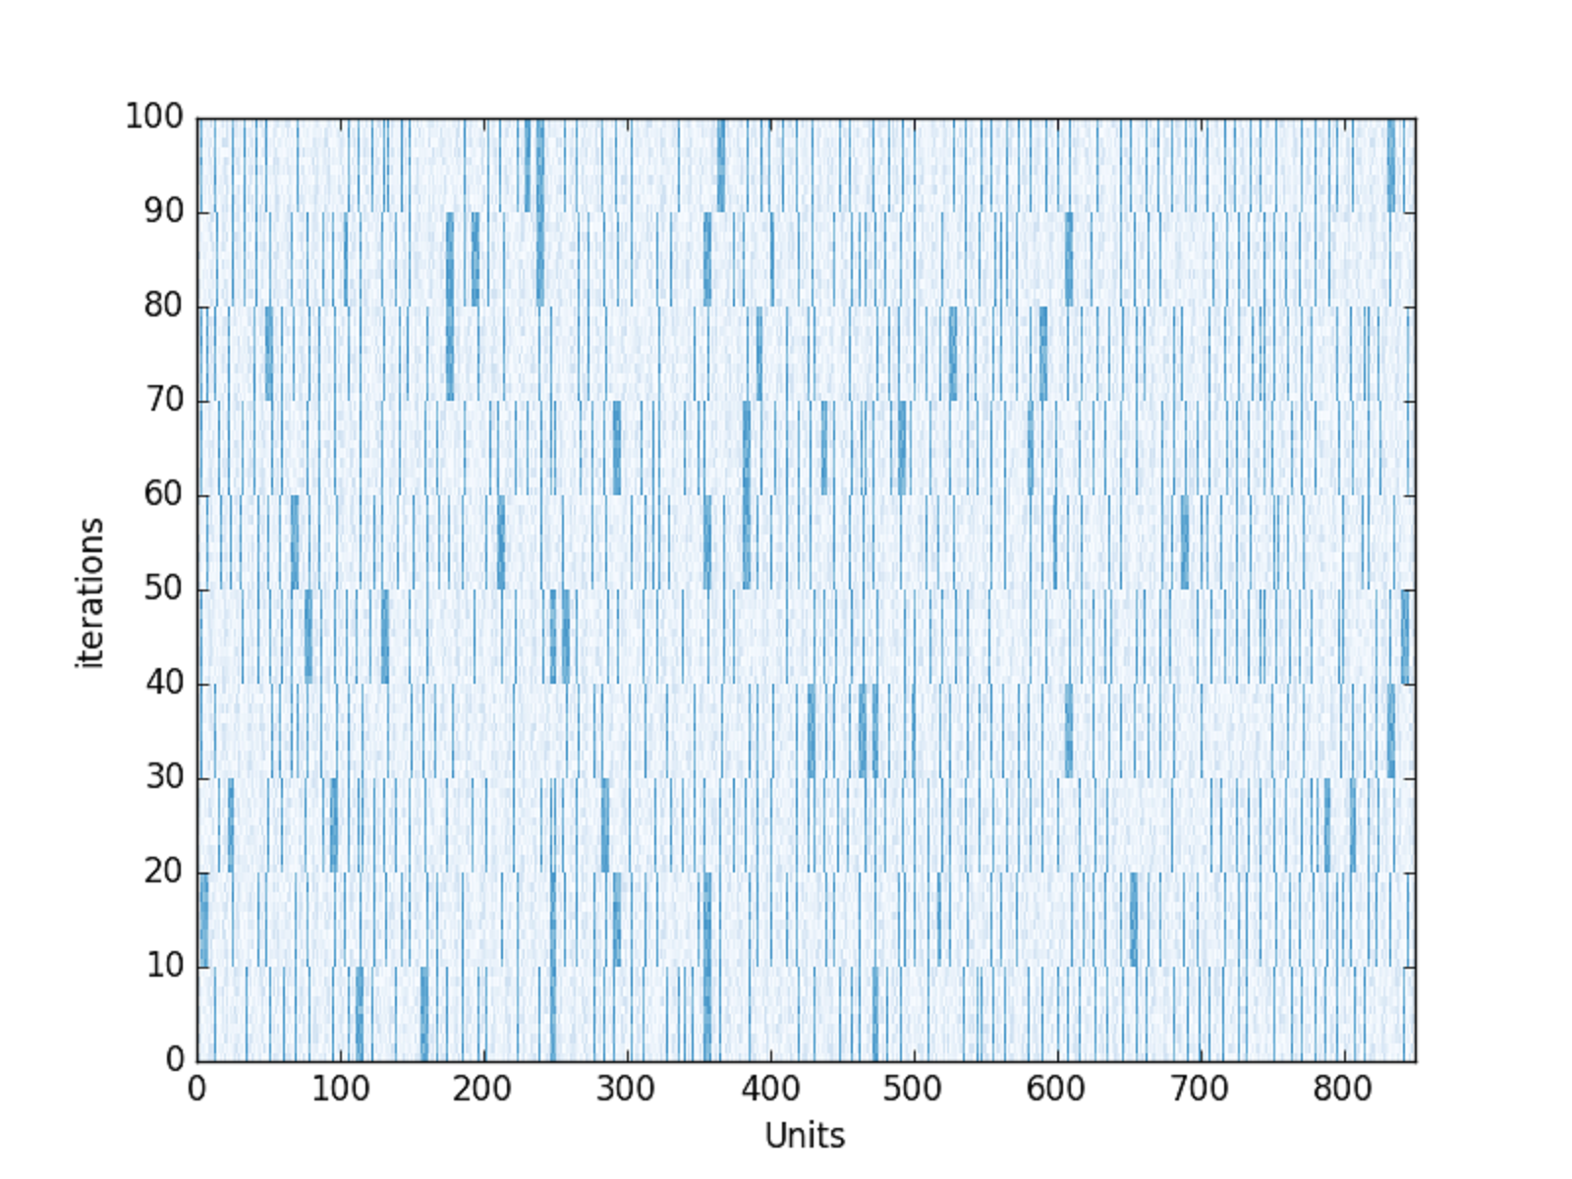
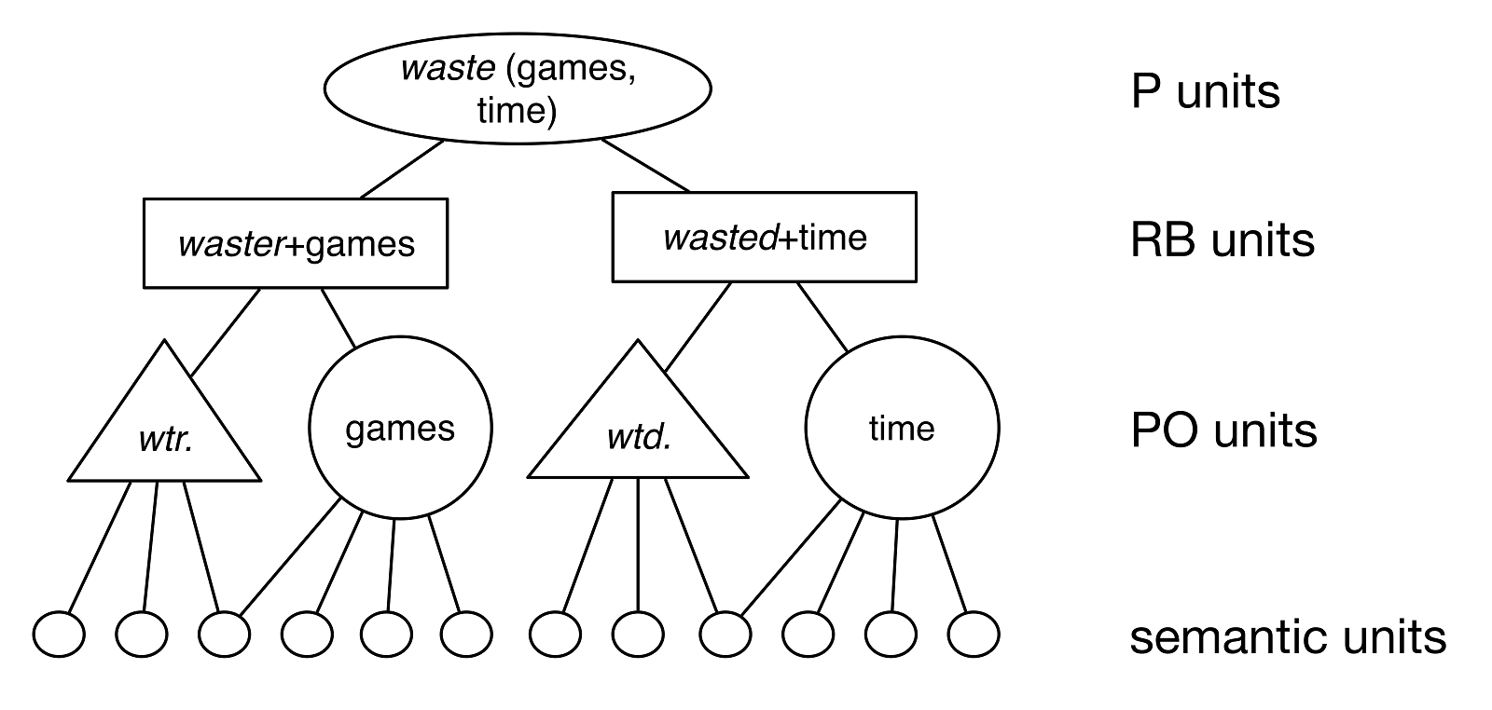
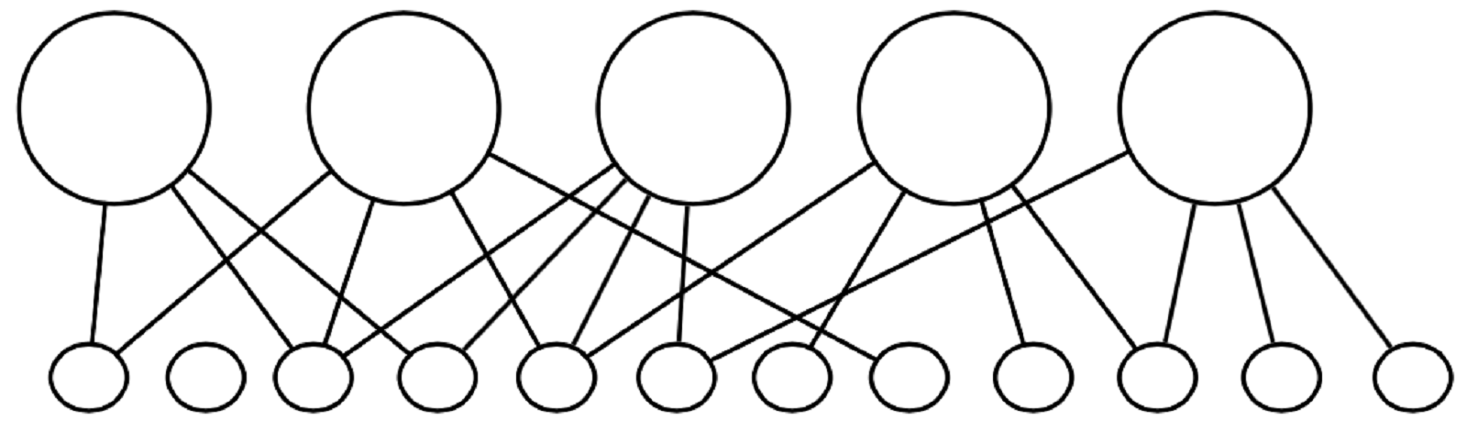
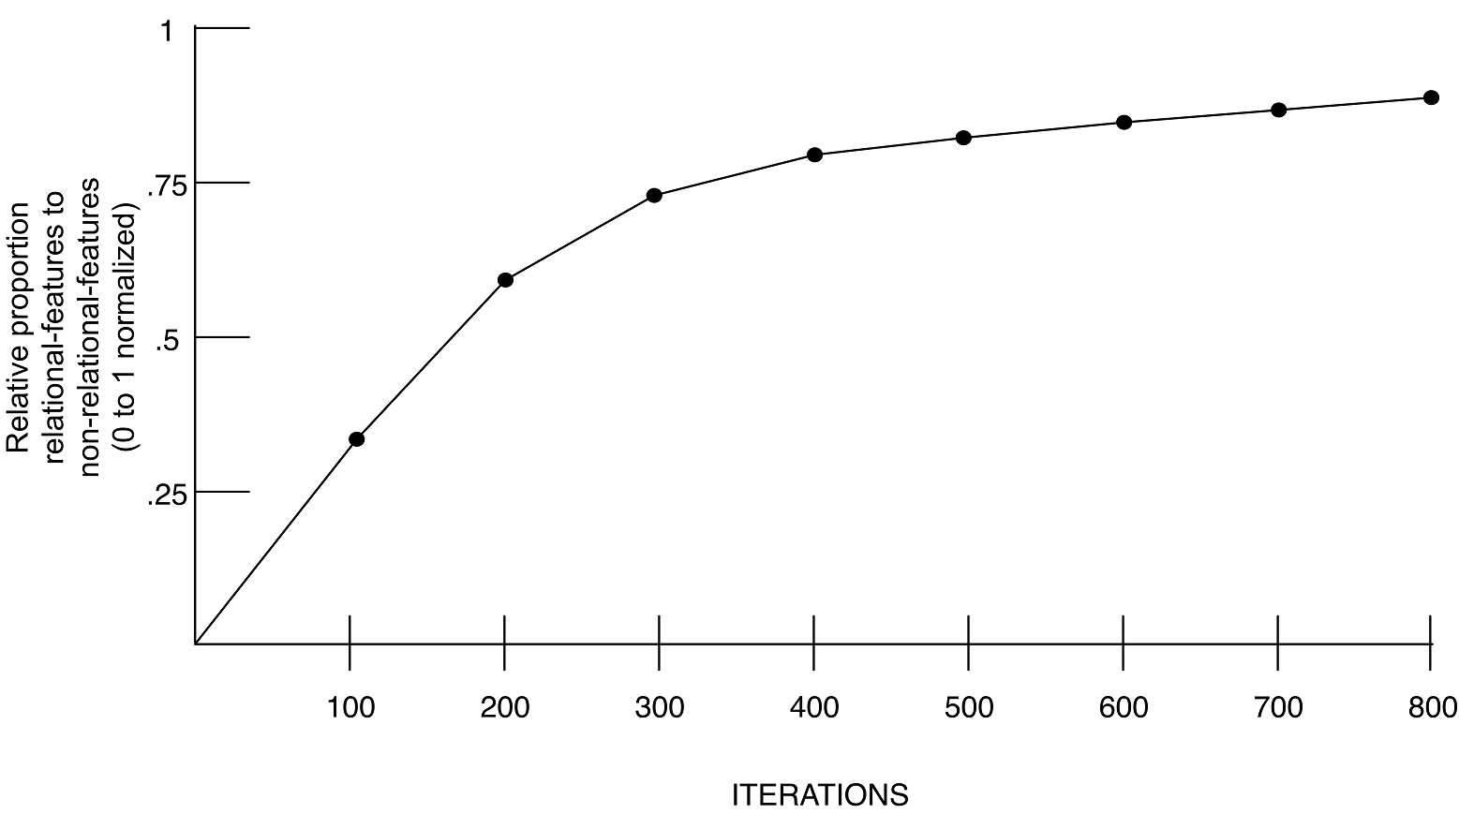

A neurocomputational mechanism for parsing:
Finding hierarchical linguistic structure
in a model of relational processing
Andrea E. Martin & Leonidas A. A. Doumas
School of Philosophy, Psychology, and Language Sciences
Department of Psychology, The University of Edinburgh
andrea.martin@ed.ac.uk
INTRODUCTION
Our brains perceive hierarchical linguistic structure at multiple timescales and levels of analysis^{1,2}
Cortical oscillations appear to (at least) track these representations, if not reflect the computation of them¹
Linking hypothesis between linguistic representation and cortical oscillations: a computational mechanism that generates hierarchical representations
DORAese & PARSING
Dry...
...fur...
...rubs...
...skin.
HYPOTHESIS
Cortical mechanism repurposed when hierarchical representation became an efficient solution^{2,3}
  A single mechanism must perform multiple, functionally-related computations while oscillating like the cortical signal
    e.g. parsing sentences and reasoning about propositional content³
DATA & RESULTS
Oscillatory unit firing
Grammatical
Jabberwocky
METHODS & STIMULI
  Stimuli and data from Ding et al. (2016)
Word List
Activation of existing representations in memory
  We used Discovery Of Relations by Analogy³ (DORA) to parse the Grammatical and Word List conditions from Ding et al. (2016), as well as a Jabberwocky condition we created:
  Grammatical: fun games waste time
  Word List: hills cents speech tears
  Jabberwocky: sharp soap scared hats
Grammatical
Jabberwocky
CONCLUSIONS
Learning
Profound mechanistic synergy between representational structure building and cortical oscillations.
First principle of cortical computation: sensitivity to time as information
(2) Computational mechanism: temporal asynchrony (desynchronization)
(3) Generative representational hierarchy from perceptual features via temporal asynchrony at multiple timescales
(4) Mechanism is an “abstraction engine” in the human brain
DORA can learn in two ways, with same results: (1) by sampling from a random variable,
(2) by processing corpora (e.g., wikipedia).
In both cases, DORA generates predicate representations from flat feature vector input.
DORA assumes/uses:
Hebbian learning
The ability to compare:
- a network with layers of units
- lateral inhibition/ leaky integrators
- separate banks of units
3. Sensitivity to time as an informational degree of freedom
Funded by ES/K009095/1 to AEM
References:
[1]Ding, N., Melloni, L., Zhang, H., Tian, X. & Poeppel, D. (2016)
[2] Martin, A. E. (2016)
[3] Doumas, L. A. A., Hummel, J. E., & Sandhofer, C. M. (2008)

