Slide 1

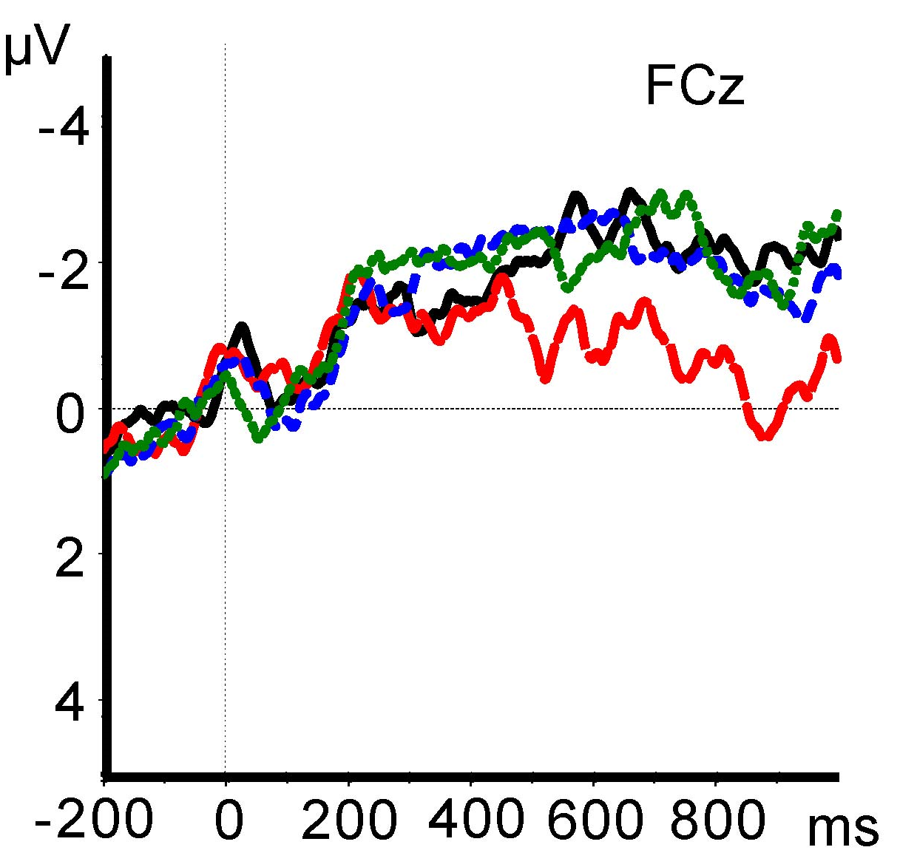
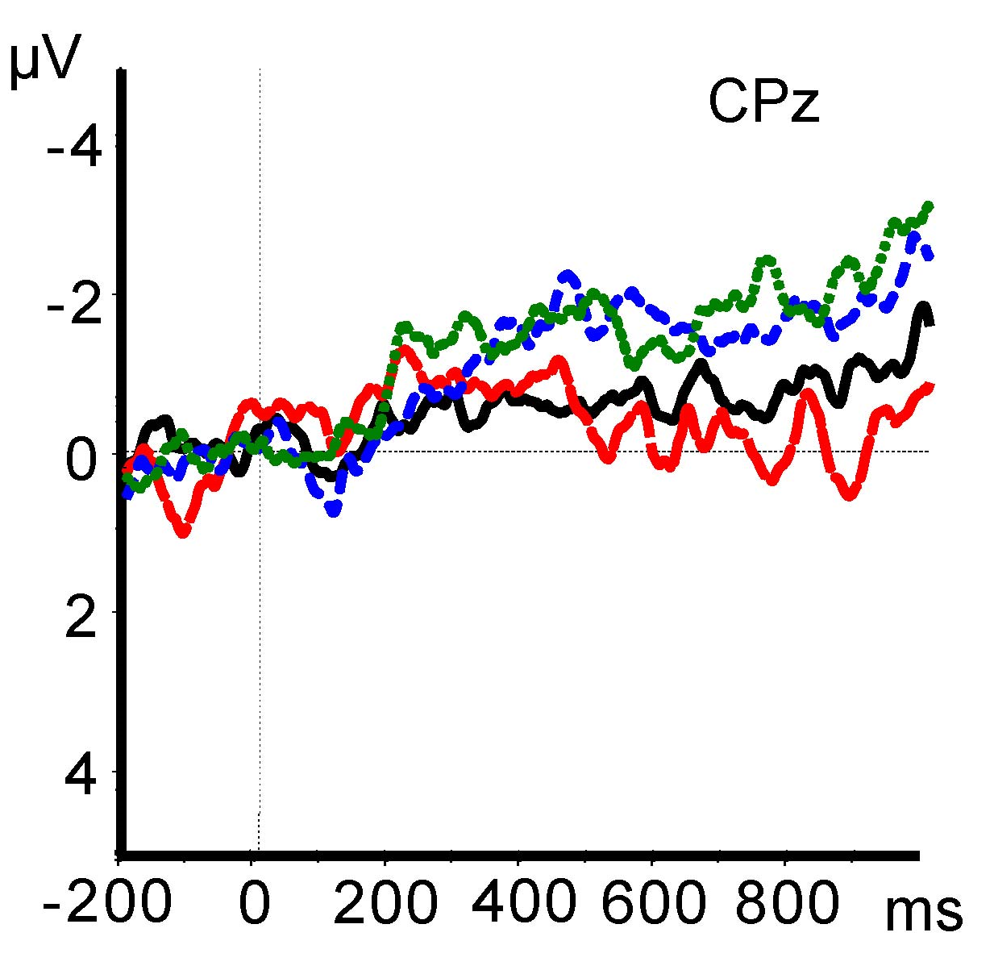
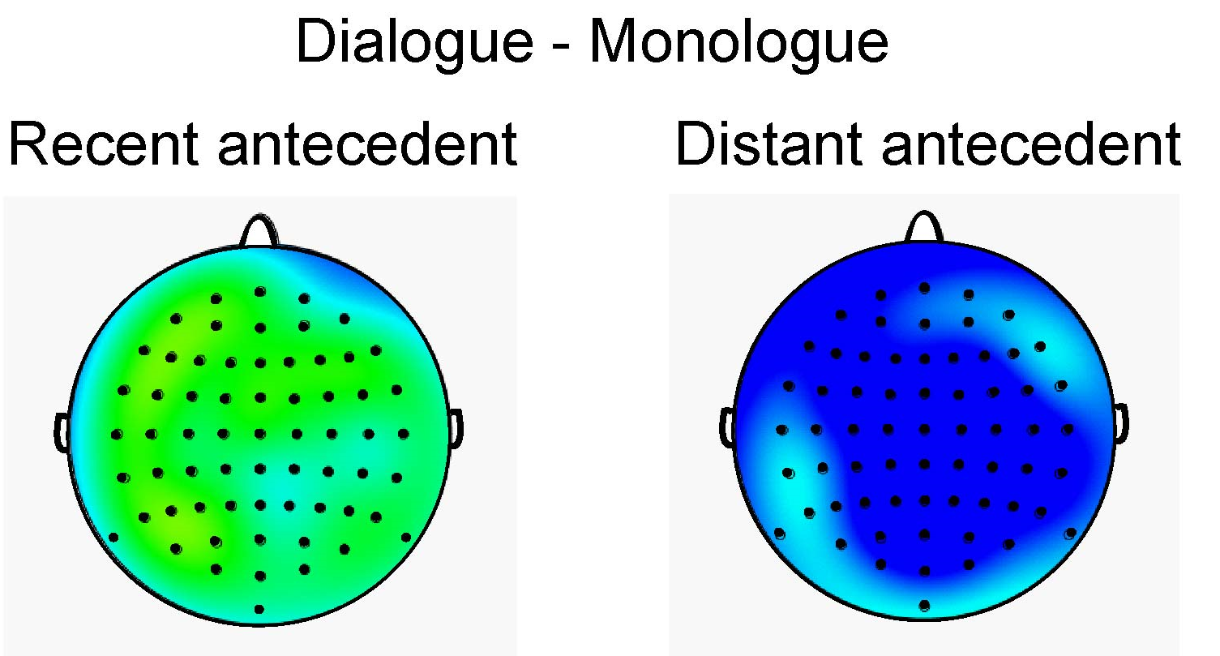
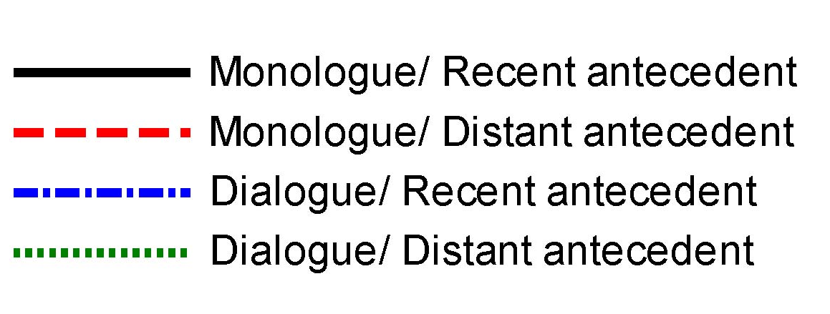

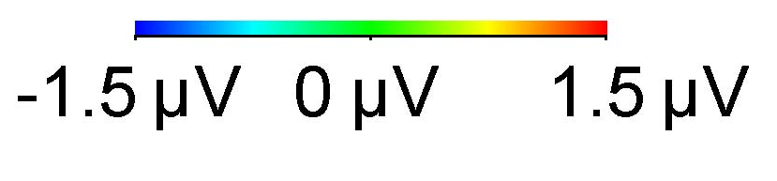
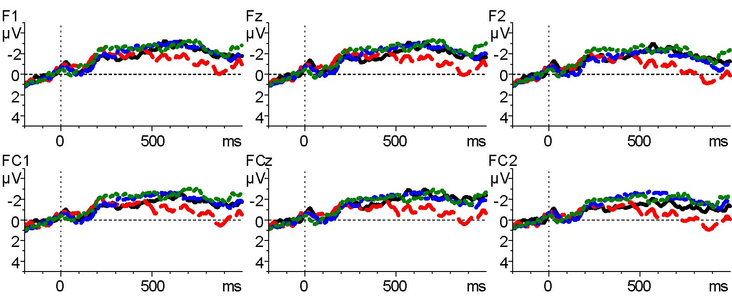
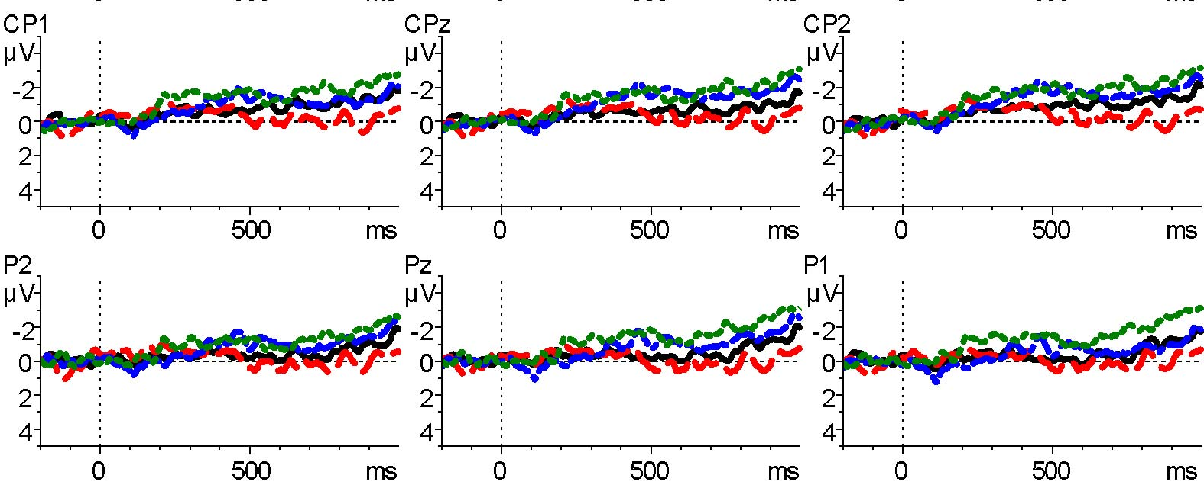

Retrieval cues in language comprehension:
Interference effects in monologue but not dialogue
Andrea E. Martin
School of Philosophy, Psychology, and Language Sciences
Department of Psychology, The University of Edinburgh
andrea.martin@ed.ac.uk
INTRODUCTION
Both language production and comprehension rely on access to recently processed representations in memory.^{1,2}
Retrieval cues^{1,2} provide direct-access to relevant representations, without a search through memory.^{3,4}
But, distance (processing additional representations between encoding a target and retrieving it) results in a higher likelihood of retrieval failure or interference.^{1,3,4}
Does interference differ in dialogue versus monologue?
What does this imply about retrieval cues ‘in the wild’?
DATA & RESULTS
METHODS
]ANT
Sluicing – where which can stand in the place of ribbon and serves as a retrieval cue.
Manipulated number of speakers and distance between antecedent and which. All grammatical stimuli. WH-word varied.
Overhearing paradigm. 36 Native Speakers of English listened to 120 auditory recordings.
Dialogue conditions featured a male and a female speaker; Monologue conditions were split female/male speaker.
]POST
STIMULI
Monologue, Recent antecedent
A: Once he had wrapped the present, Carl chose a ribbon, I’m not sure which_, probably the red one.
Monologue, Distant antecedent A: Carl chose a ribbon once he had wrapped the present, I’m not sure which_, probably the red one.
Dialogue, Recent antecedent A: Once he had wrapped the present, Carl chose a ribbon B: I’m not sure which_, probably the red one. Dialogue, Distant antecedent A: Carl chose a ribbon once he had wrapped the present. B: I’m not sure which_, probably the red one.
CONCLUSIONS
Distant antecedent in dialogue shows no evidence of interference
Additional speaker cue may have made composite retrieval cues diagnostic to antecedent in dialogue compared to in monologue
HYPOTHESIS & PREDICTIONS
All grammatical spoken stimuli, so effect sizes small
Distant antecedent will benefit from additional speaker cue in dialogue
Monologue Distant condition will show interference effect compared to:
  Dialogue Distance
  Monologue Recent
References:
[1] Lewis, R., Vasishth, S., & Van Dyke, J. (2006). TICS.
[2] Martin, A. E. (2016). Front. Lang. Sci.
[3] Martin, A. E., & McElree, B.(2008). JML.
[4] Martin, A.E., & McElree, B. (2009). JEP:LMC.
Funded by ES/K009095/1 to AEM

