Slide 1
Dual-tasking language: what tasks can we do, or not do, at the same time?
Amie Fairs, Sara Bögels, Antje S. Meyer
Psycholinguistics in Flanders, Leuven
30th May 2017

Slide 2




Semantics
Concept prep.
Word form
Lexical selection
Features
Word form
You know I went to the International Documentary Film Festival last weekend in Amsterdam and ...
e.g. Bogels et al. (2015)
Notes:
dt in language – listen to interlocuter, and take the sounds they make and convert to the words they say. You also have to think about what you want to say and convert that into sounds to speak back to the other person. Recent research seems to show we can do these processes at the same time.

Slide 3
Semantics
Concept prep.
Word form
Lexical selection
Features
Word form
Production and comprehension linked.
MAKES DUAL-TASKING HARDER.
Practice language dual-tasking on a daily basis.
MAKES DUAL-TASKING EASIER.
e.g. Hickok & Poeppel (2004, 2007); Pickering & Garrod (2004, 2013)
e.g. Hirst, Spelke, Reaves, Caharack & Neisser (1980); Liepelt, Strobach, Frensch & Schubert (2011)
Notes:
Implies overlap – but is that actually possible? Is it possible to do two language tasks at the same time? prod and comp are linked so we might think that doing both at the same time would be difficult. but we potentially practice a dual-lang dual task on a daily basis, which would make it easy. for this reason, we tested a dual-task with two language tasks against a dual-task with one language task and one non-language task to see what the differences are. additionally, if we do these tasks at the same time, what can affect the tasks, and what kind of processing do we do?

Slide 4
Experiment questions
If people have to dual-task, do they do both tasks serially or in parallel depending on the task?
Does the processing manner change depending on if you respond to the tasks?
Are processing manner effects modulated by whether the two tasks are language-related or not?

Slide 5
Experiment 1: Identification
Task 1: Tone or syllable identification (blocked)
high vs low tone
‘aak’ vs ‘iek’ syllables
Task 2: Picture naming (with distractors)
Half distractors related, half unrelated
2 SOAs:
0ms vs 1000ms (variable)

Slide 6

Experiment 1 design – dual task
+
Task 1: Identification
Language: syllable
Non-language: tone
arm
Task 2: Naming
Picture (related/unrelated distractors)
0ms
Time

Slide 7
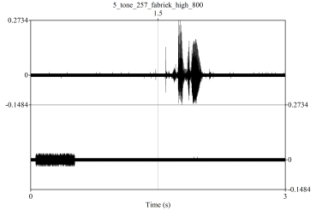
Experiment 1 design – 0ms SOA
+
arm
Response:
T1
T2
0ms
Time

Slide 8
Experiment 1 design – 1000ms SOA
+
arm
Response:
T1
T2
0ms
1000ms
Time

Slide 9
Overview of design
Experiment 1: 0ms & 1000ms SOAs
T1: Tone/syllable identification
T2: Picture naming (written distractors)
Hear tone or syllable, press a button
Name the picture
arm
Experiments 2 & 3: 0ms & 1000ms SOAs
T1: Tone/syllable choice
T2: Picture naming (written distractors)
Hear tone or syllable, decide
what to do on the next task
Name the picture or read the word
arm

Slide 10
Dual-task schema - serial
Task 1 e.g. tone identification
perception
response selection
motor response
Task 2 e.g. picture naming
Related
perception
response selection
int
motor response
Unrelated
perception
response selection
motor response
Semantic interference
Time

Slide 11
Dual-task schema - serial
Serial processing
T1
perception
stim sel/resp decision
motor response
T2
Related
perception
conc prep/lex sel
int
encoding + exec
T2
Unrelated
perception
conc prep/lex sel
encoding + exec
Time

Slide 12
Dual-task schema - parallel
Task 1 e.g. tone identification
perception
response selection
motor response
Task 2 e.g. picture naming
Related
perception
response selection
int
motor response
Unrelated
perception
response selection
motor response
NO semantic interference
Time

Slide 13
Dual-tasking
At 0ms:
Interference = serial processing
No interference = parallel processing
At 1000ms always expect interference because tasks DO NOT overlap

Slide 14
Dual-task schema - parallel
T1
perception
stim sel/resp decision
motor response
T2
Related
perception
conc prep/lex sel
int
encoding + exec
T2
Unrelated
perception
conc prep/lex sel
encoding + exec
Parallel processing
T2 Related
perception
conc prep/lex sel
int
encoding + exec
T2 Unrelated
perception
conc prep/lex sel
encoding + exec
Time

Slide 15
Dual-task schema
T1
perception
stim sel/resp decision
motor response
Serial
T2
Related
perception
conc prep/lex sel
int
encoding + exec
T2
Unrelated
perception
conc prep/lex sel
encoding + exec
T2 Related
perception
conc prep/lex sel
int
encoding + exec
Parallel
T2 Unrelated
perception
conc prep/lex sel
encoding + exec
T2
Long SOA
perception
conc prep/lex sel
int
encoding + exec
Time

Slide 16
Experiment 1: Identification
Task 1: Tone or syllable identification (blocked)
high vs low tone
‘aak’ vs ‘iek’ syllables
Task 2: Picture naming (with distractors)
Half distractors related, half unrelated
2 SOAs:
0ms vs 1000ms (variable)

Slide 17
Experiment Design
0ms SOA
+
arm
Response:
T1
T2
0ms
Time

Slide 18
Experiment Design
1000ms SOA
+
arm
Response:
T1
T2
0ms
1000ms
Time

Slide 19
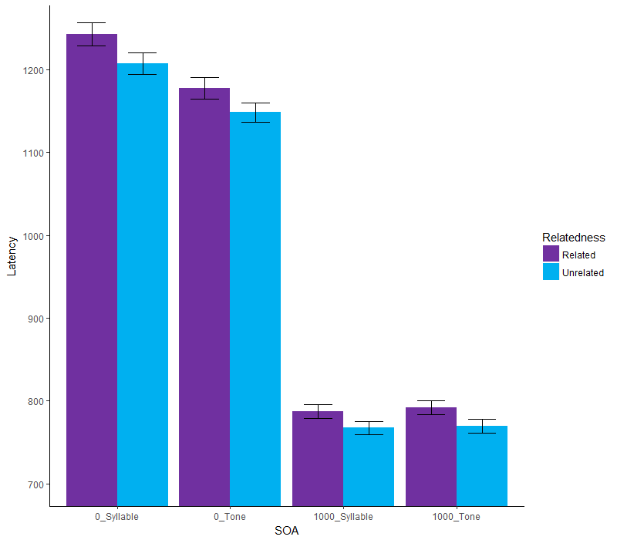
*
*
Naming latency
*
*
Syllable
Tone
Syllable
Tone
N = 32
0ms SOA
1000ms SOA

Slide 20
Experiment 1 interpretation
Interference = serial processing
No interference = parallel processing
When giving an overt response to task 1 (the tone or syllable), participants do not also engage in lexical selection.

Slide 21
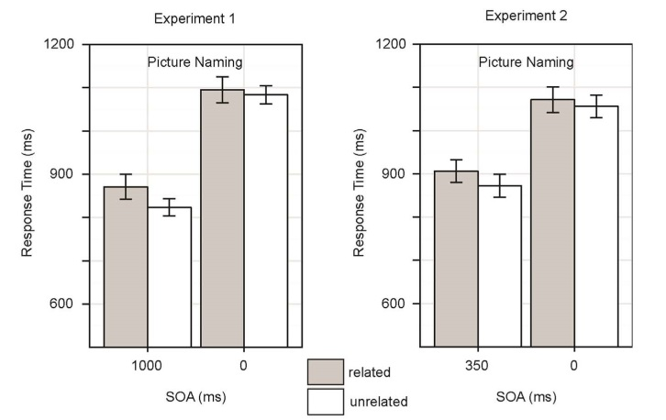
Experiment 2: Task choice
Evidence of concurrent T1 and T2 processing (Piai et al., 2015):
  no semantic interference effect measured
But what if the two stimuli are processed similarly?

Slide 22
Experiment 2 aims
Aims:
Can we replicate Piai, Roelofs & Schriefers (2015)?
What happens in this task when the task choice stimulus is language-related?

Slide 23
Experiment 2 design – 0ms SOA
+
arm
Response:
T2
0ms
Time

Slide 24
Experiment 2 design
Task 1: Tone or syllable choice (blocked)
low (name) vs high (read) tones
‘aak’ (name) vs ‘iek’ (read) syllables
Task 2: Picture naming or word reading (with distractors)
Half distractors related, half unrelated
2 SOAs:
0ms vs 1000ms (variable)
Notes:
Our design diff from Piai et al 2015 – they had blocked SOA, their tones were shorter and different pitches, diff numbers of practice trials.
Not presenting the reading data because of time/naming is more important.

Slide 25
Experiment Design
0ms SOA – syllable condition
+
arm
Response:
Time

Slide 26
Experiment Design
1000ms SOA – tone condition
+
arm
Response:
0ms
1000ms
Time

Slide 27
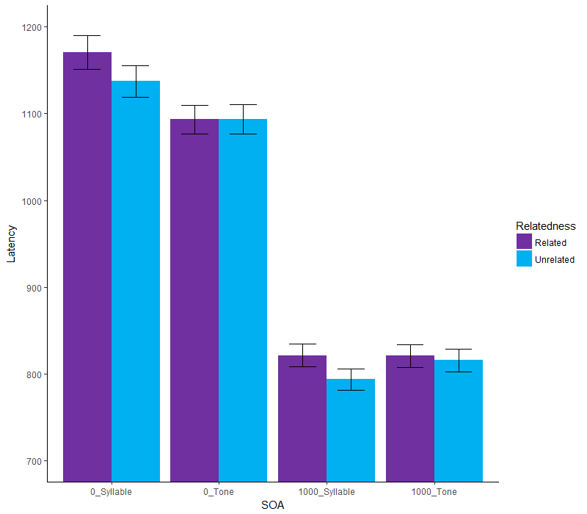
*
NS
Naming latency
*
NS
Syllable
Tone
Syllable
Tone
0ms SOA
1000ms SOA
N = 34

Slide 28
Experiment 2 interpretation
Fail to replicate Piai, Roelofs & Schriefers (2015).
Interference = serial processing ??
No interference = parallel processing ??
SOA by condition interaction.
Why? Variable vs blocked SOA?

Slide 29
Experiment 3: Blocked replication
Task 1: Tone or syllable choice (blocked)
low (name) vs high (read) tones
‘aak’ (name) vs ‘iek’ (read) syllables
Task 2: Picture naming or word reading (with distractors)
Half distractors related, half unrelated
2 SOAs:
0ms vs 1000ms (blocked)

Slide 30
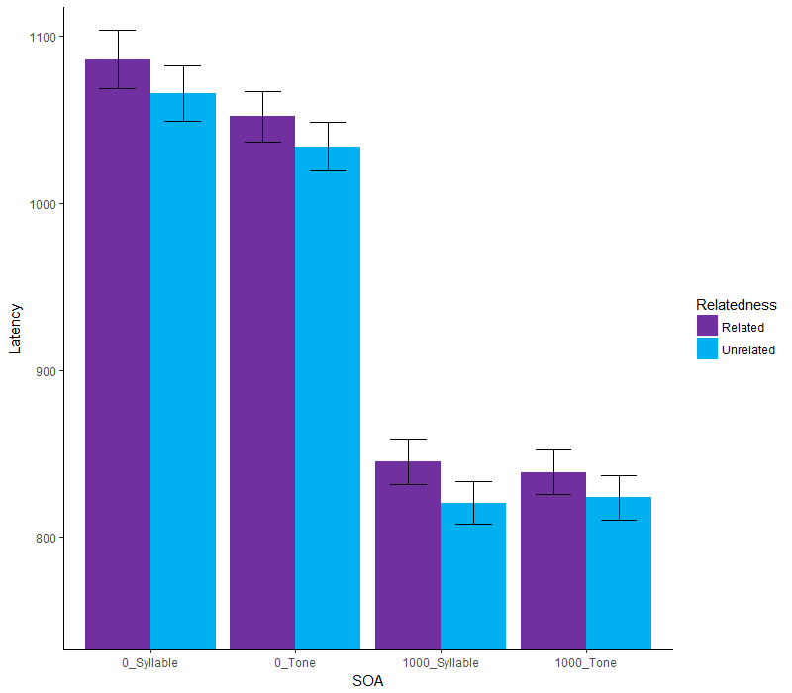
*
*
Naming latency
*
*
Syllable
Tone
Syllable
Tone
N = 37
0ms SOA
1000ms SOA

Slide 31
Experiment 3 interpretation
Interference = serial processing
No interference = parallel processing
When making a choice based on a tone or syllable about the following task (with predictable timing), participants do not also engage in lexical selection.

Slide 32


Measuring interference
Experiment 1 | Syllable condition | Tone condition
0ms
1000ms
Experiment 2 | Syllable condition | Tone condition
0ms
1000ms
Experiment 3 | Syllable condition | Tone condition
0ms
1000ms
Notes:
what does this mean? first, across all experiments, we measure semantic interference in the syllable condition

Slide 33
Discussion #1
Syllable condition: always interference
Tone condition: mostly interference
Latencies in syllable condition at 0ms always longer than tone condition

Slide 34
Answers to questions
If people have to dual-task, do
they do both tasks serially or in
parallel depending on the task?
Does the processing manner change
depending on if you respond to the
tasks?
Are processing manner effects
modulated by whether the two
tasks are language-related
or not?
Serially
No
No, but there is a general language interference effect

Slide 35
Thank you for listening
Any questions?

Slide 37
Extra experiment 2 analyses
Look at following slides

Slide 38
Order Effects
Syllable-Tone
SOA | Condition | Latency difference (ms)
0 | Syllable | 32.18
0 | Tone | 4.02
1000 | Syllable | 20
1000 | Tone | -3.01
Tone-Syllable
SOA | Condition | Latency difference (ms)
0 | Syllable | 22.01
0 | Tone | 3.88
1000 | Syllable | 11.27
1000 | Tone | 7.55

Slide 39
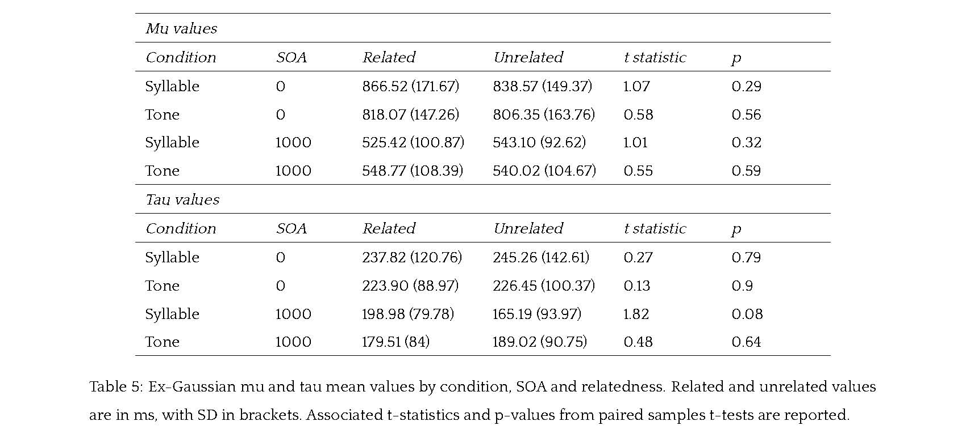
Ex-Gaussian analysis
No significant differences

Slide 40
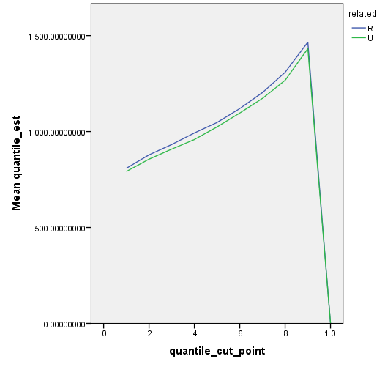
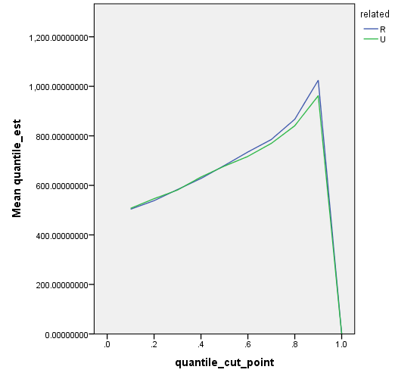
Syllable Quantile Plots

Slide 41
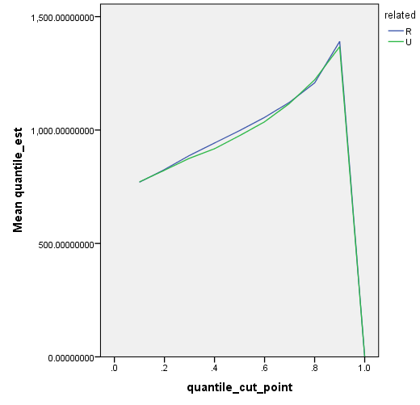
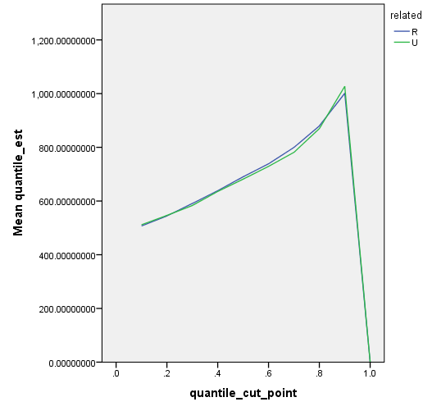
Tone Quantile Plots

Slide 42
Switch Trials
SOA switch + Related switch
When added to models as control variables, effects are still the same

Slide 43
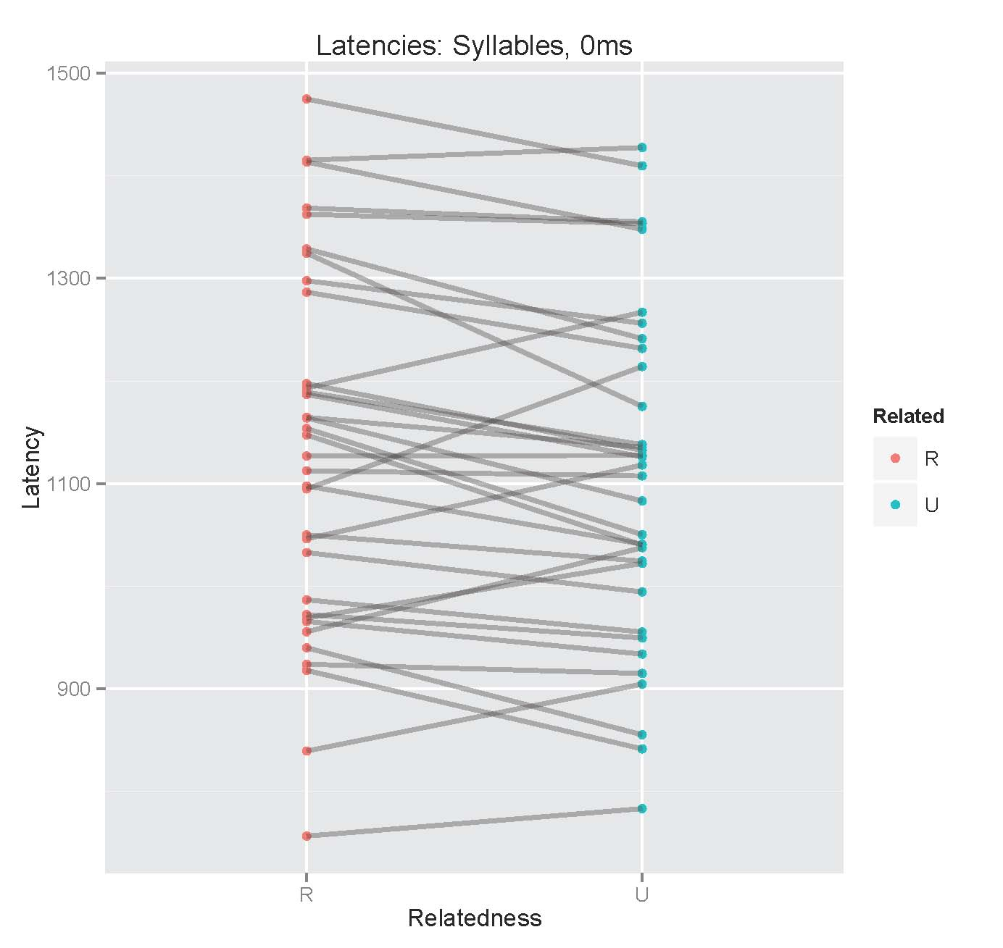
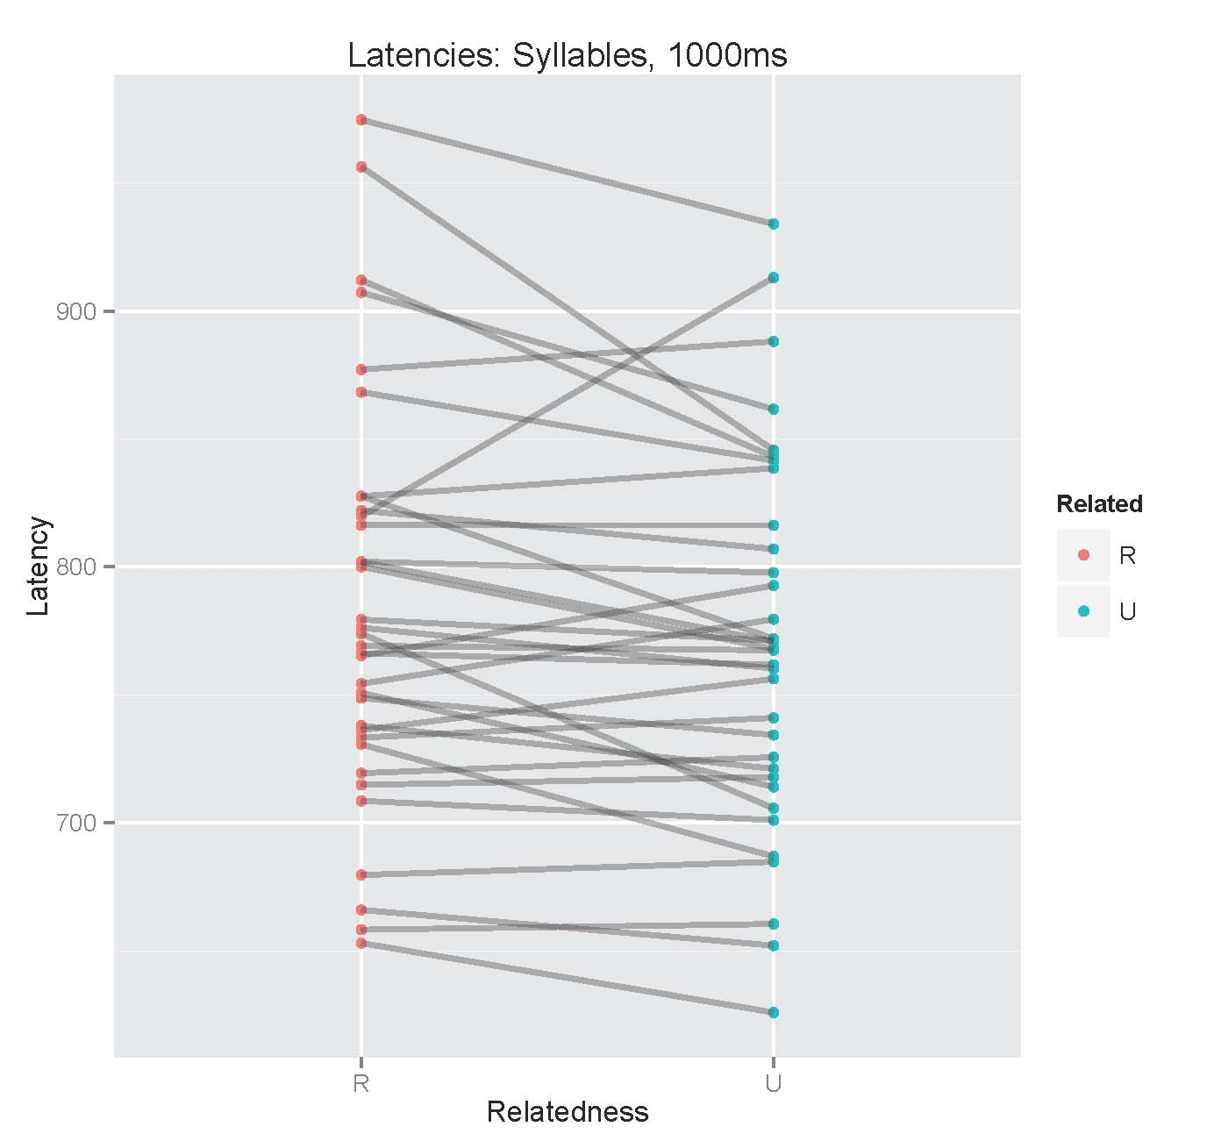
Individual Graphs - Syllables

Slide 44
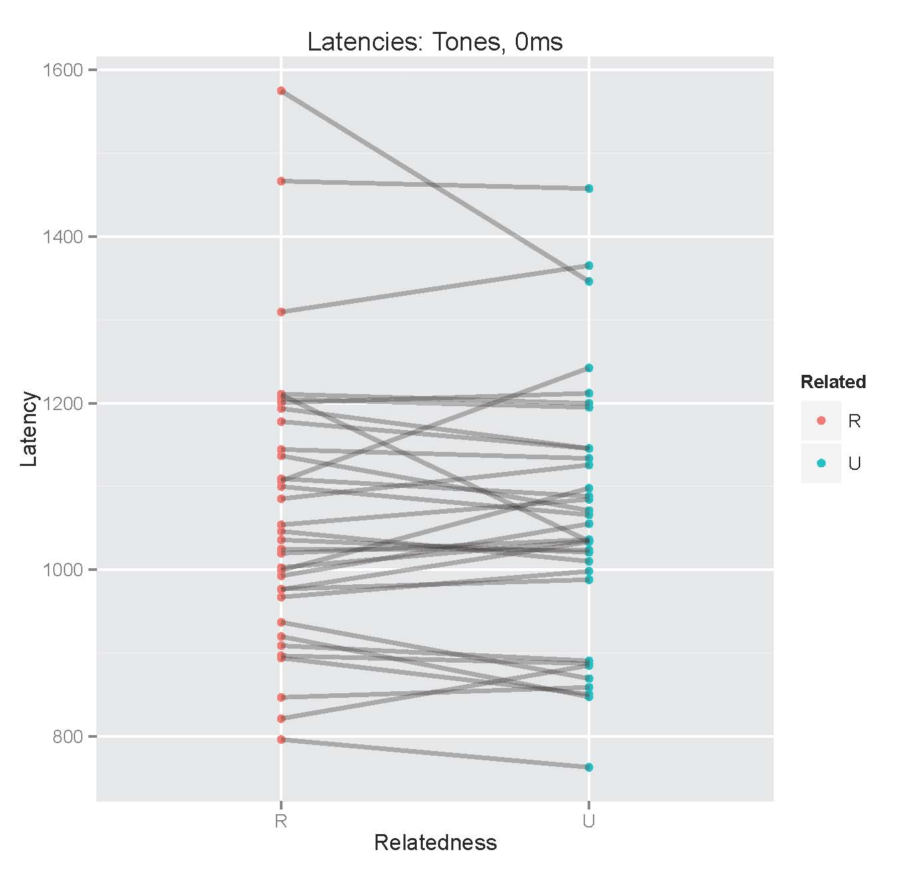
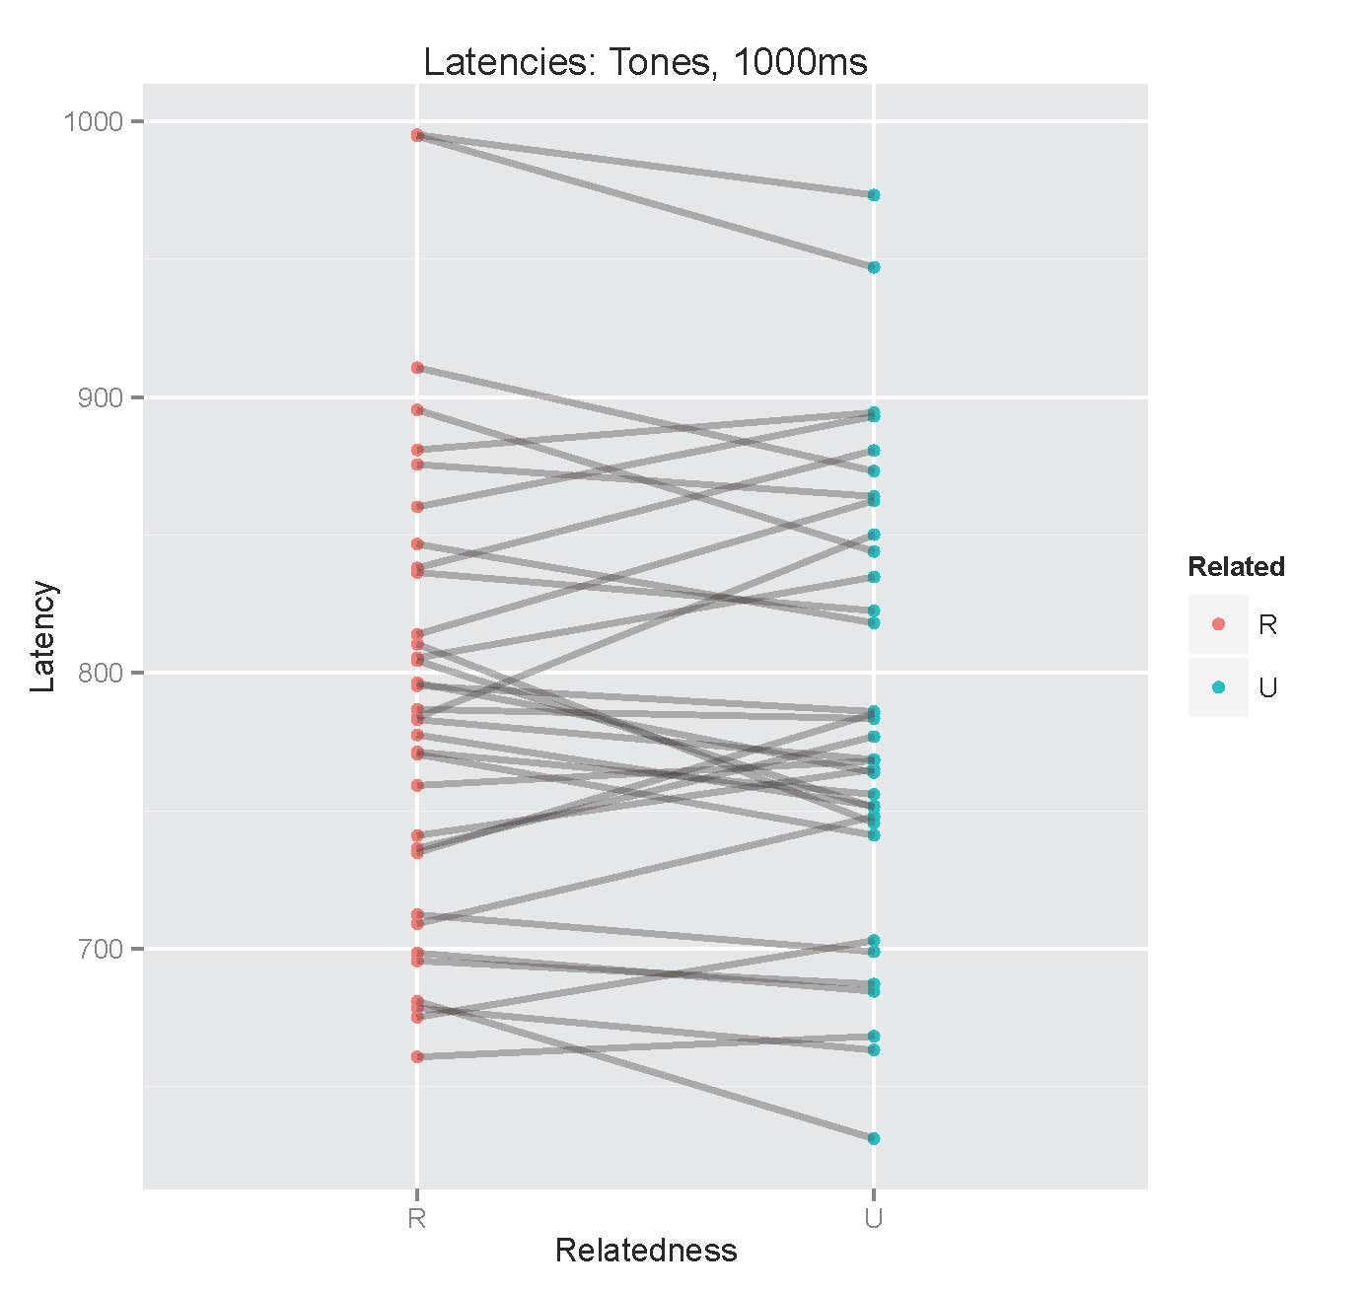
Individual Graphs - Tones

Slide 45
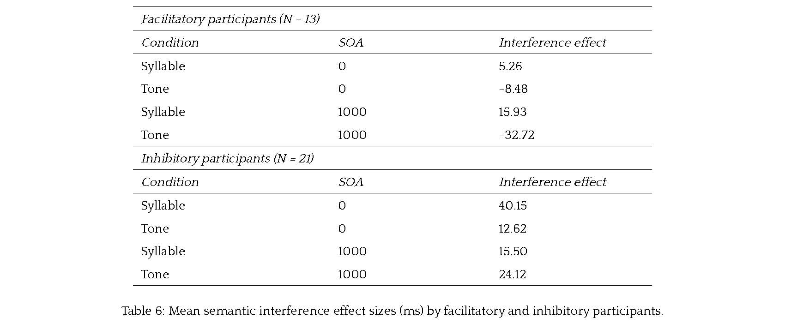
Selective Attention?

Slide 46
Subjective Difficulty
Tone harder (N = 9)
SOA | Condition | Latency difference (ms)
0 | Syllable | 34.16
0 | Tone | -4.96
1000 | Syllable | 27.7
1000 | Tone | 8.76
Syllable harder (N = 21)
SOA | Condition | Latency difference (ms)
0 | Syllable | 30.66
0 | Tone | 5.24
1000 | Syllable | 13.7
1000 | Tone | -5.16

