Slide 1
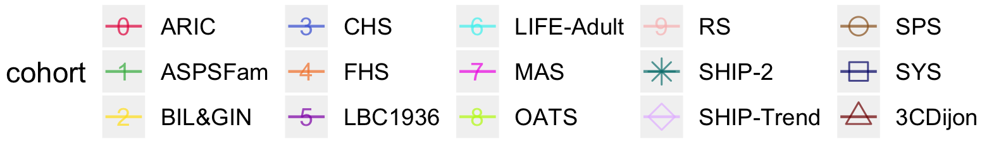
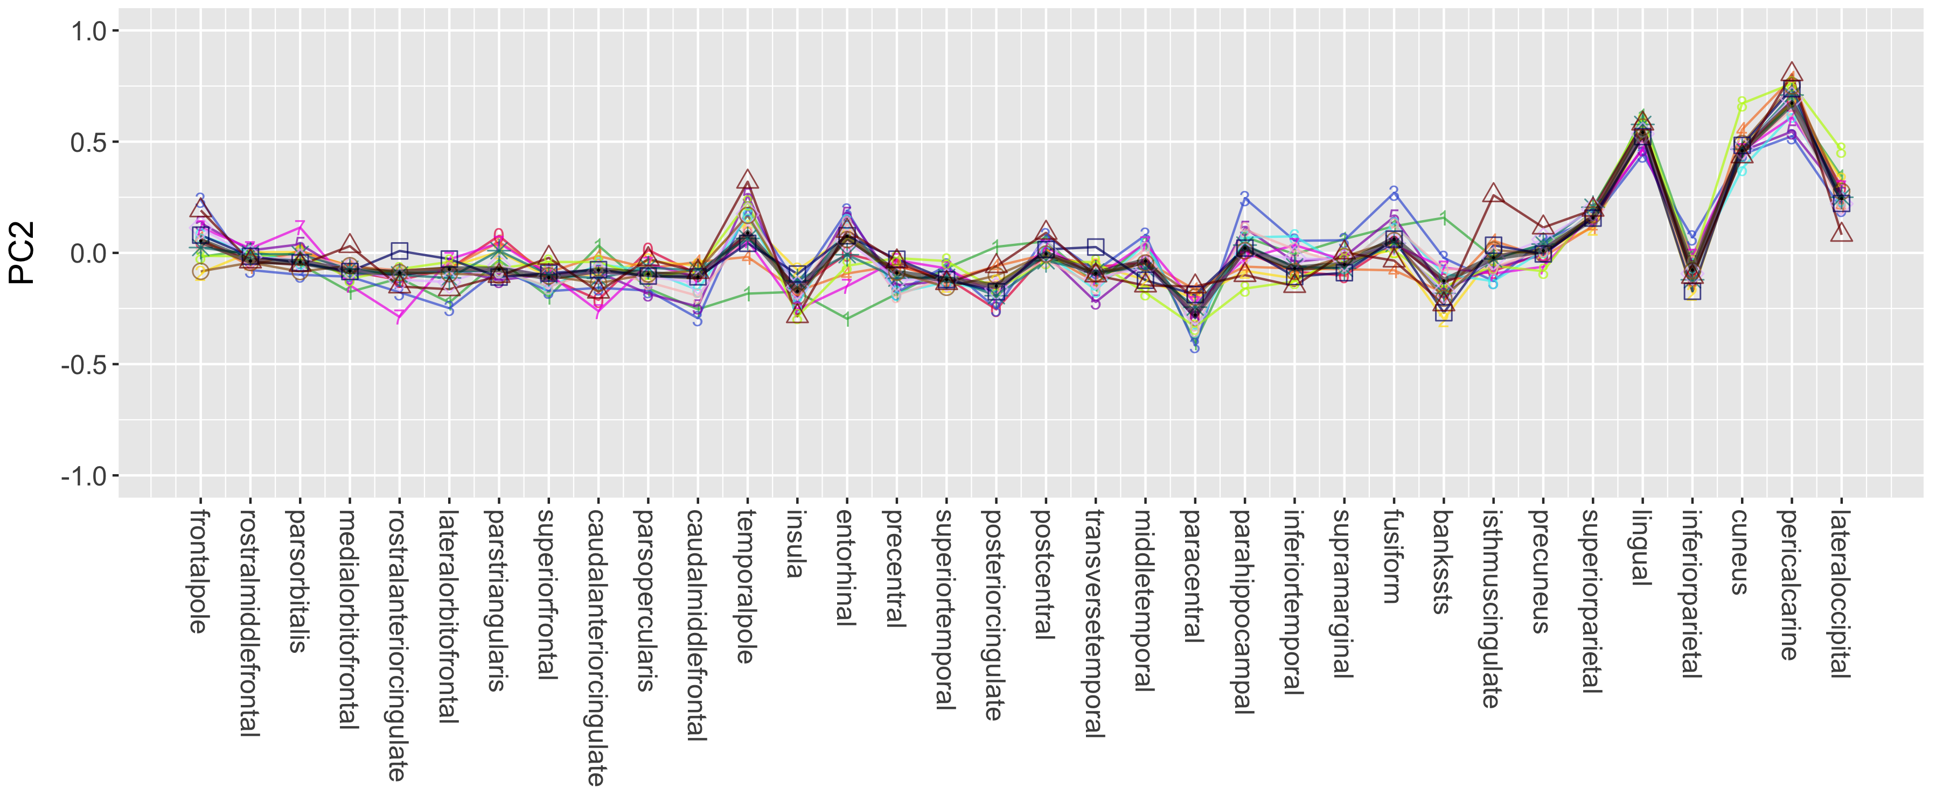
A
PC1
B
PC2
Notes:
Figure E1. Loadings for the first two leading principal components (PC) of surface area measurements in 34 cortical regions: PC1 (panel A) and PC2 (panel B). Each cohort estimated the surface area of the 34 cortical regions (left and right hemispheres summed), using FreeSurfer and carried out principal component analyses to obtain PC loading values for the first two leading PCs, which are indicated by colored lines: 0-red (ARIC), 1-green (ASPSFam), 2-yellow (BIL&GIN), 3-blue (CHS), 4-orange (FHS), 5-purple (LBC1936), 6-cyan (LIFE-Adult), 7-magenta (MAS), 8-lime-green (OATS), 9-light pink (RS), dark green star (SHIP-2), light purple diamond (SHIP-Trend), brown circle (SPS), indigo rectangle (SYS), and dark red triangle (3CDijon) . Black thicker lines indicate the median loading values across the following cohorts: ARIC, ASPSFam, BIL&GIN, CHS, FHS, LIFE-Adult, RS, SPS and SYS. The median loading values were then used to derive the ‘general’ PC score for each individual and later used as the response variable in the meta-GWAS analyses. Cohort abbreviations are presented in Table E1A.

Slide 2
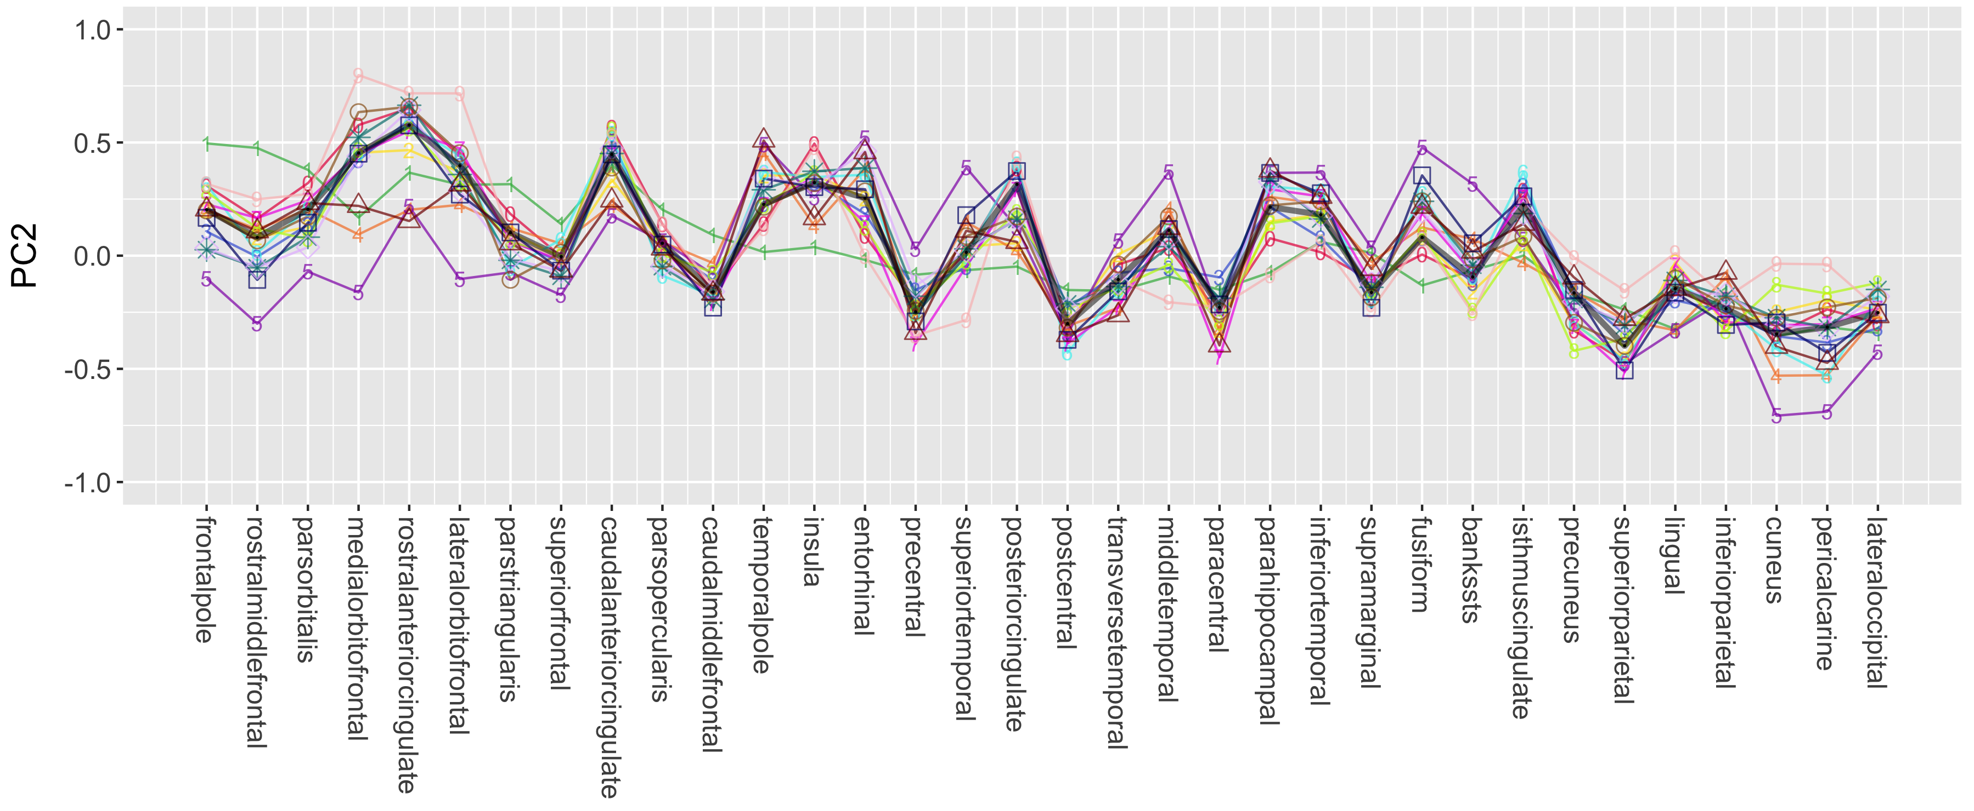
A
PC1
B
PC2
Notes:
Figure E2. Loadings for the first two leading principal components (PC) of thickness measurements in 34 cortical regions: PC1 (panel A) and PC2 (panel B). Each cohort estimated the thickness of the 34 cortical regions (left and right hemispheres averaged), using FreeSurfer and carried out principal component analyses to obtain PC loading values for the first two leading PCs, which are indicated by colored lines: 0-red (ARIC), 1-green (ASPSFam), 2-yellow (BIL&GIN), 3-blue (CHS), 4-orange (FHS), 5-purple (LBC1936), 6-cyan (LIFE-Adult), 7-magenta (MAS), 8-lime-green (OATS), 9-light pink (RS), dark green star (SHIP-2), light purple diamond (SHIP-Trend), brown circle (SPS), indigo rectangle (SYS), and dark red triangle (3CDijon) . Black thicker lines indicate the median loading values across the following cohorts: ARIC, ASPSFam, BIL&GIN, CHS, FHS, LIFE-Adult, RS, SPS and SYS. The median loading values were then used to derive the ‘general’ PC score for each individual and later used as the response variable in the meta-GWAS analyses. Cohort abbreviations are presented in Table E1A.

Slide 3
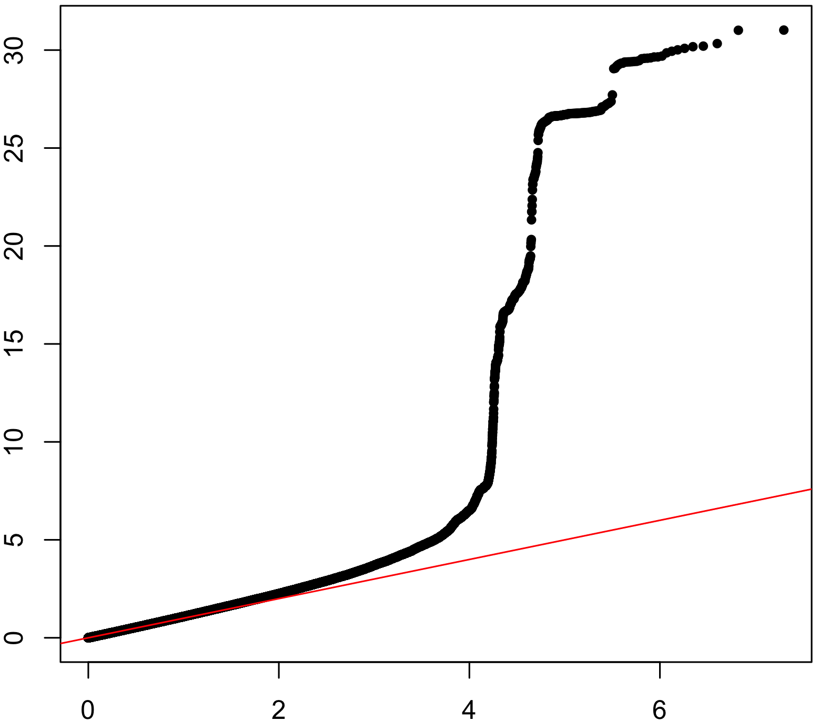
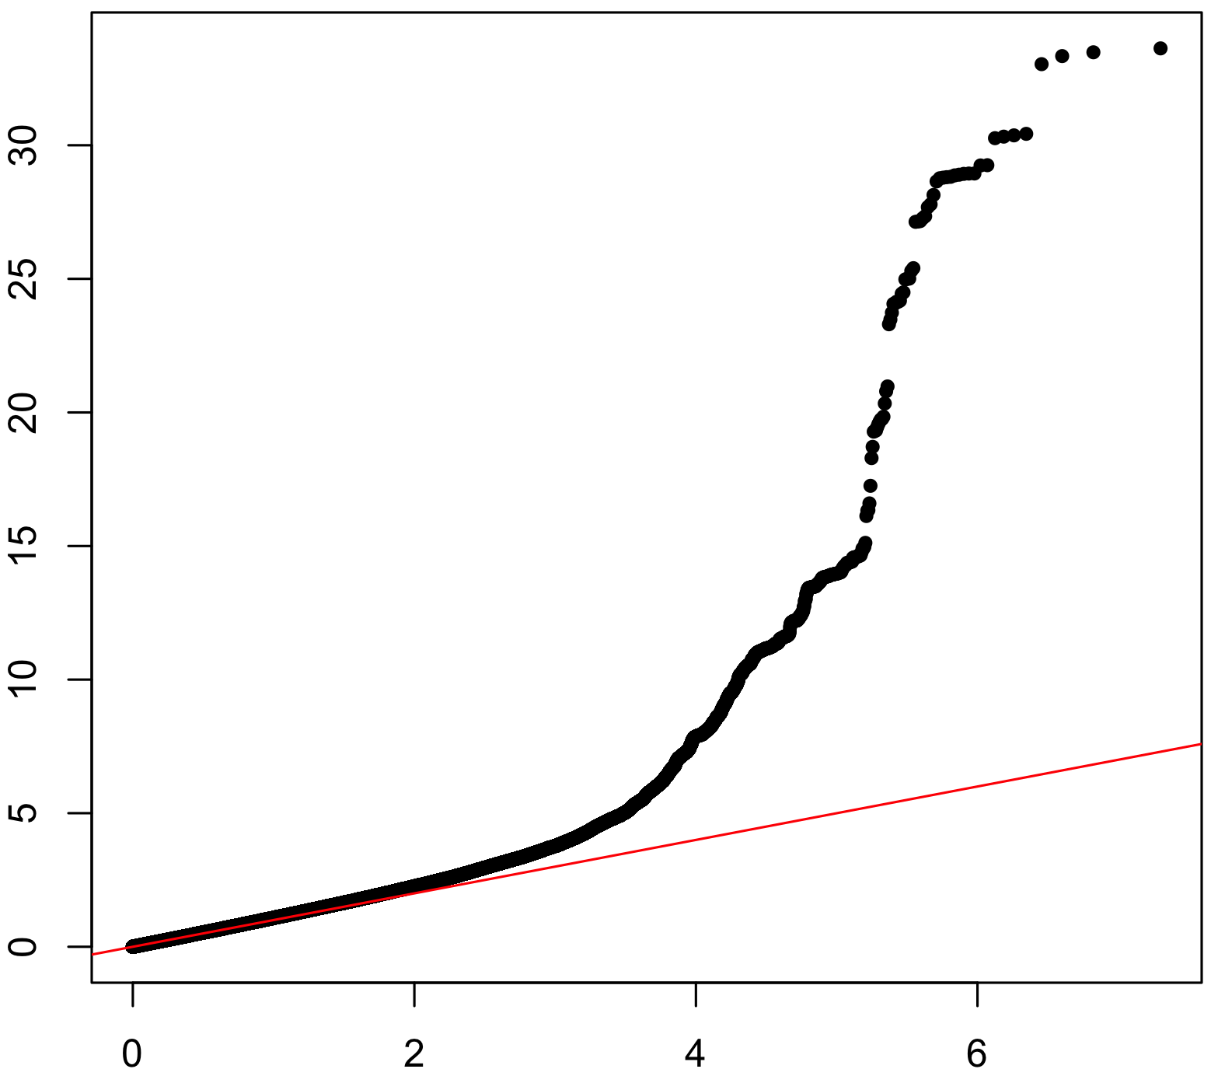
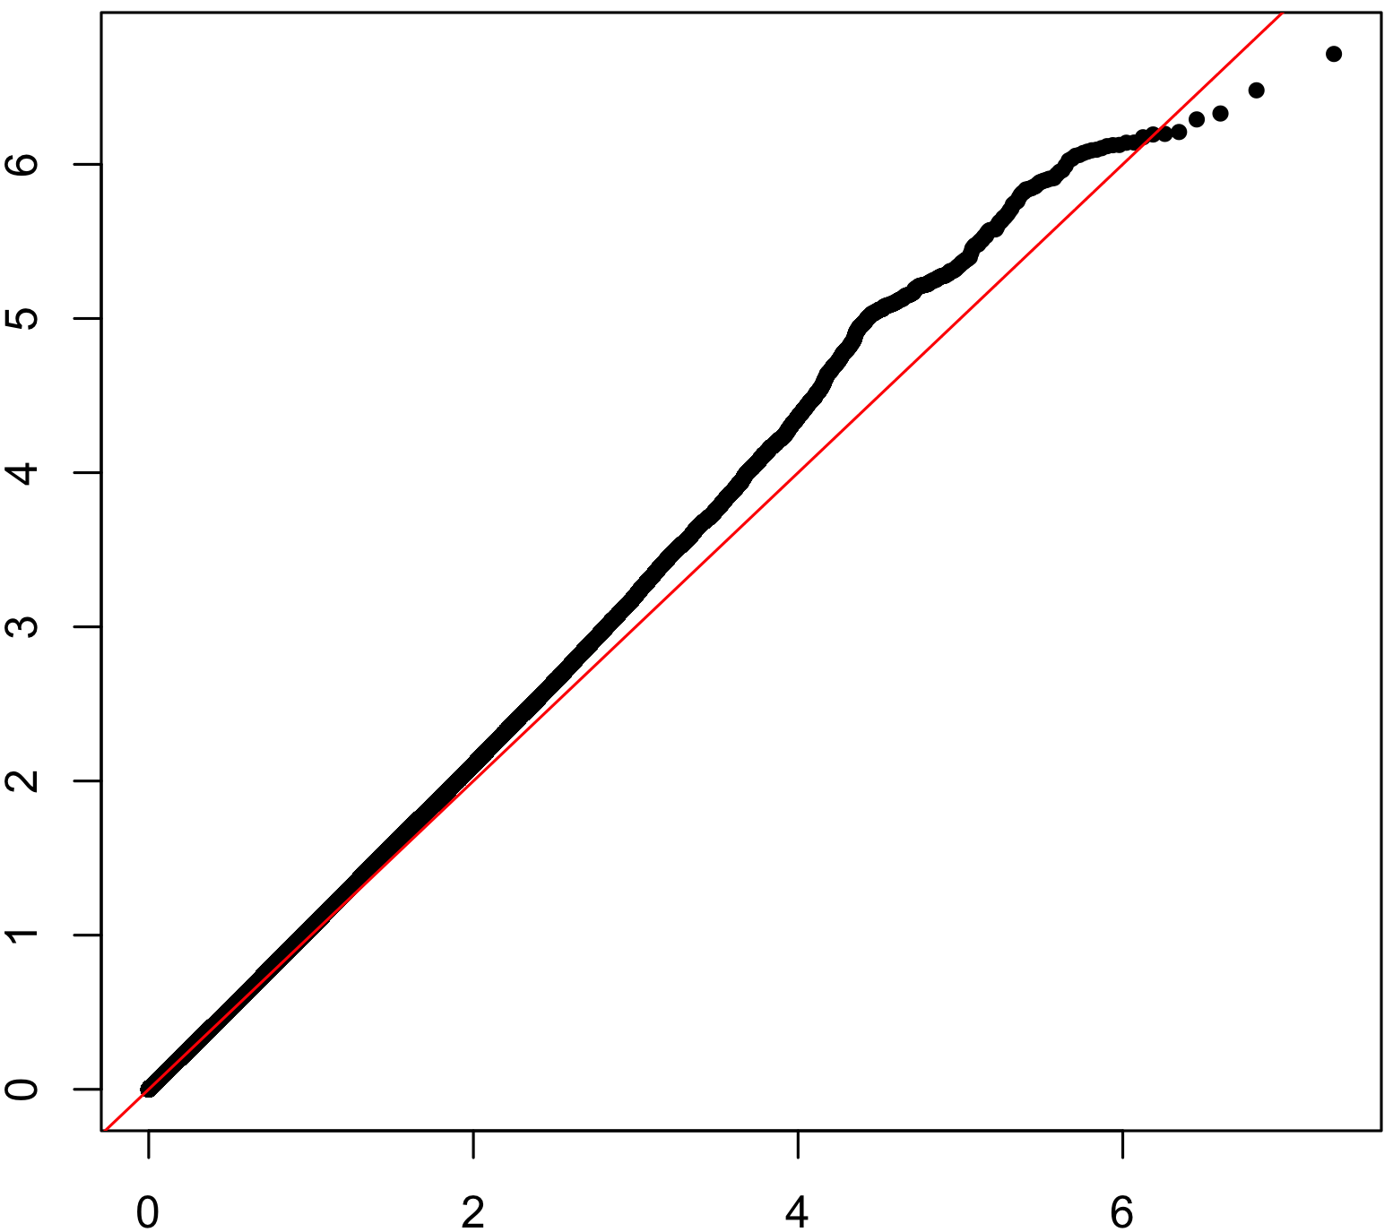
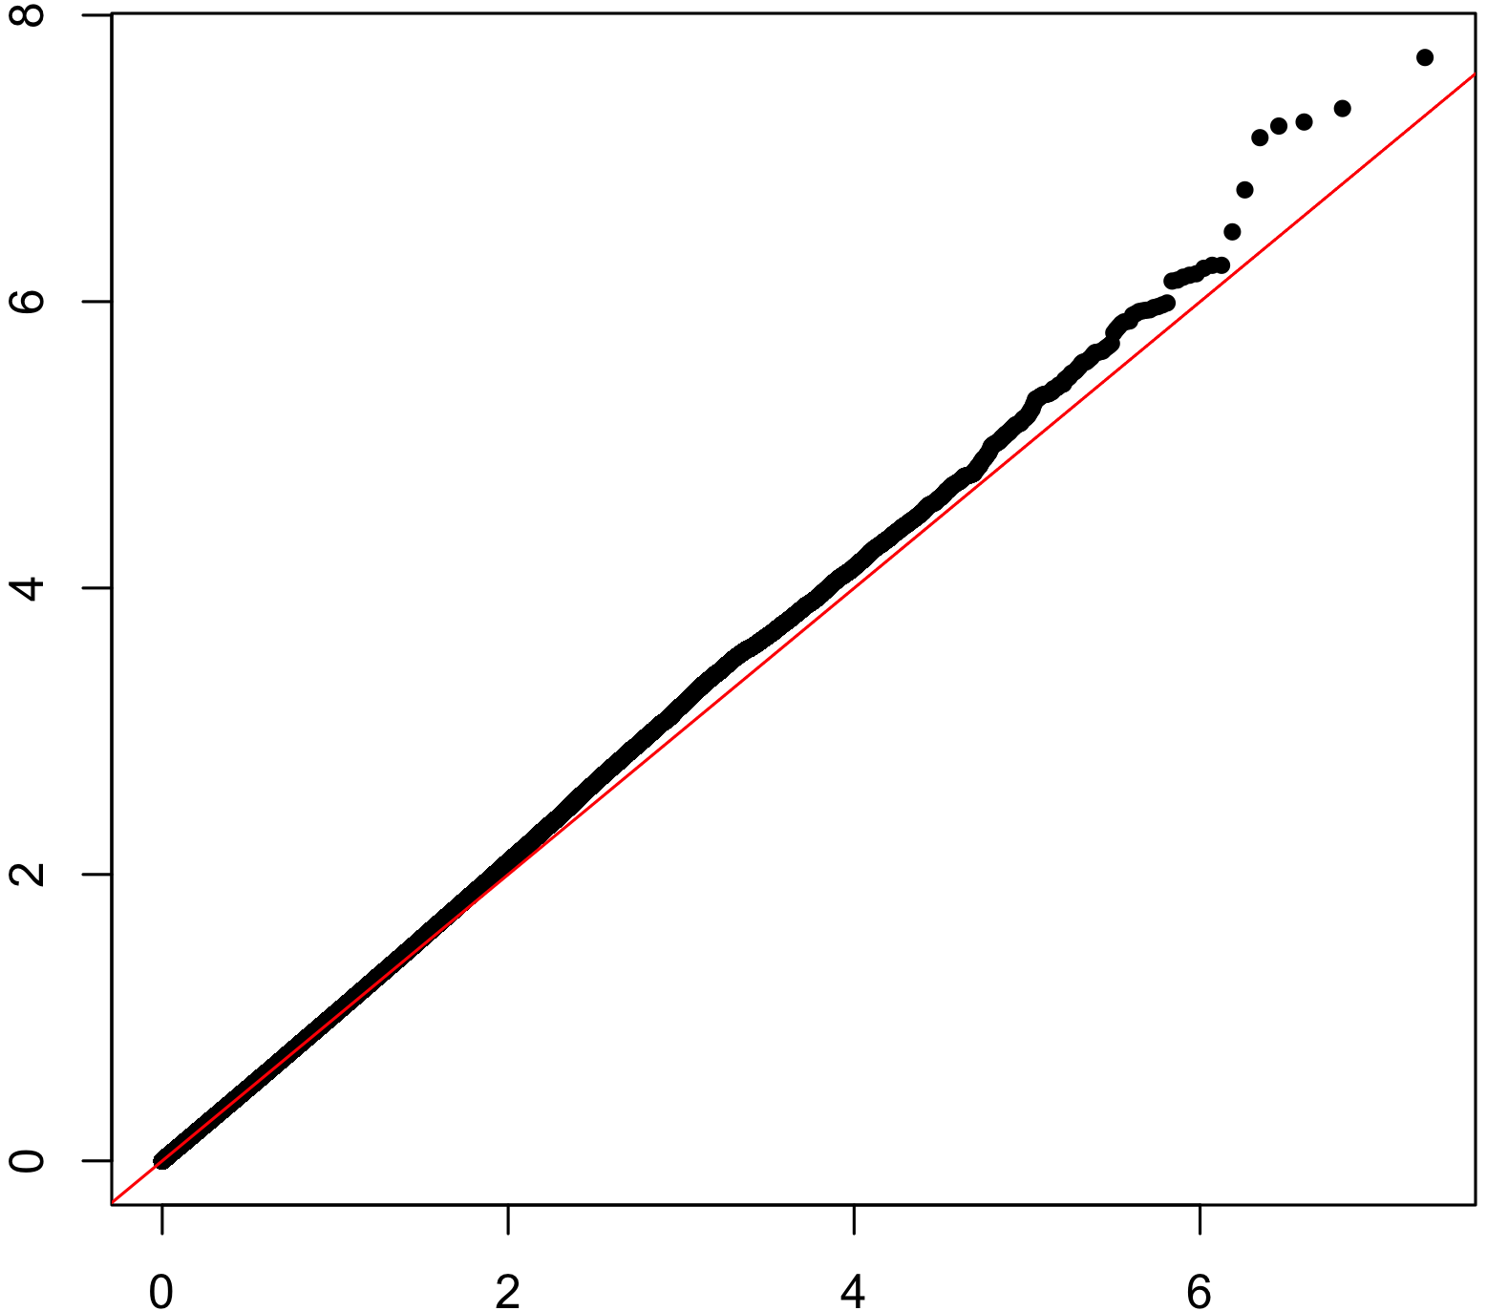
PC1
PC2
λ=1.11
λ=1.10
Surface Area
Observed –log₁₀ (P-value)
λ=1.06
λ=1.03
Thickness
Expected –log₁₀ (P-value)
Notes:
Figure E3. Quantile-quantile plots of cortical surface area and thickness PC1 and PC2 genome-wide association study meta-analyses. Observed -log10 transformed P-values of associations with cortical surface area and thickness PC1 and PC2 are plotted against the expected values for all SNPs tested in each of the GWAS meta-analyses. Results were inspected for inflation due to confounders such as population stratification or sample overlap, by calculating the inflation factor (λ) as well as the LD score intercept using LD score regression¹. An inflation factor λ > 1 suggests an inflation of the association statistics, which can be due to both spurious and genuine effects. It is likely to increase with sample size and degree of polygenicity of the phenotype, as the distribution of effect sizes begins to differ substantially from a null distribution when more variants have true associations. An LD score intercept > 1 suggests that there is spurious association, but an intercept <1.10 is generally considered to suggest that the signal is mostly due to genuine association effects. LD score regression intercepts were 1.05 (se=0.0079), 1.03 (se=0.0076), 1.03 (se=0.0065) and 1.02 (se= 0.007), for PC1-SA, PC2-SA, PC1-TH and PC2-TH, respectively.
1.Bulik-Sullivan, B. K. et al. LD Score regression distinguishes confounding from polygenicity in genome-wide association studies. Nat. Genet. 47, 291–295 (2015).

Slide 4
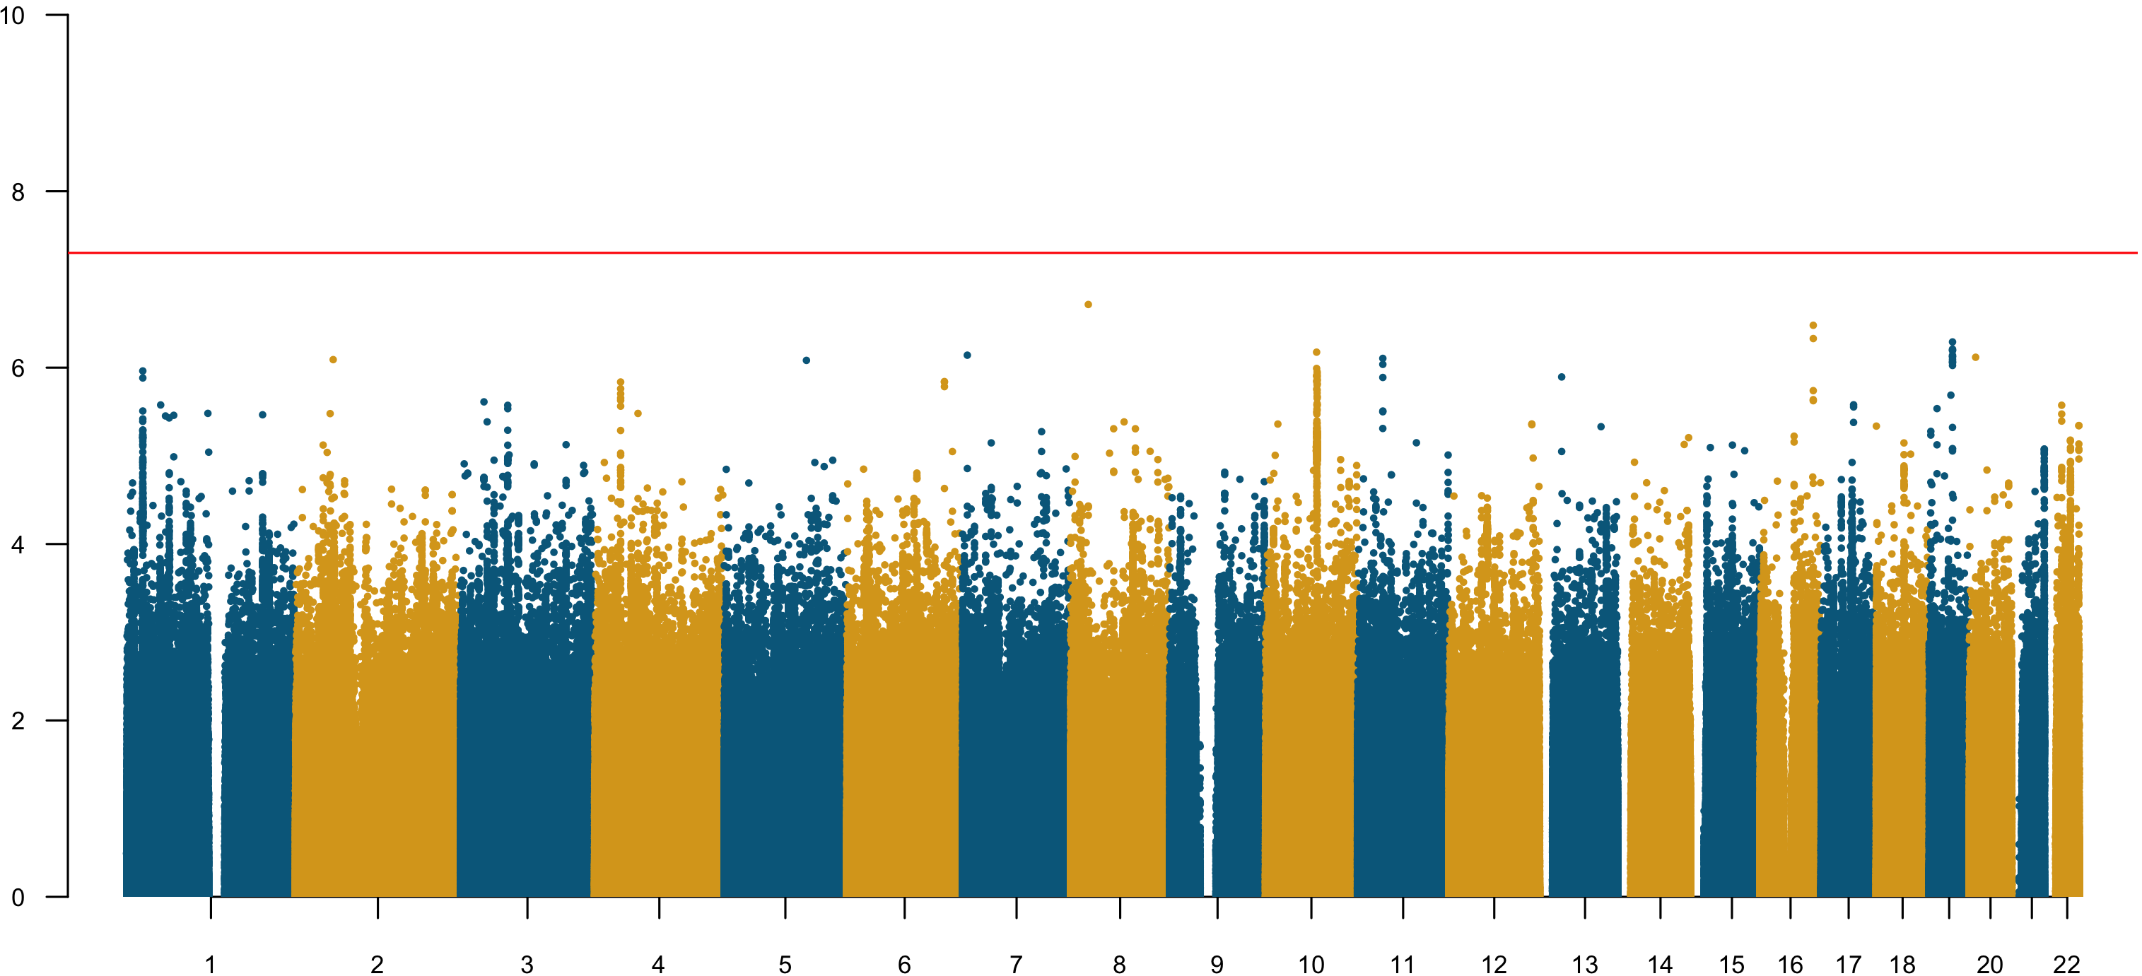
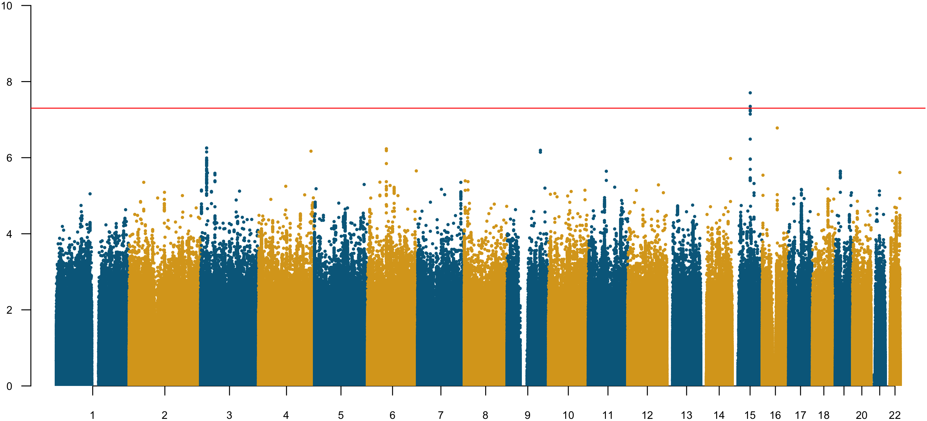
A
PC1
Chromosome
B
PC2
Chromosome
Notes:
Figure E4. Manhattan plots for the meta-analyses of GWAS thickness PC1 (panel A) and PC2 (panel B) scores in CHARGE and UKBB cohorts. The GWAS meta-analyses were carried out as follows. Using the median PC loadings across the CHARGE consortium cohorts (Figure E5), each cohort derived the ‘general’ PC scores to be used as phenotypes in the genome-wide association tests in order to ensure ‘homogeneity’ in phenotype derivation. All the association tests were adjusted for age, sex and other cohort-specific confounding variables, such as study site and/or family structure. The cohort-specific GWAS results were then examined for quality-control with Easy QC software¹, and meta-analyzed with METAL² using fixed effects models. The vertical axis indicates the –log₁₀ p-values of the SNPs in the meta-analyses. The red horizontal line indicates the genome-wide significance level of 5.0×10⁻⁸. For PC1, no SNPs were associated at the GWAS significance level. For PC2 the most significant locus was located on chromosome 15, as highlighted by the red-dotted oval (top SNP: rs12438460; p = 2.0×10⁻⁸). There was no protein coding gene mapped to the GWAS-significant locus.
¹Winkler, T. W. et al. Quality control and conduct of genome-wide association meta-analyses. Nat. Protoc. 9, 1192–1212 (2014).
²Willer, C. J., Li, Y. & Abecasis, G. R. METAL: fast and efficient meta-analysis of genomewide association scans. Bioinformatics 26, 2190–2191 (2010).

Slide 5
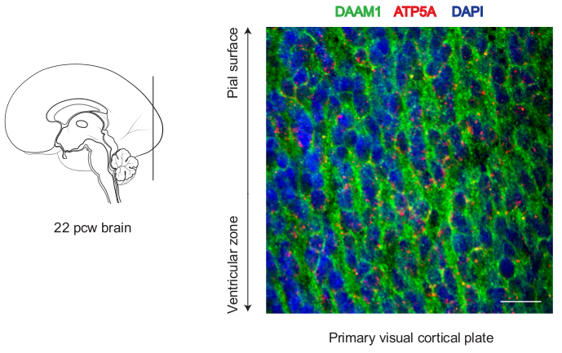
A
B
30 μm
Notes:
Figure E5. DAAM1 co-localizes with mitochondrial marker ATP5A in the primary visual cortical plate.
A. Schematic representation of the medial view of a midfetal (22 post-conception weeks) human brain; vertical line indicates the level at which coronal sectioning was performed for immunofluorescent experiments. B. Co-localization of DAAM1 and ATP5A in the human midfetal primary visual cortical plate. DAAM1 (green) can be observed in the cytoplasm of cells, whereas ATP5A (red) is localized in mitochondria, which are enriched around the nucleus (labeled with DAPI in blue) of cells. Scale bar represents 30 μm.

